Slide 1

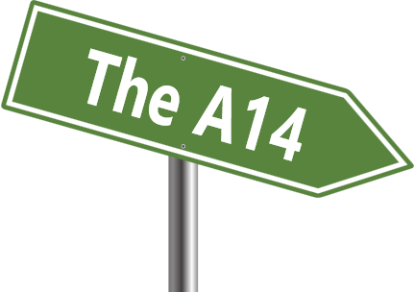
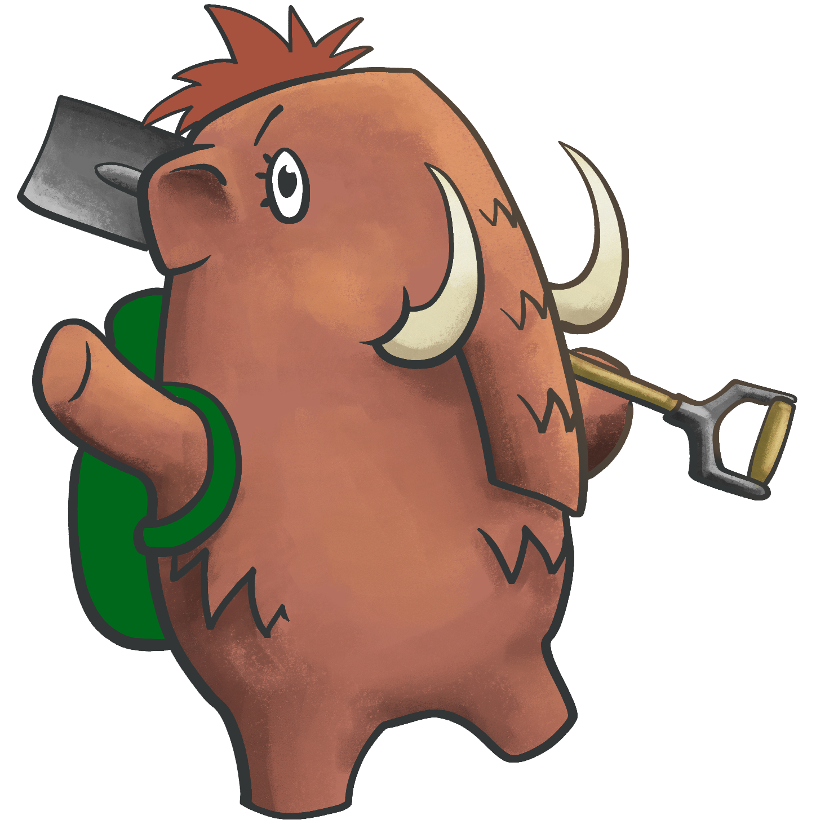
Discover Archaeology
What do you think it was like where you live in the past?
Let’s find out!
I'm Steppe
the mammoth,
follow me!

Slide 2

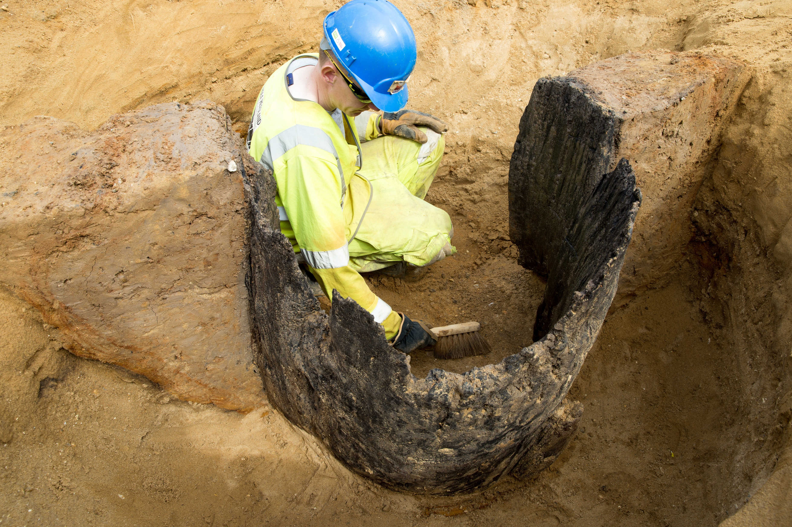
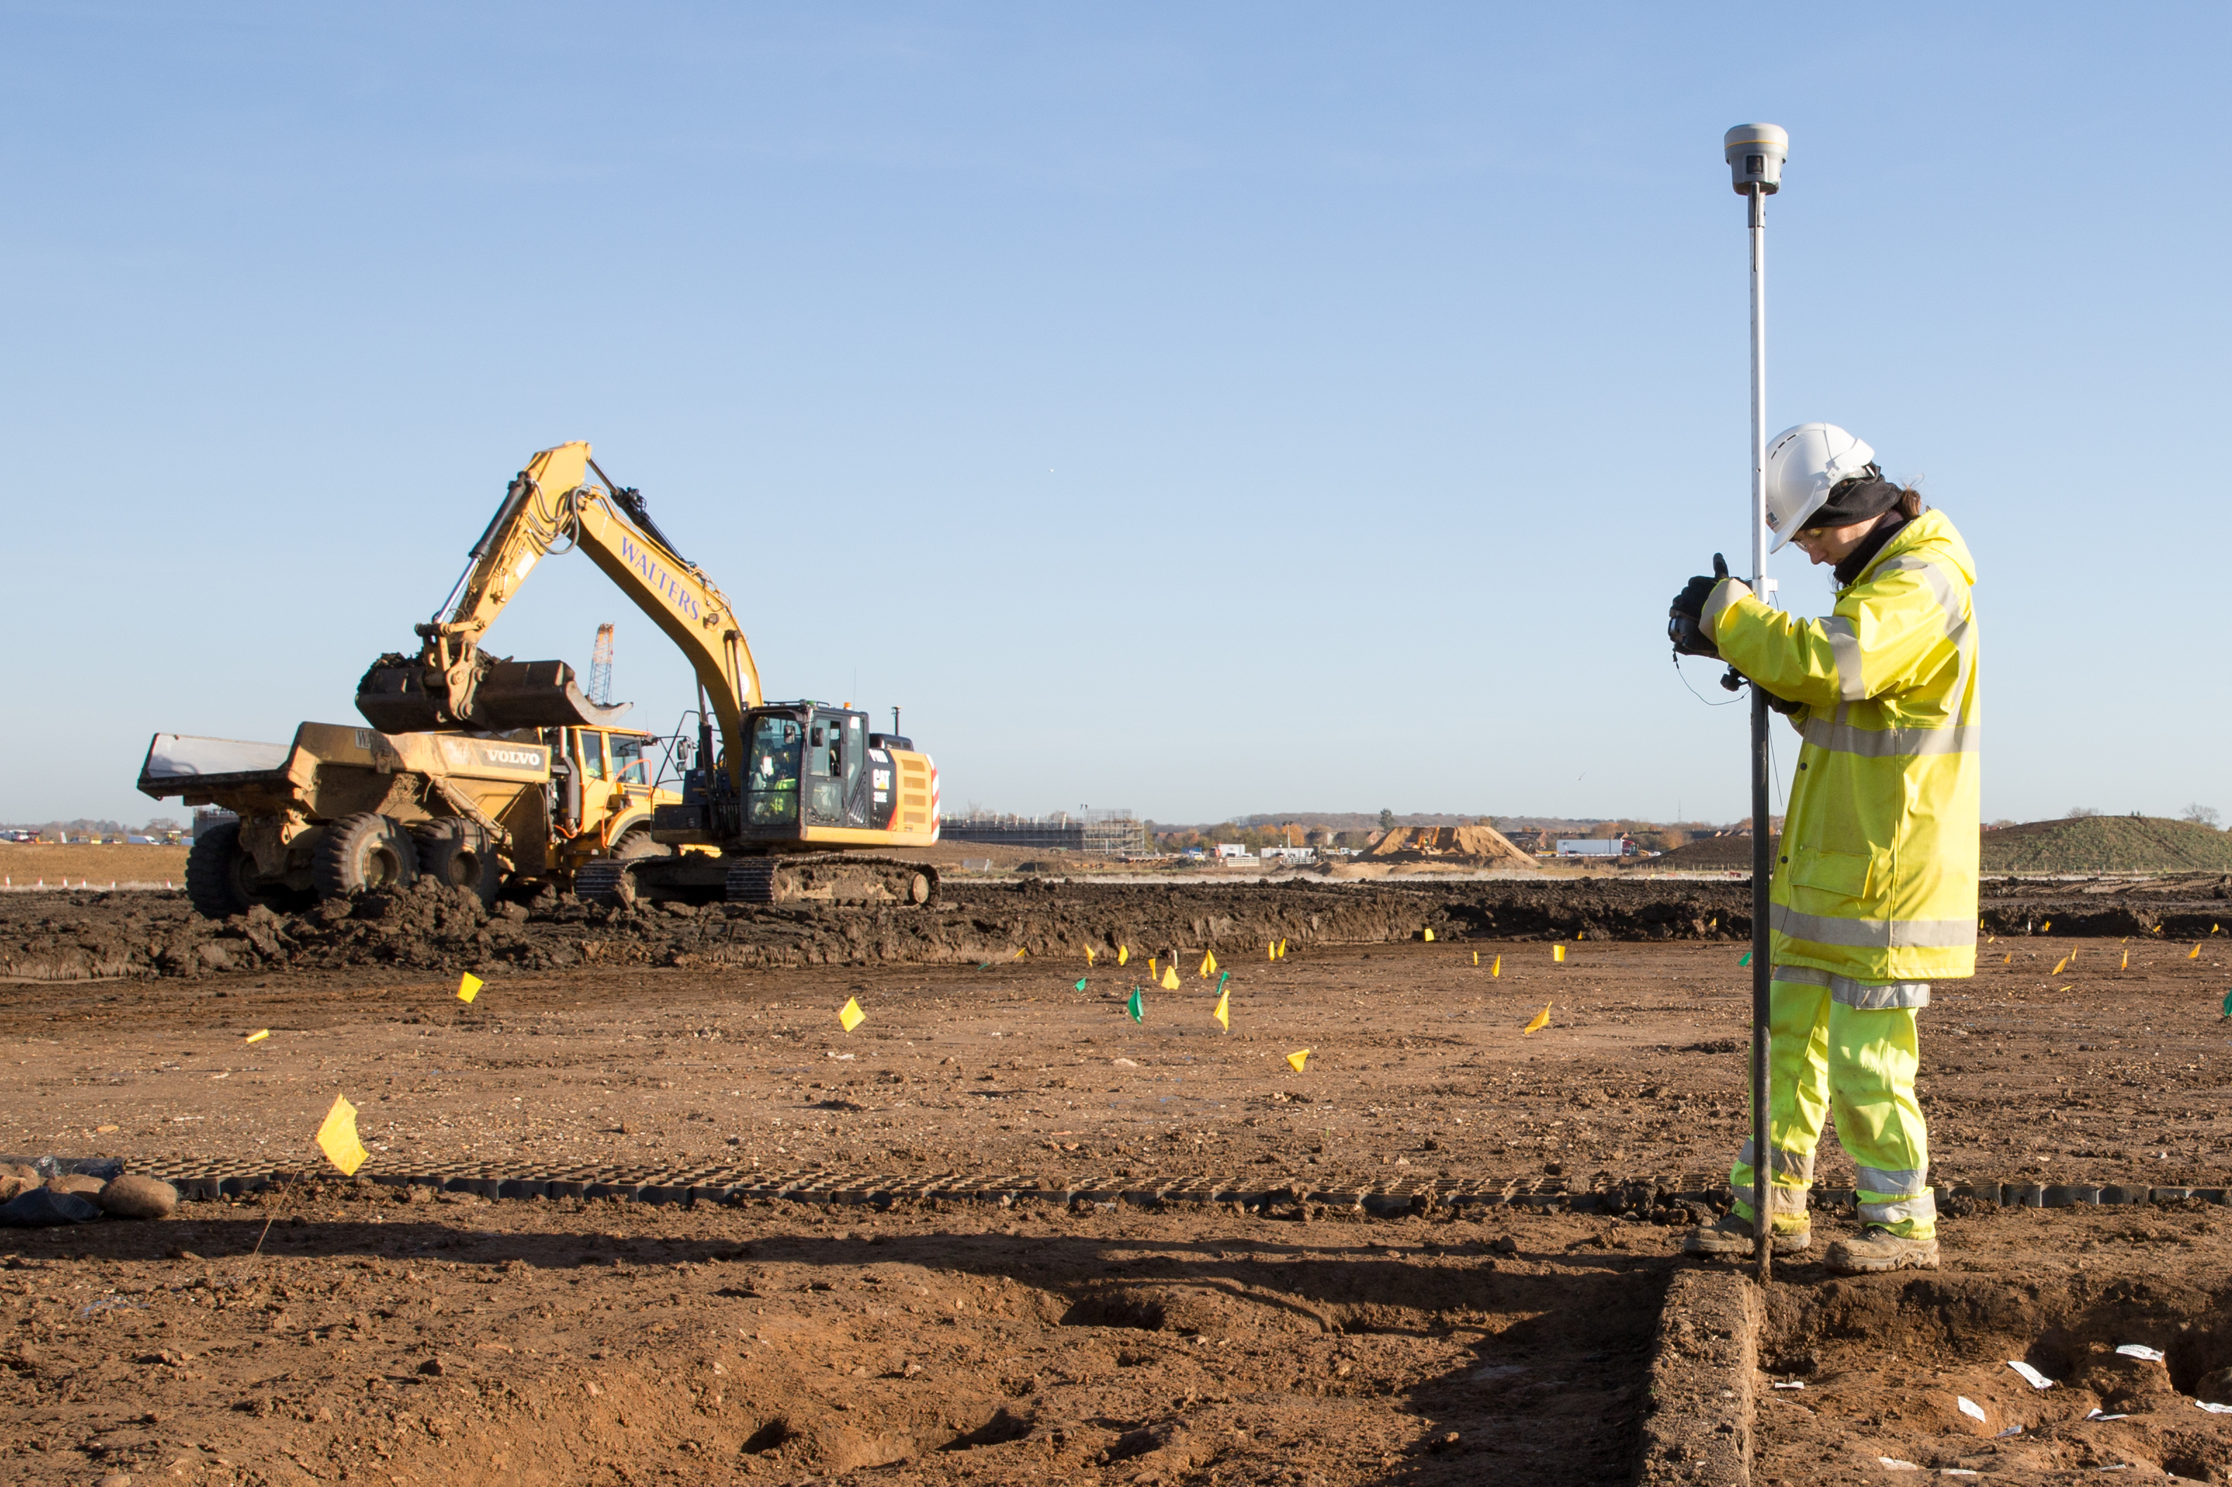
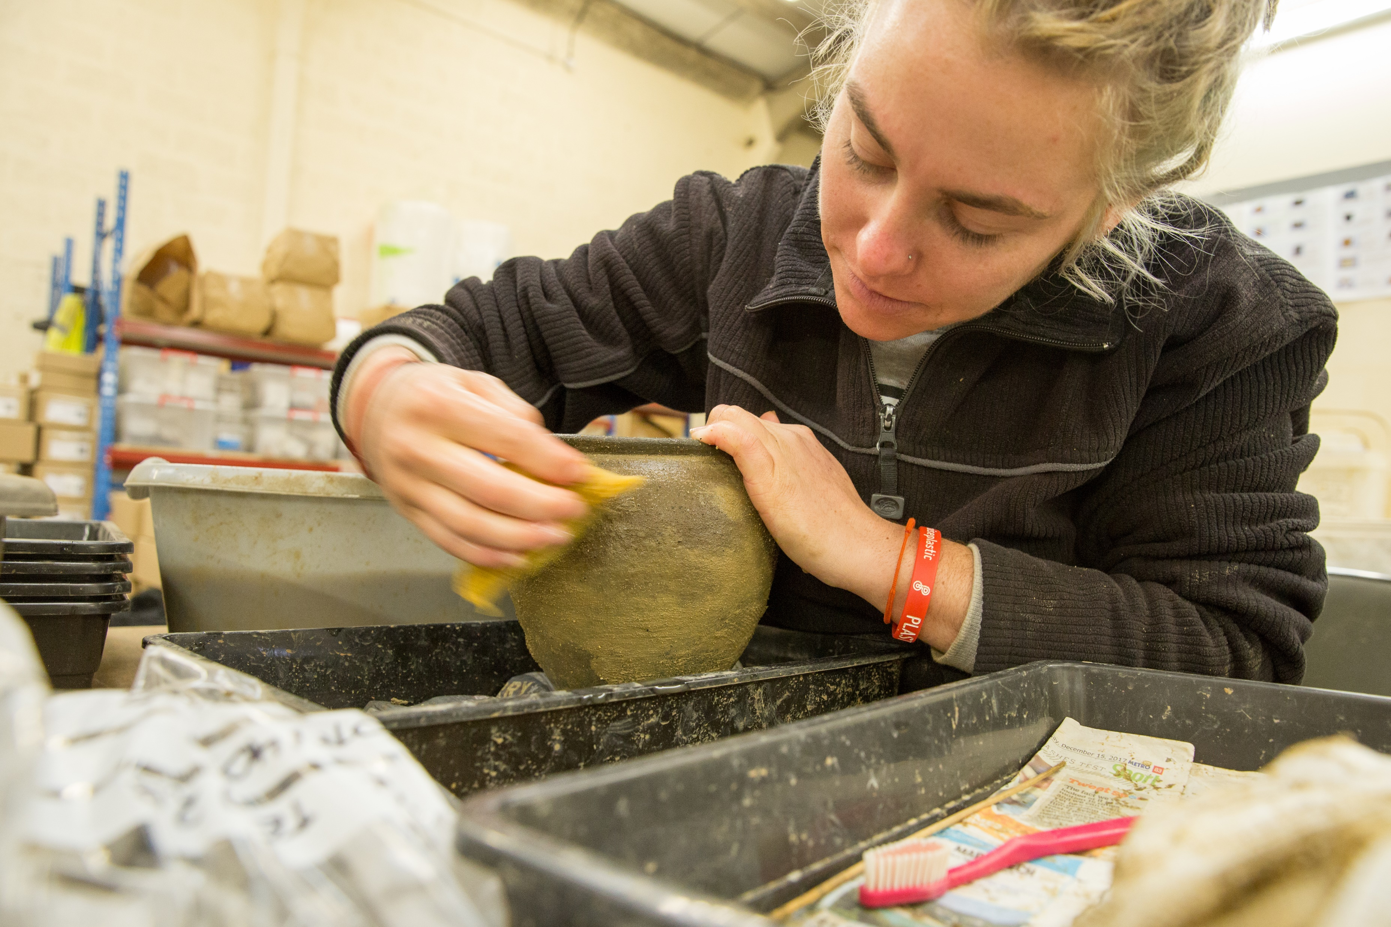
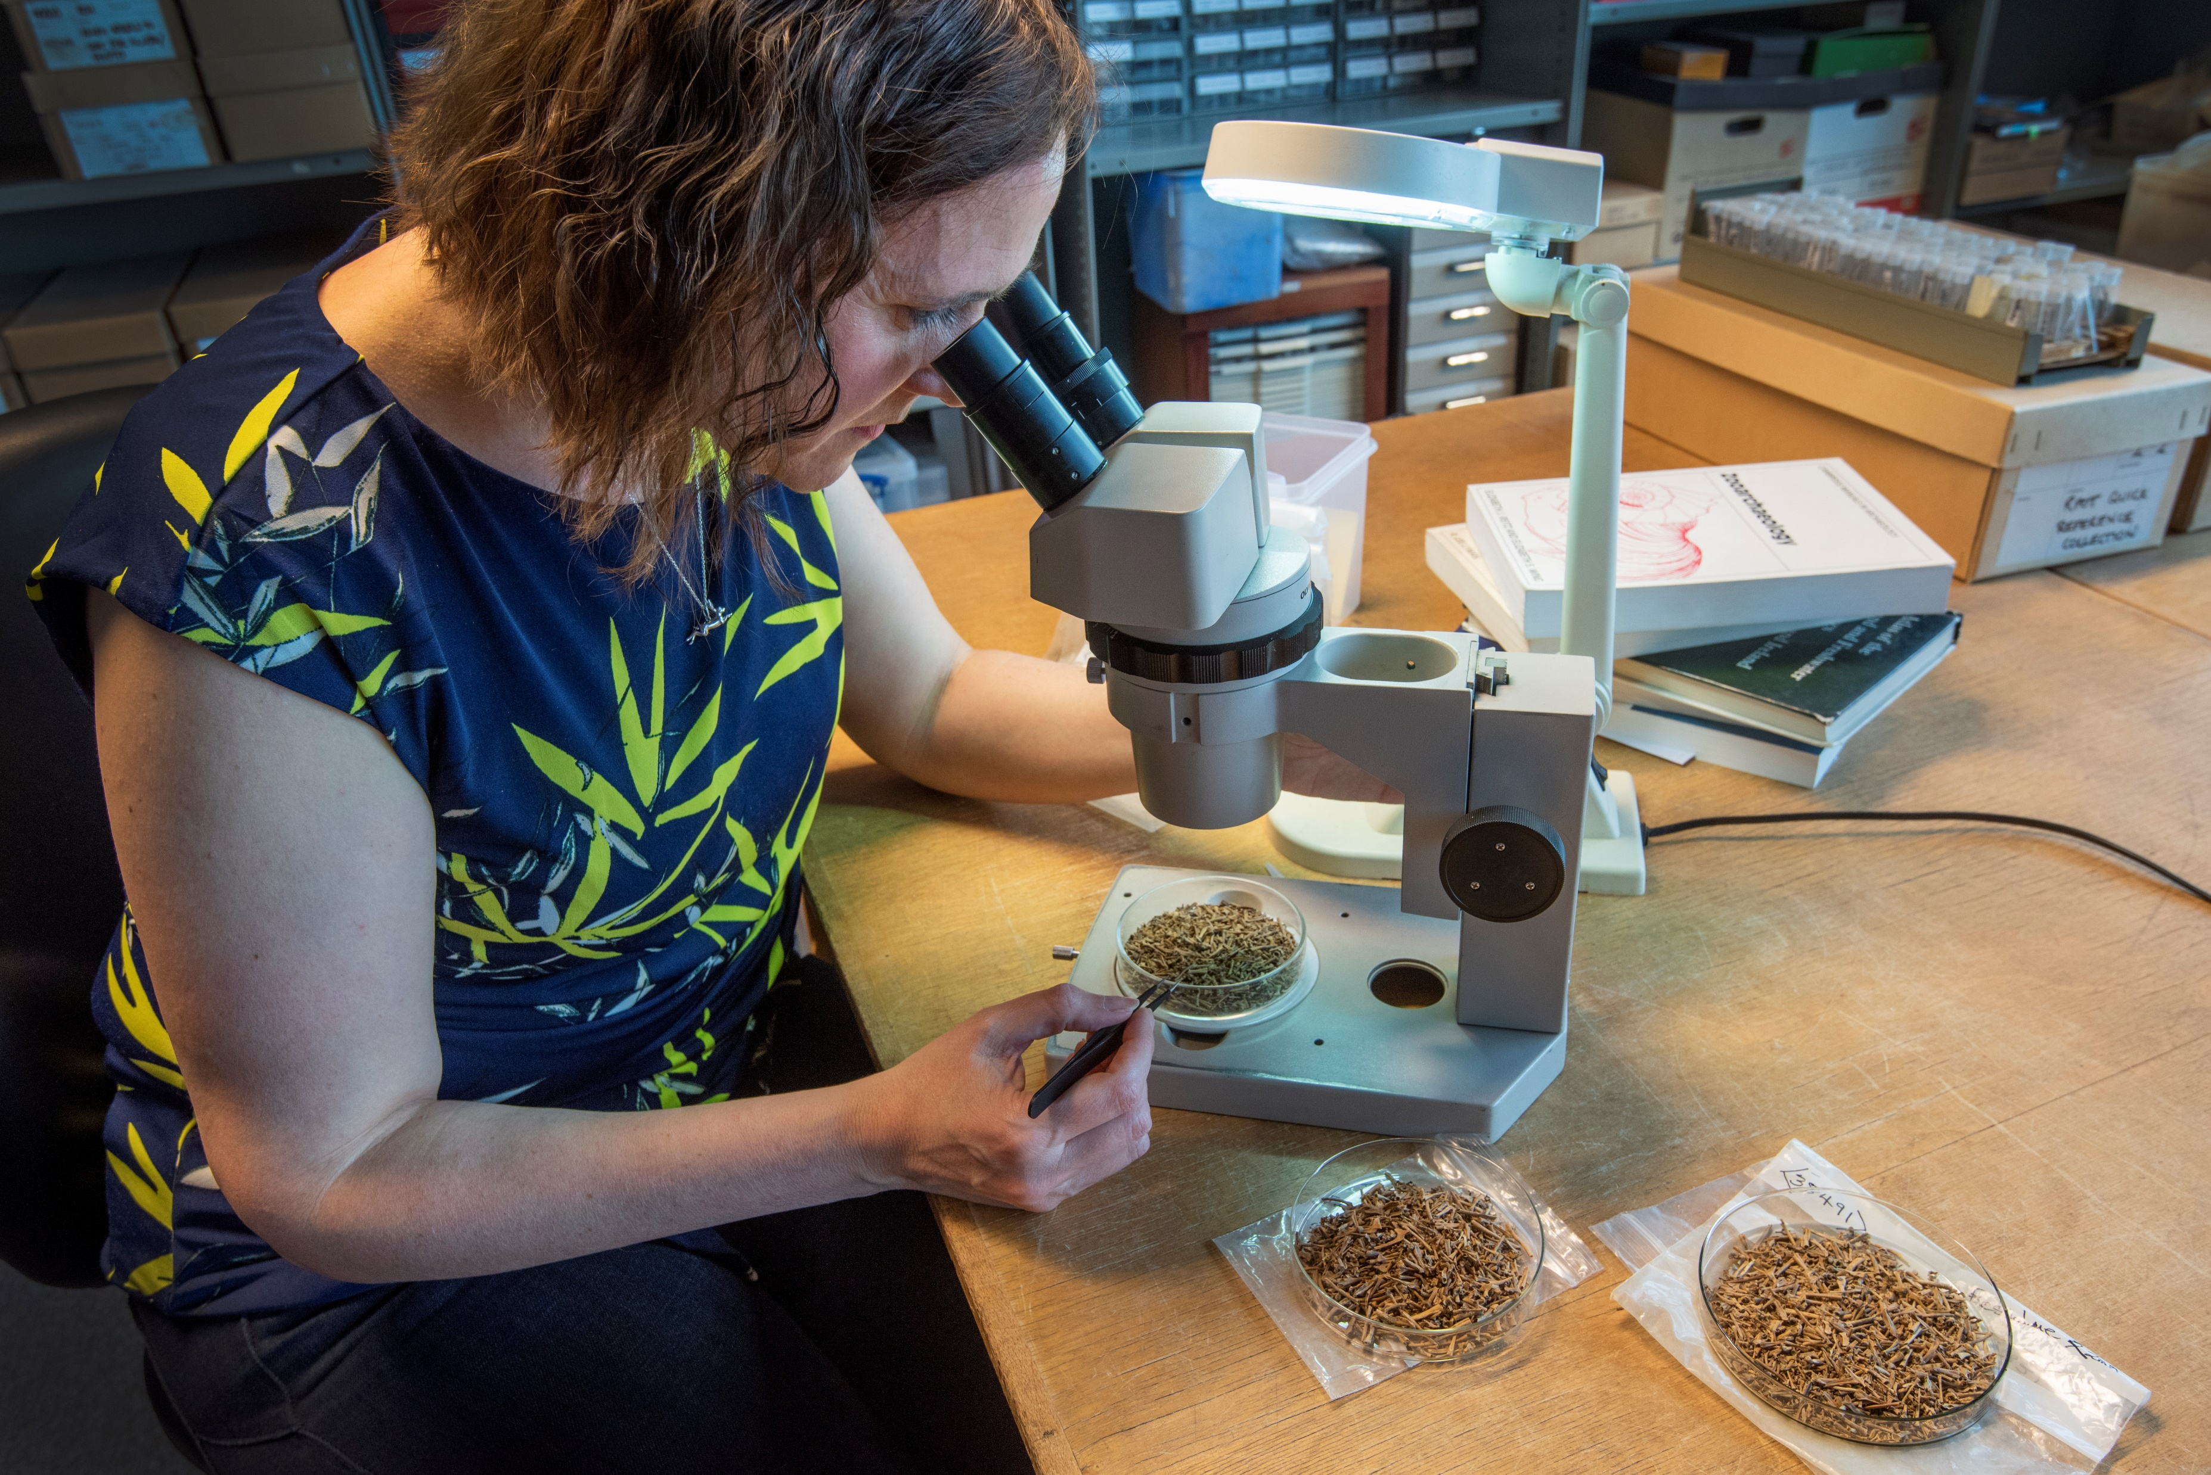
What do archaeologist do?
Collect photos and information to make maps or models of sites
Dig (excavate) places
where people used to live and work
Clean and study
objects to find out
what they are
Look at the
remains of plants
and animal bones

Slide 3
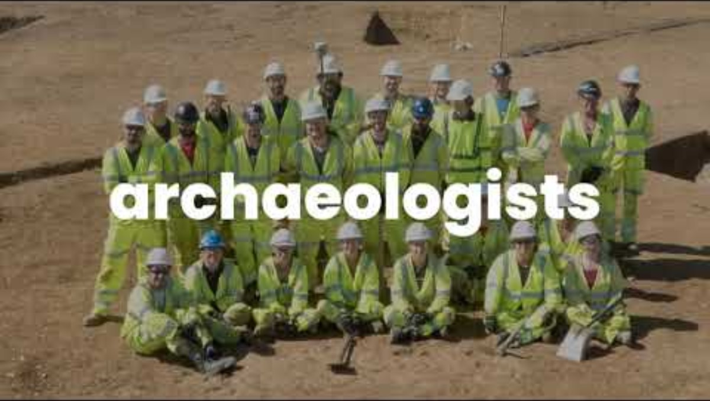
What have we found along the A14?​

Slide 4



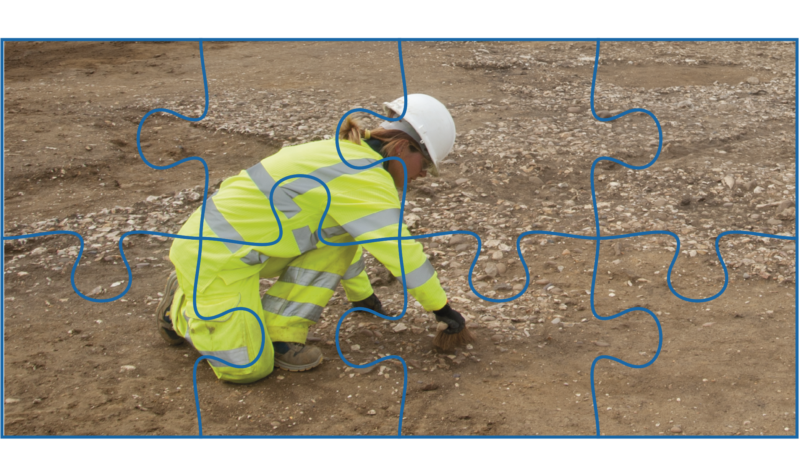
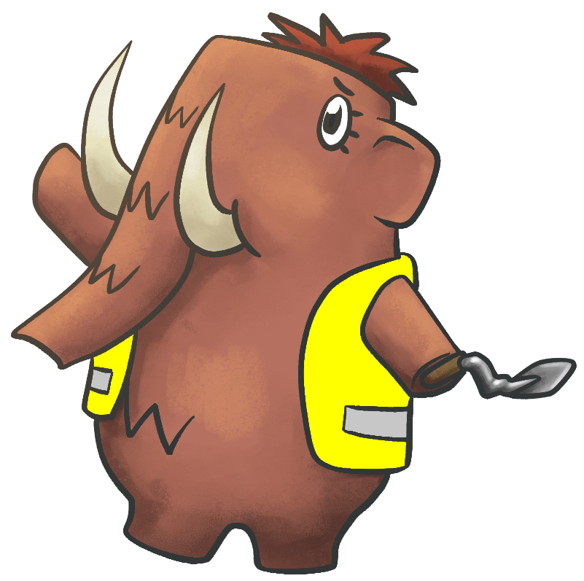
We look for
clues about
the past.
Archaeologist are
like detectives.
We also ask a lot
of questions.
Now it’s your turn to be an archaeologist!

