Slide 1
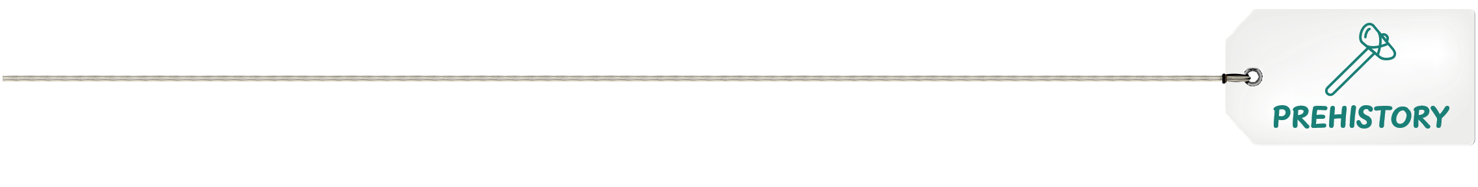
The people and animals
of Prehistoric Cambridgeshire

Slide 2
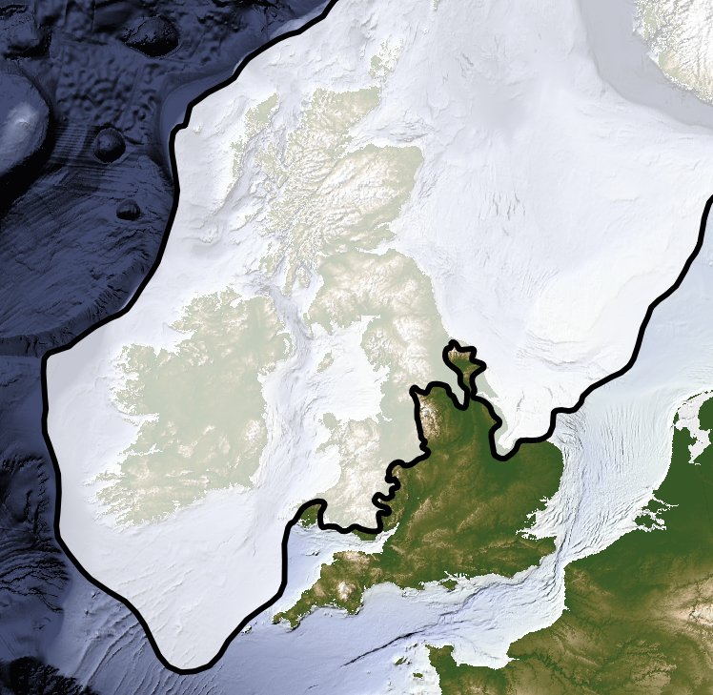
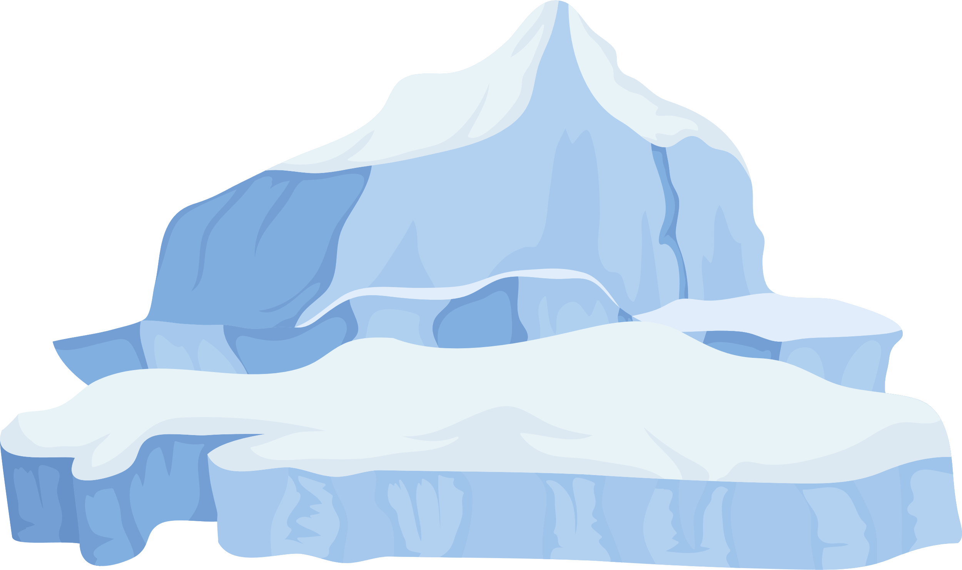
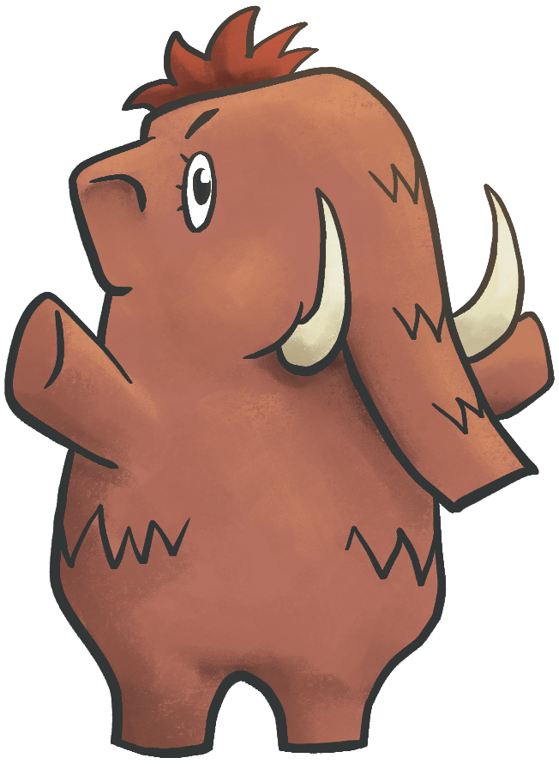
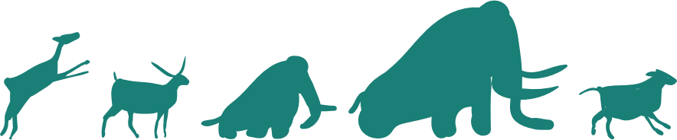

110,000-12,000 years ago:
ICE AGE
Most of Britain was covered in large sheets of ice called glaciers
That’s where
I’m from!
Cambridgeshire was a lot warmer and lots of
animals came to live here

Slide 3
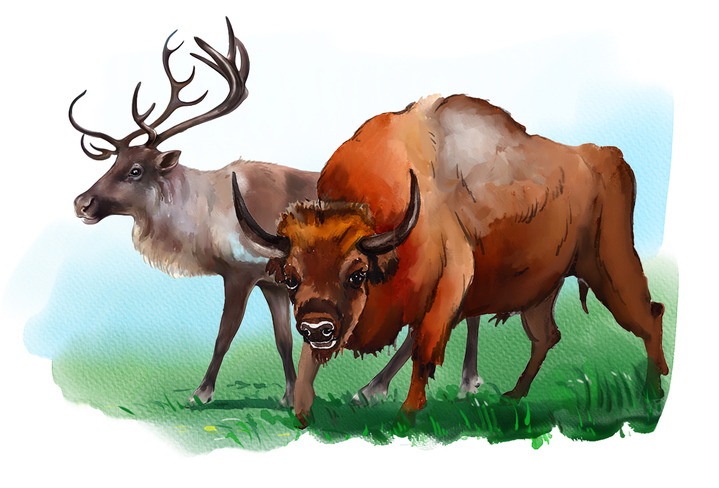
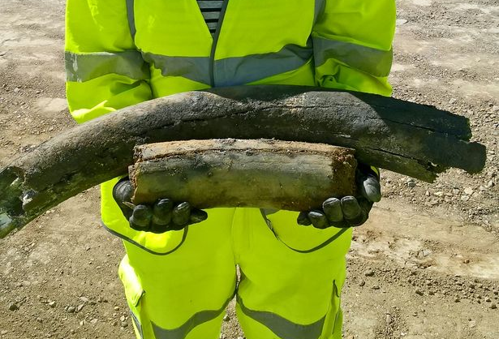
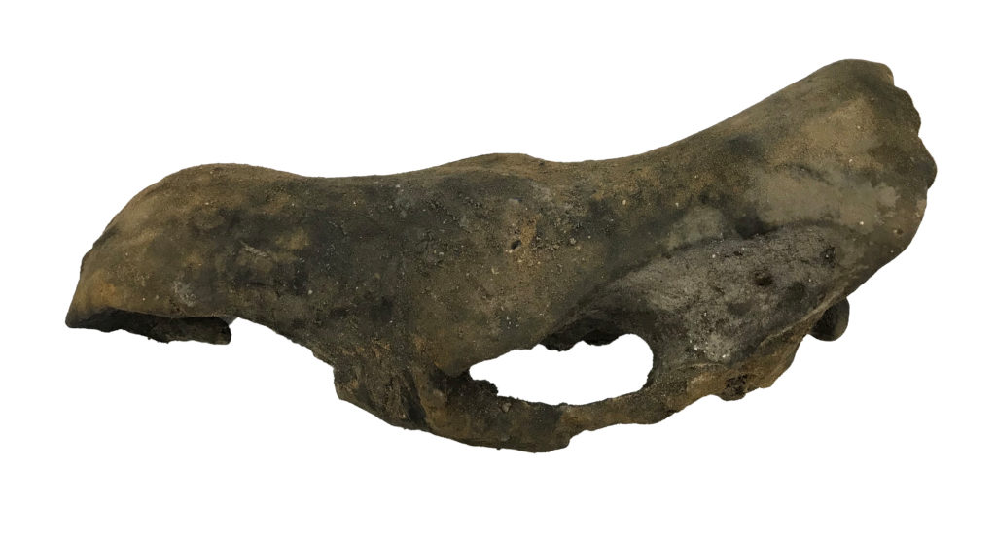
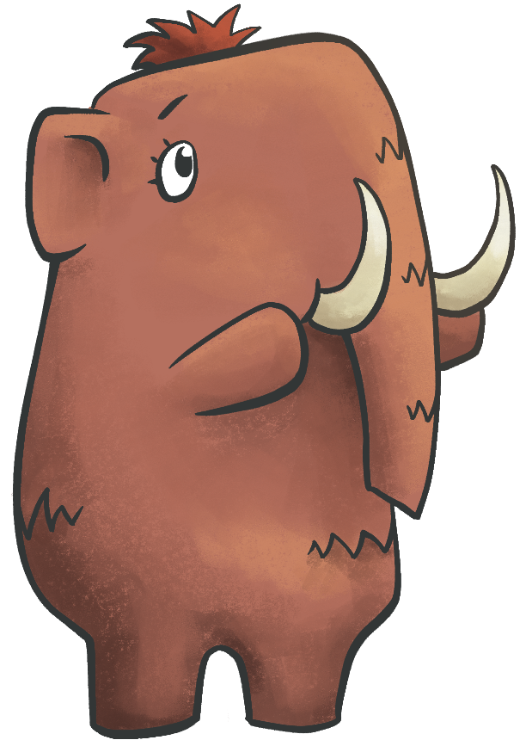
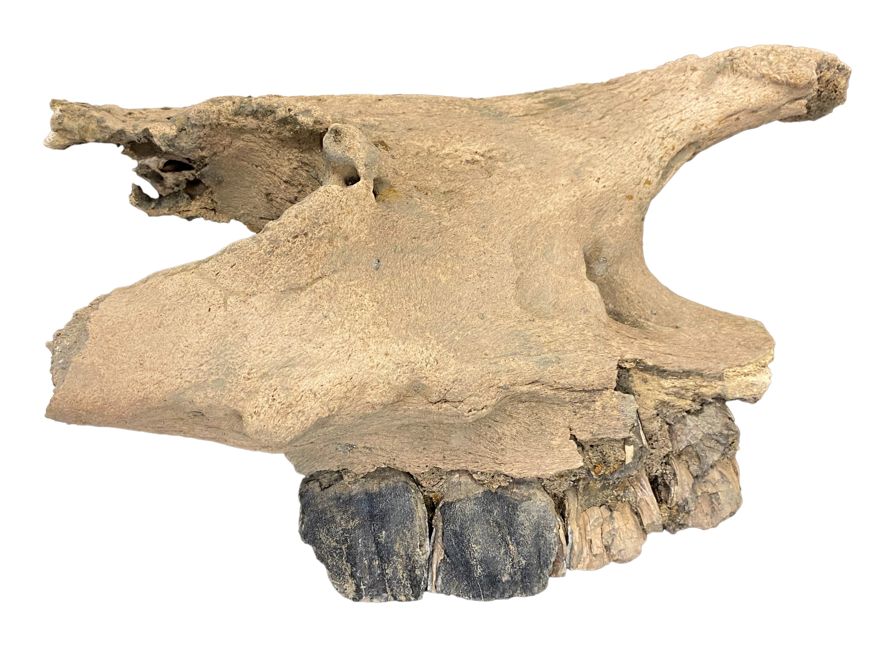
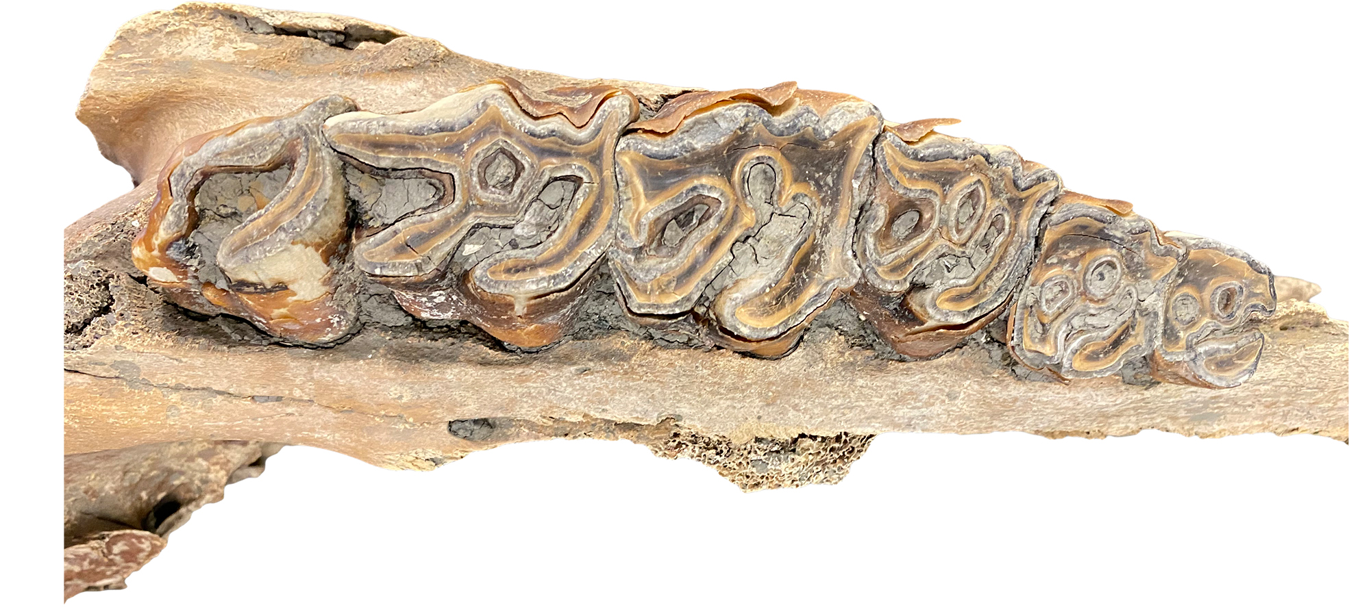
Megafauna = ‘giant animals’
These animals grew bigger
to survive the cold.
We found woolly mammoths.
We also found woolly rhinos!​
Archaeologists can tell the ages of animals by looking at their teeth!

Slide 4
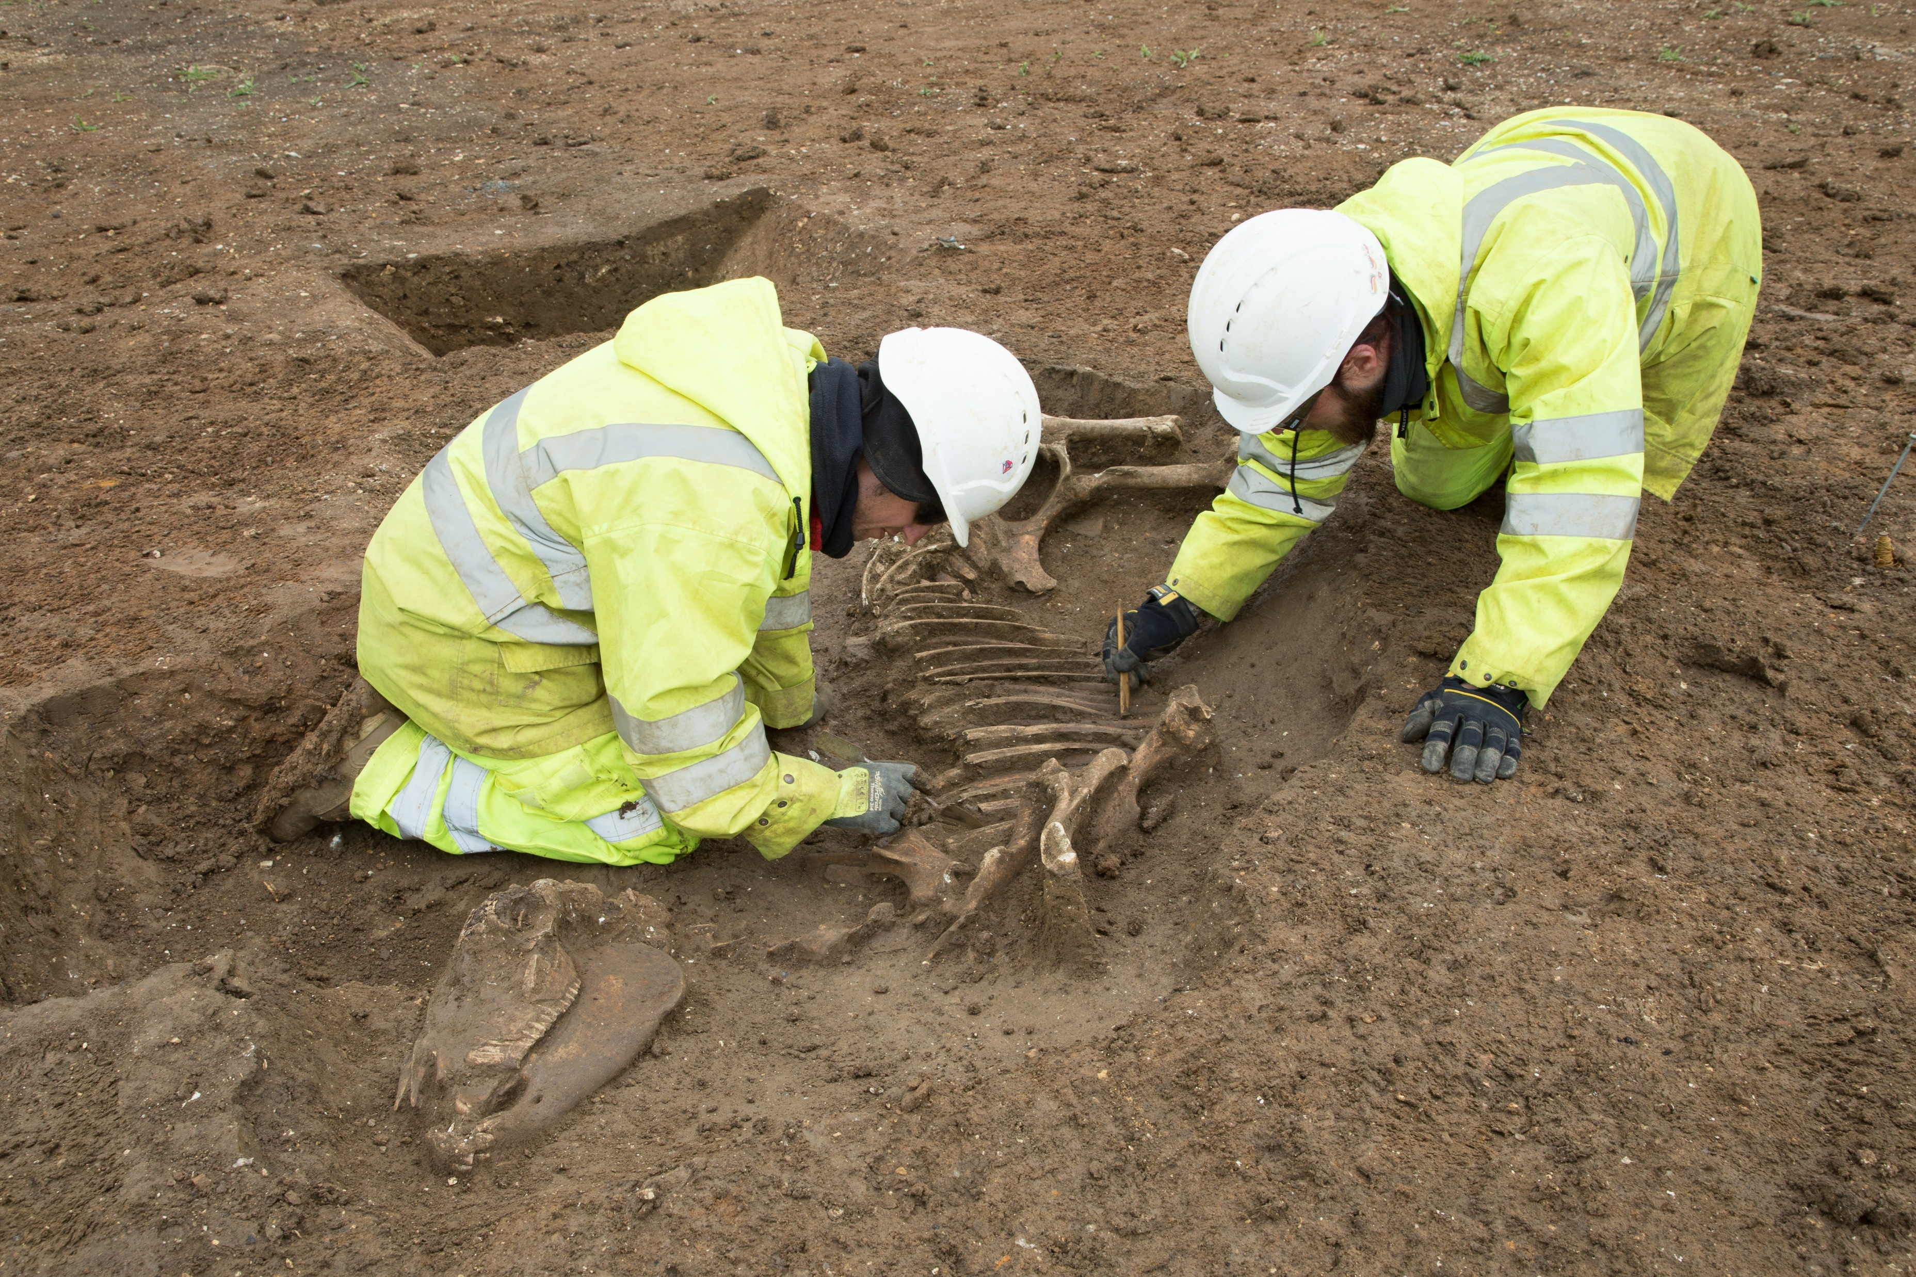
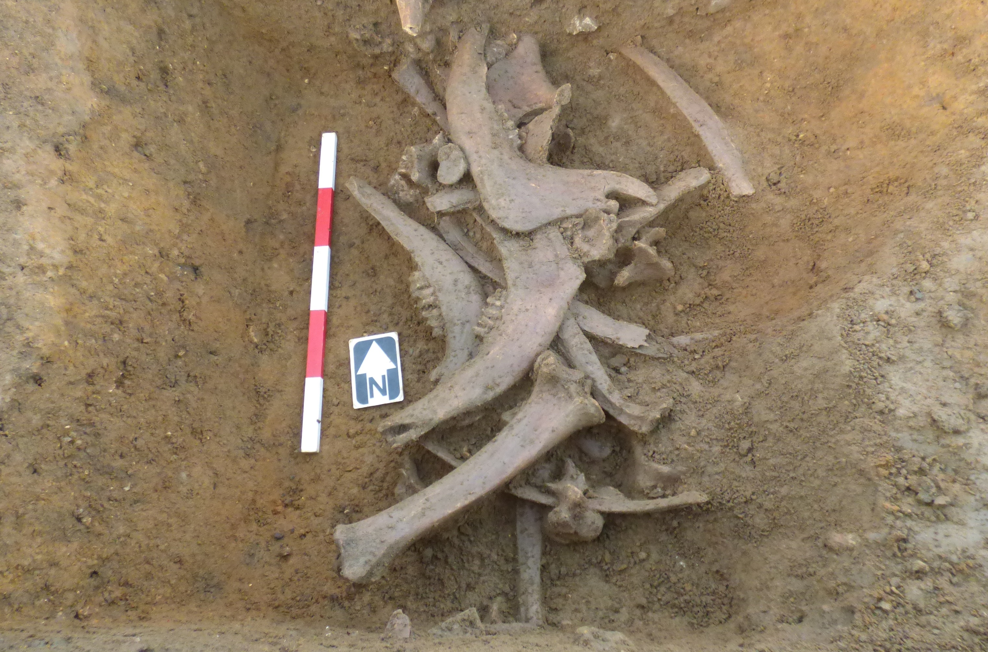
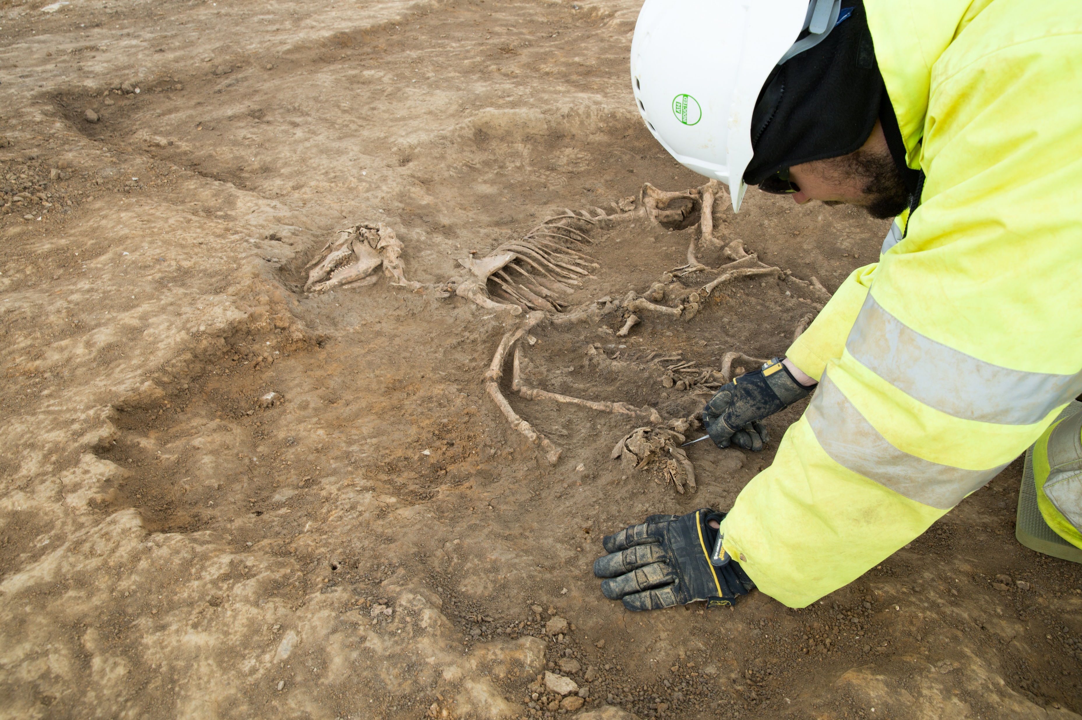
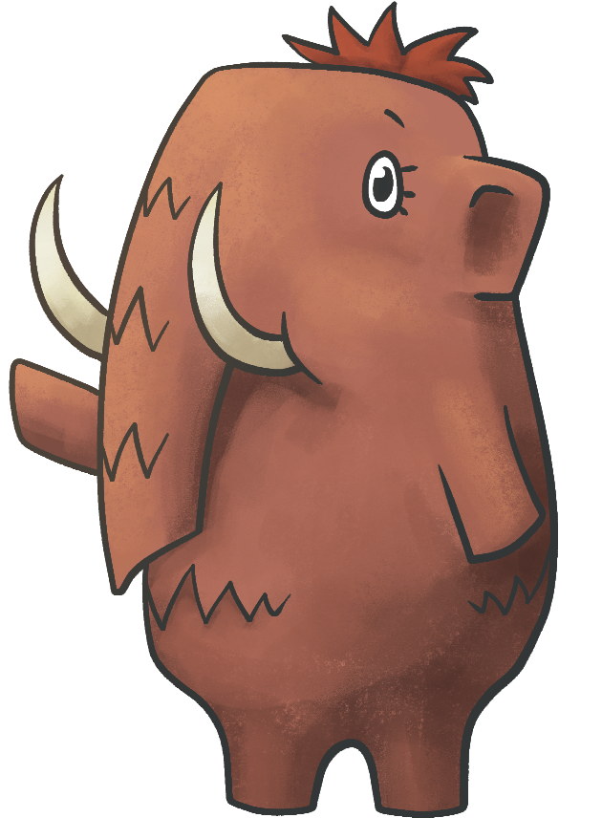
750 BCE – CE 43
IRON AGE
Archaeologists excavating the
remains of a horse
Livestock remains
Archaeozoologist examining
cattle remains
We can learn
a lot about animals
from their bones.​

Slide 5
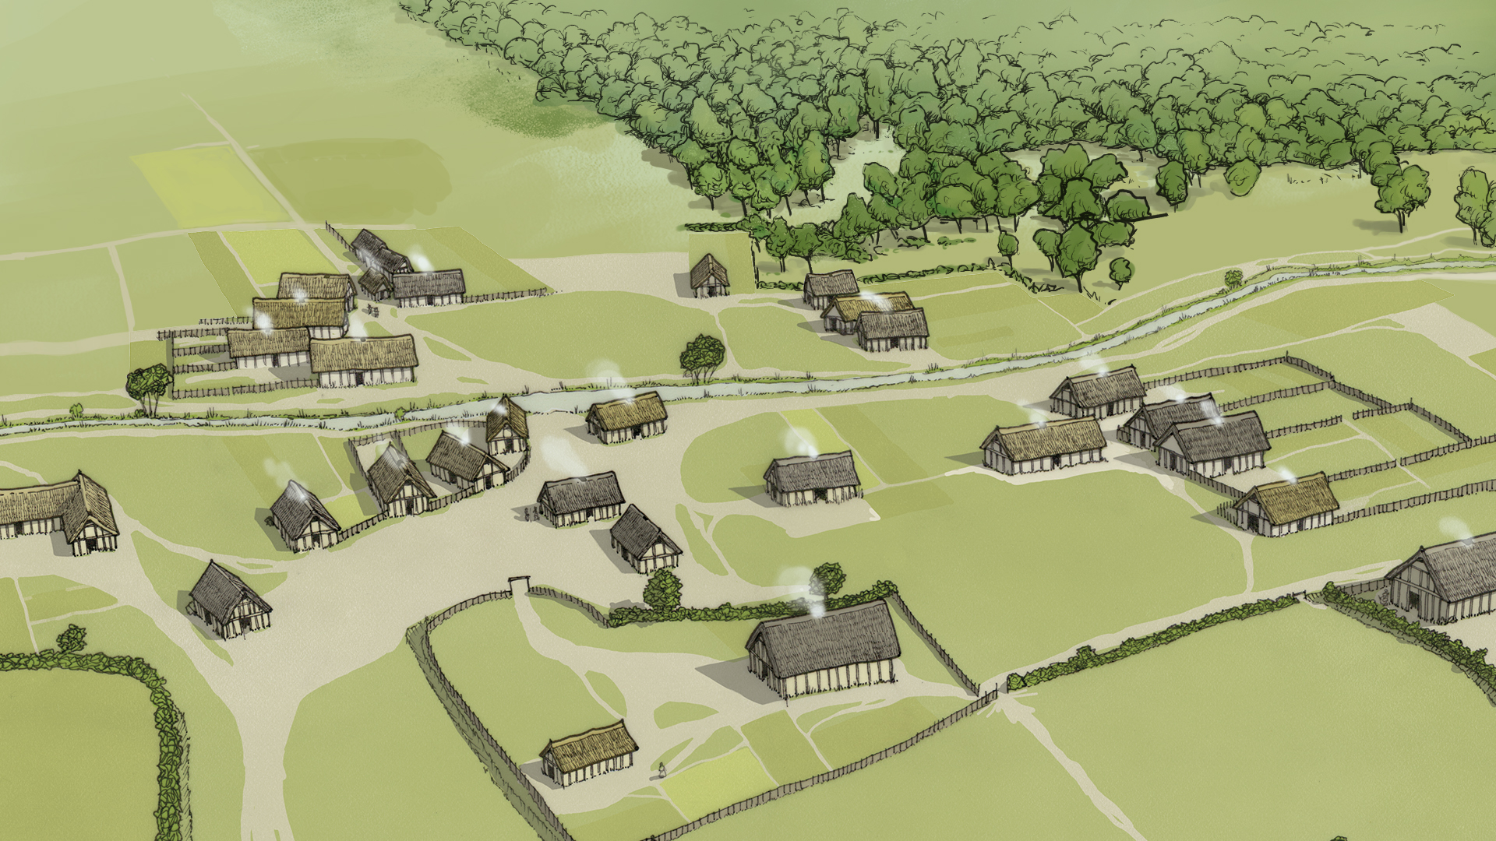
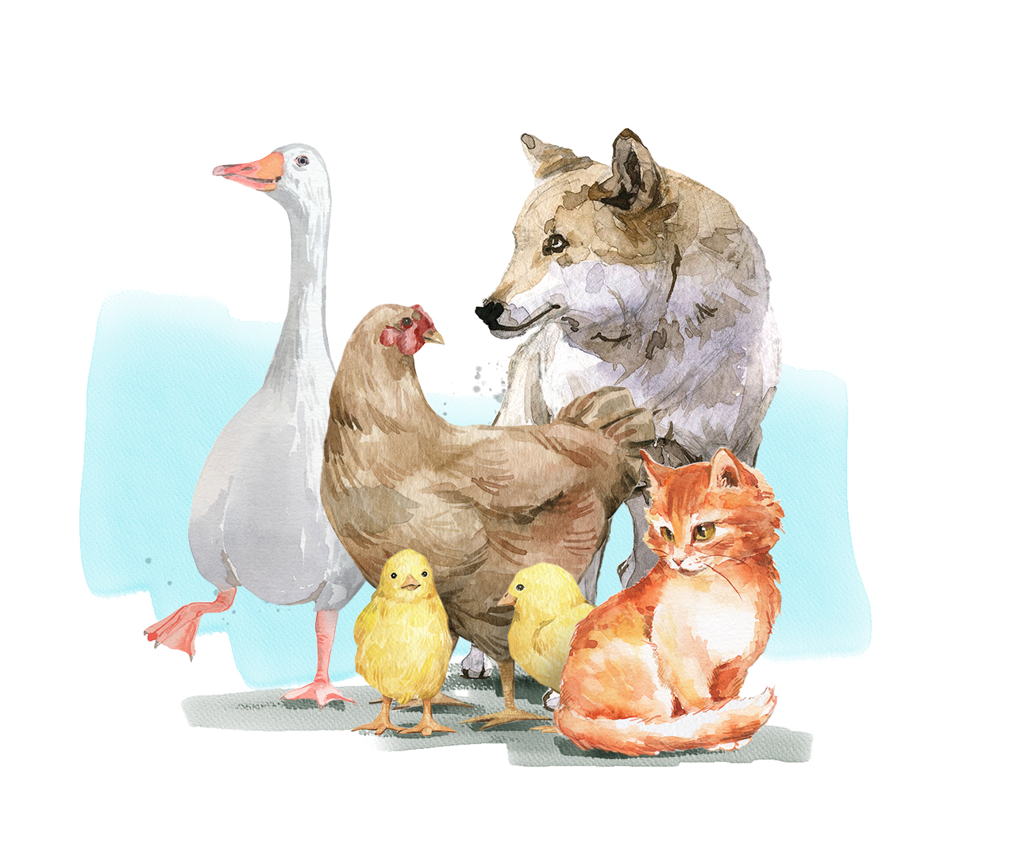
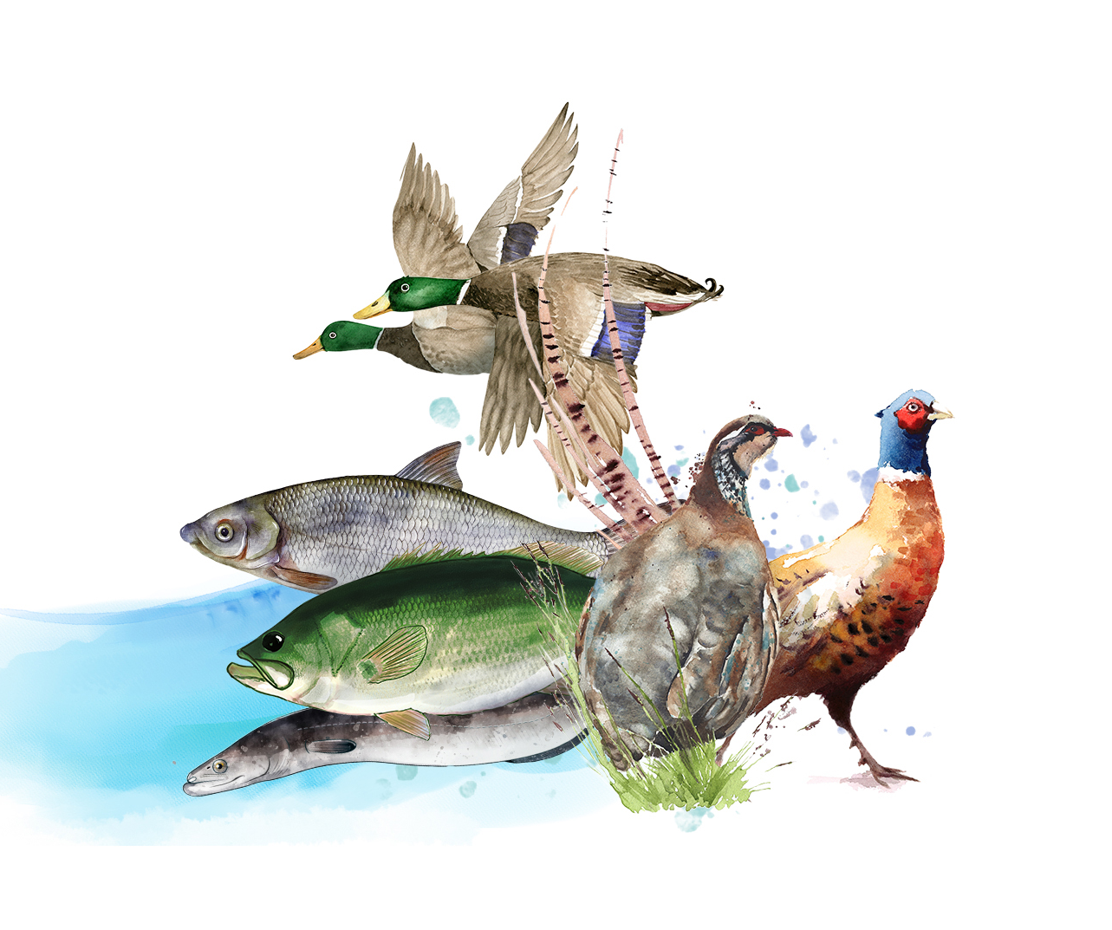
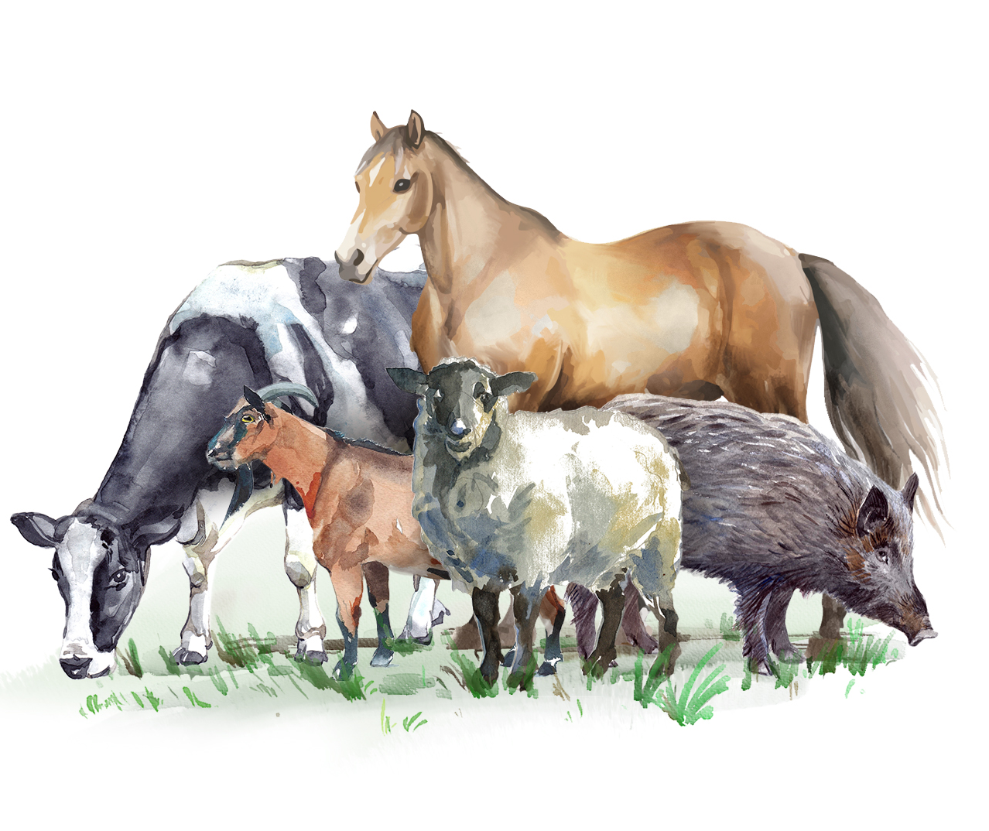
Animals in and around
people’s homes: dogs, cats,
chickens and geese.
Animals hunted for food:
deer, fish and wild birds. ​
Farm animals: cattle, sheep,
goats, pigs, and horses.

Slide 6

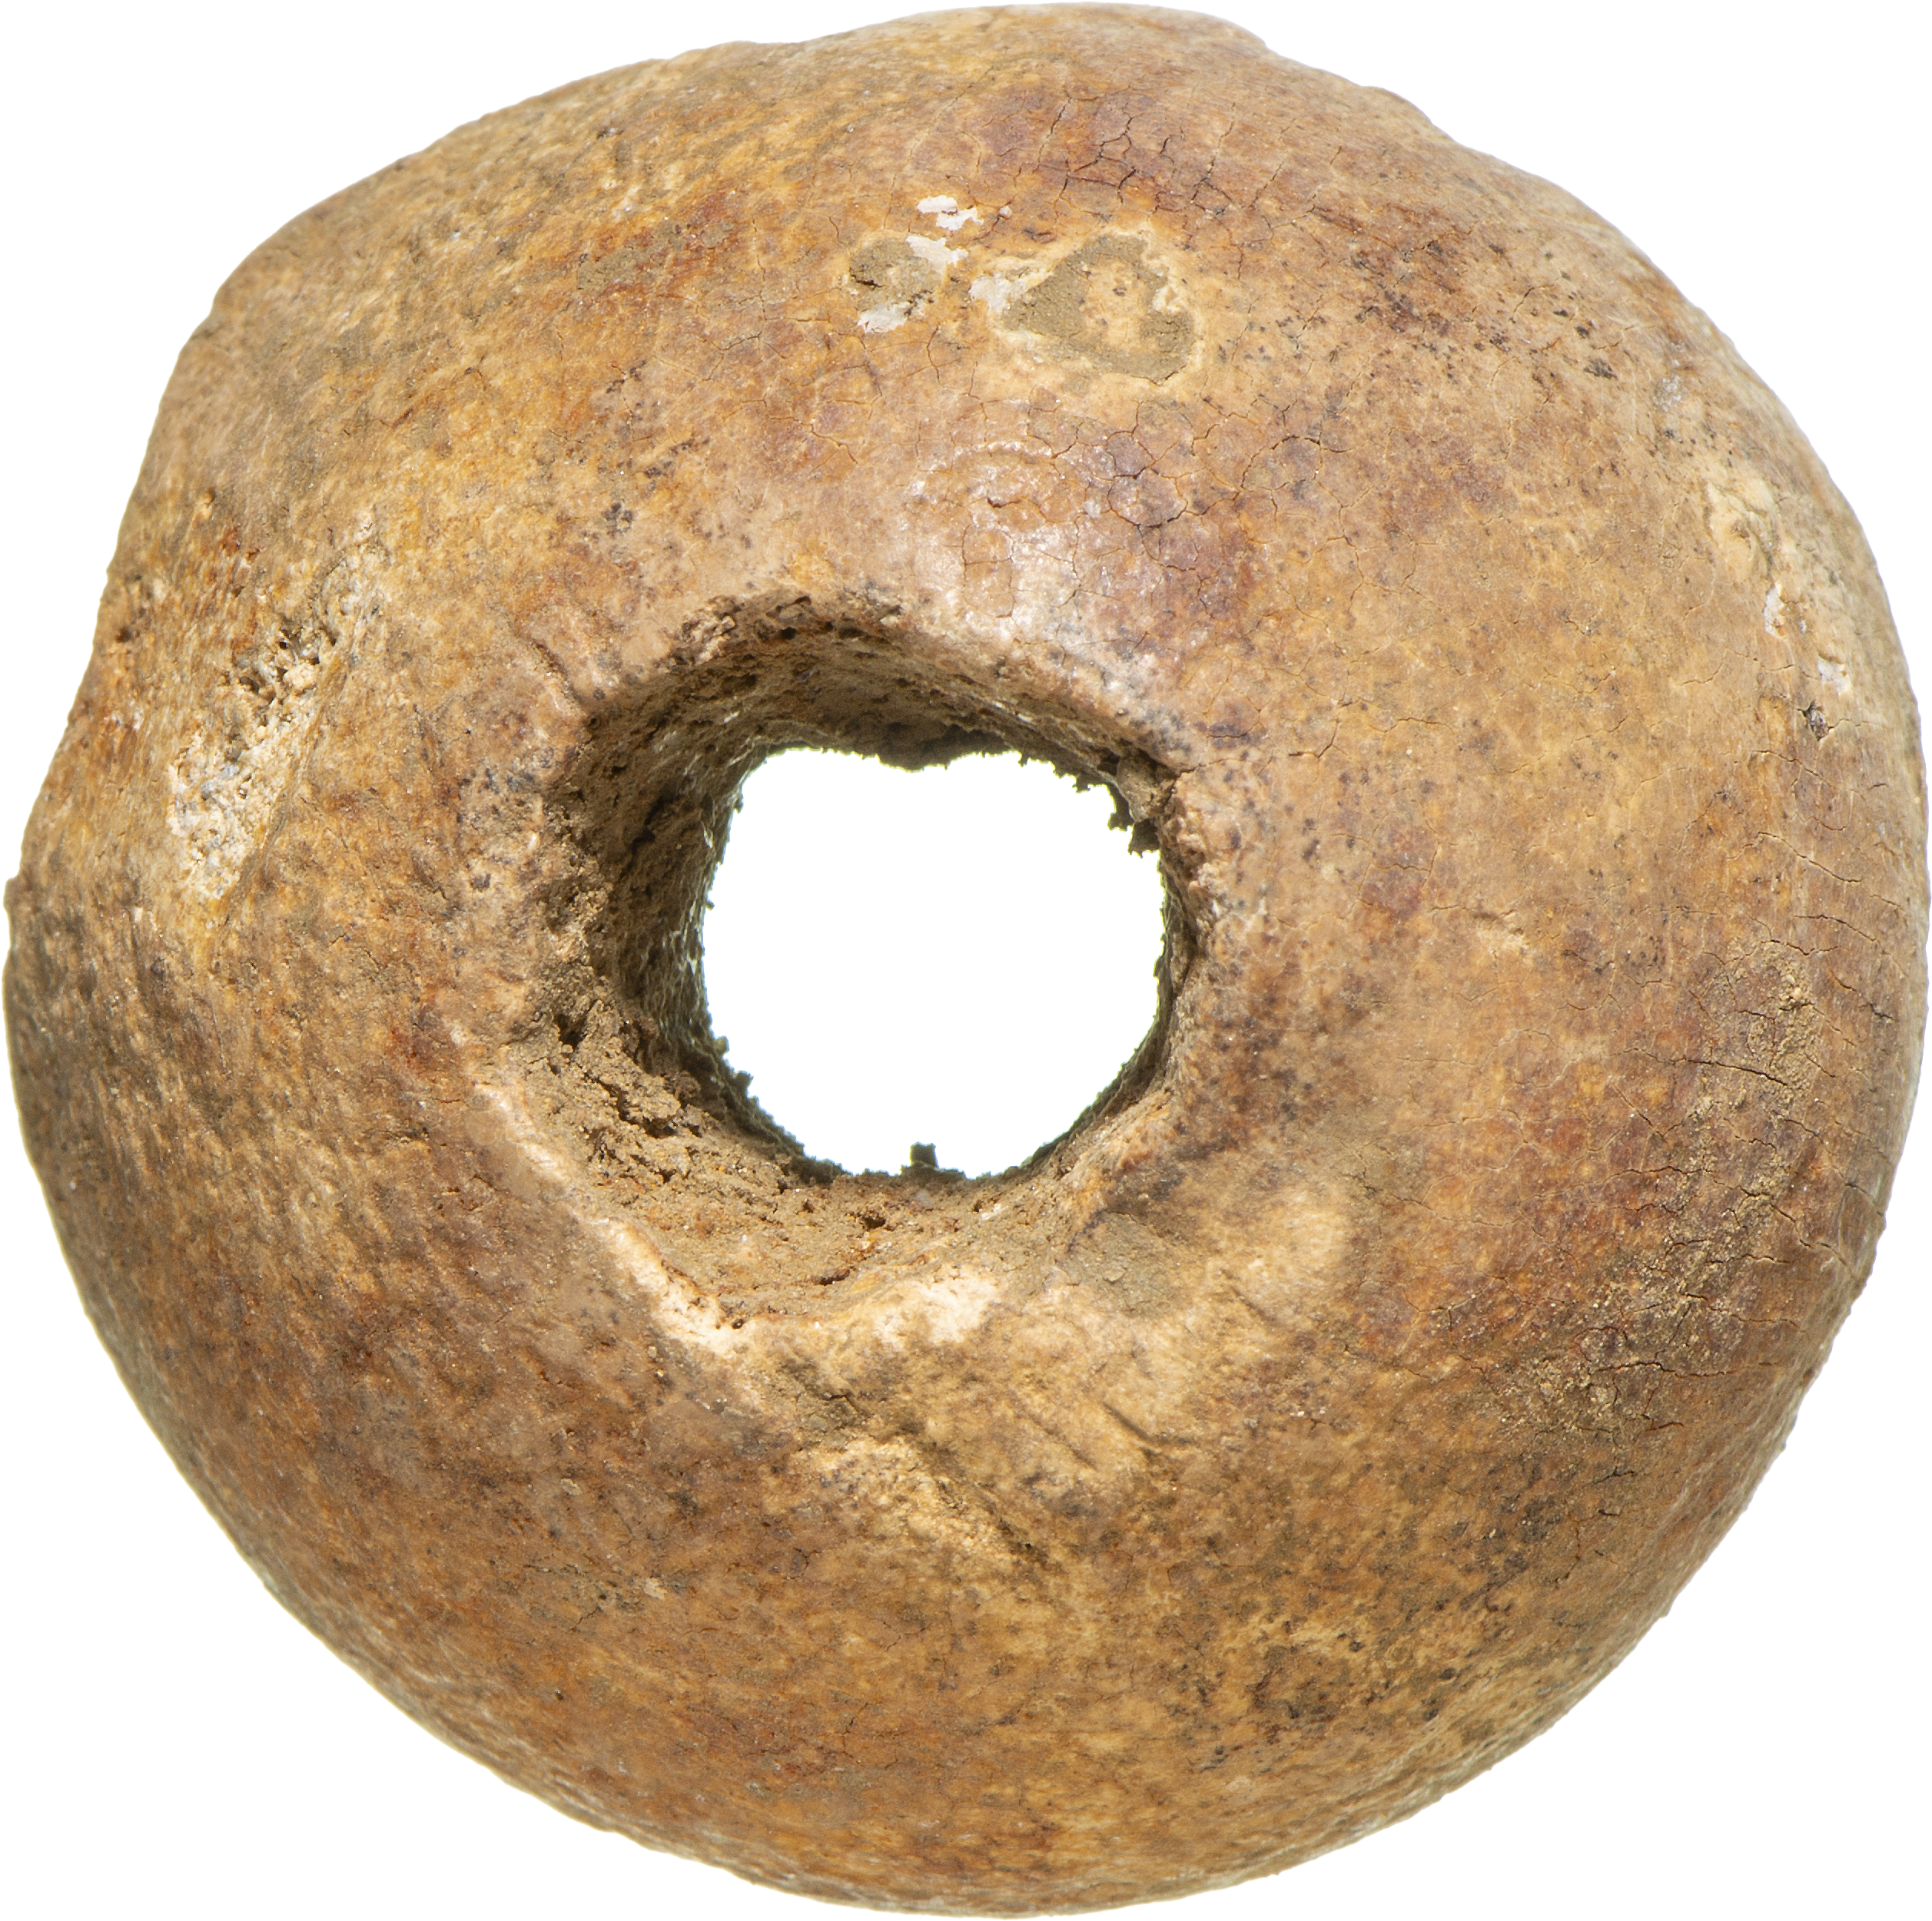
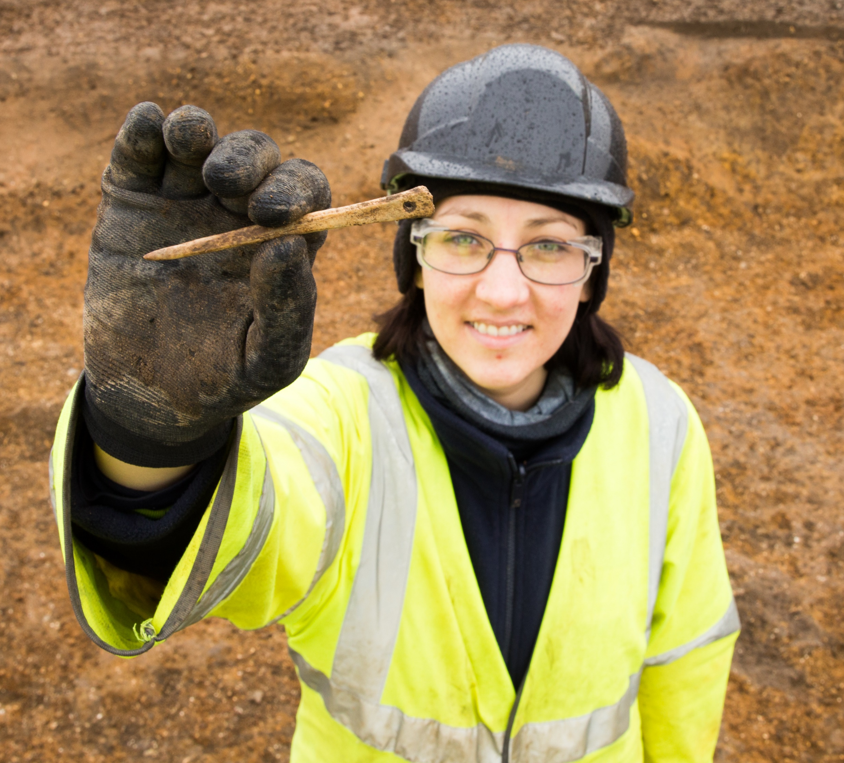
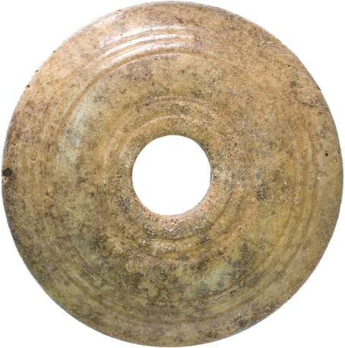
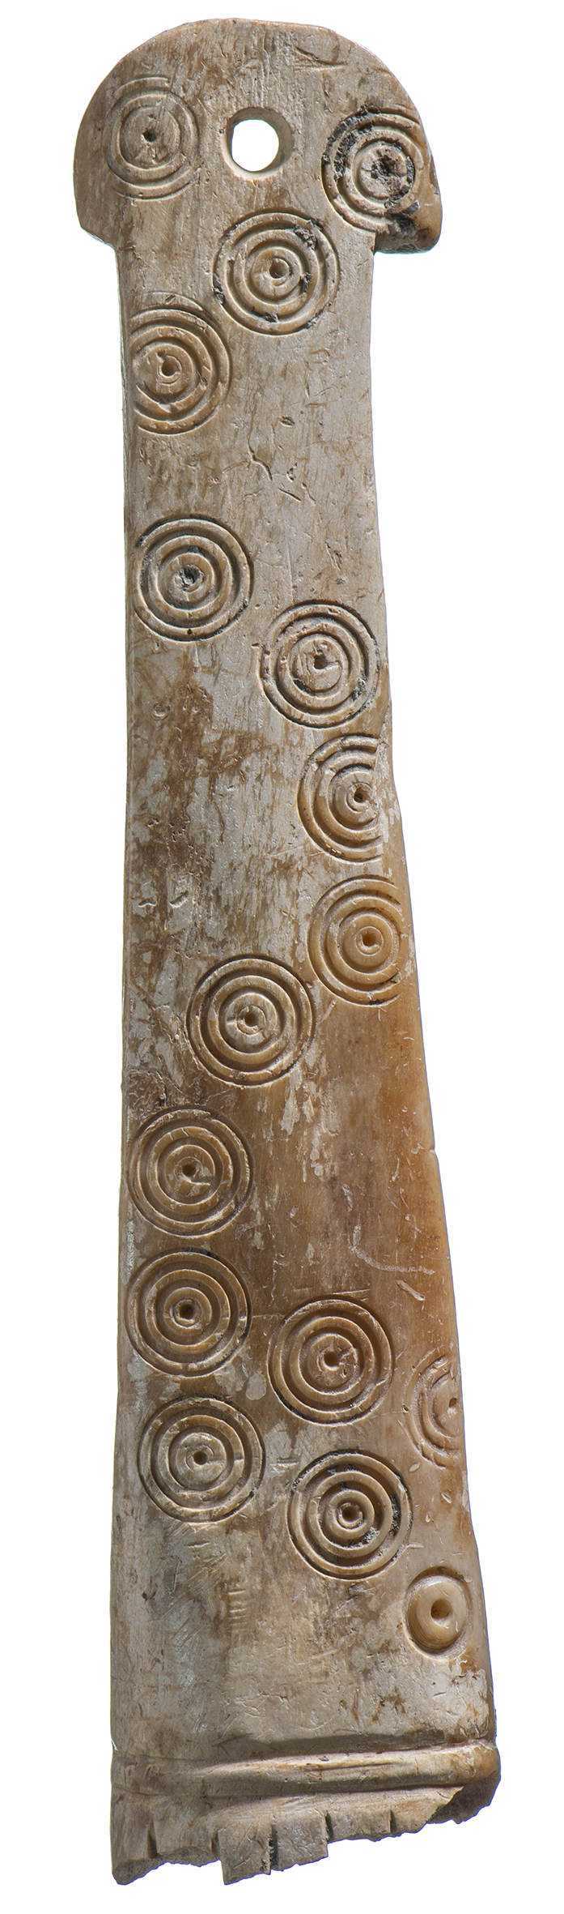
What did people make from animal bones?​
Do you know what these objects we found were used for?​
Notes:
Box 1: Iron age combs
Box 2: needle
Box 3: spindle whorls

Slide 7
Now it’s your turn!
Prehistoric activities

Slide 8
Animal bone identification
Activity 1

Slide 9
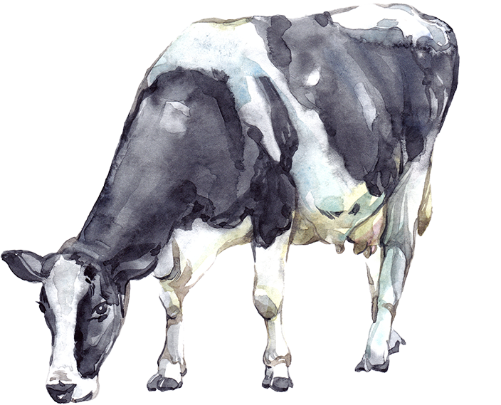
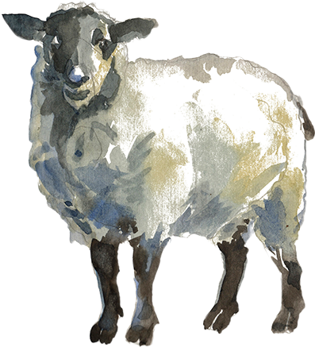
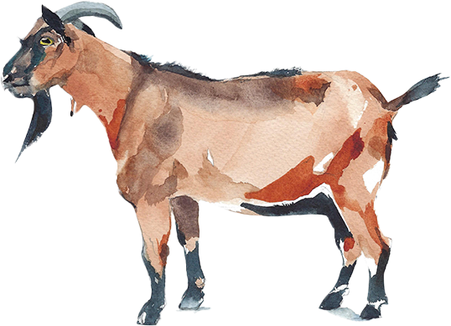
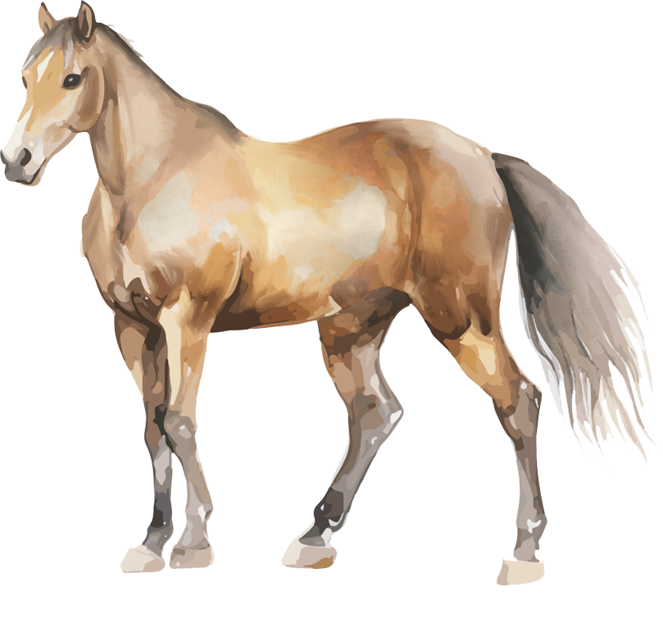
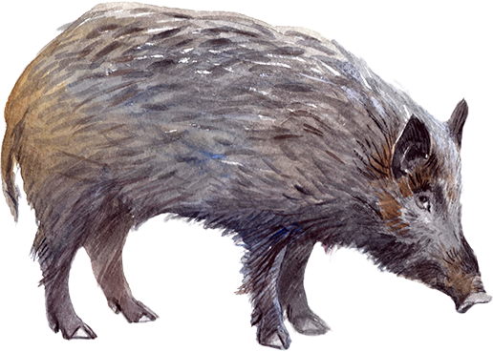
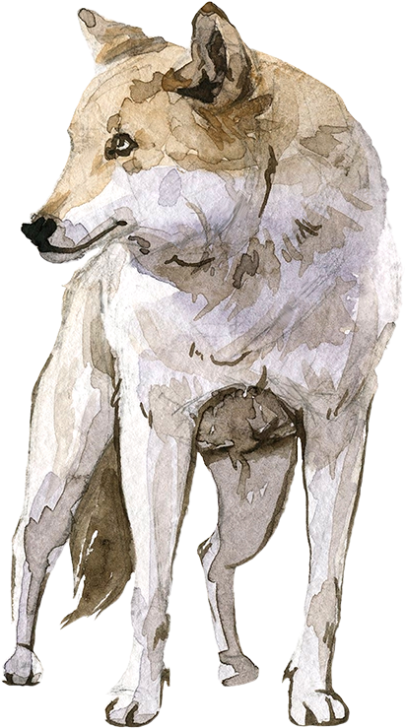
What animals did people in the past keep and why?​
COWS
SHEEP
GOATS
.
HORSES
.
.
PIGS
DOGS

Slide 10




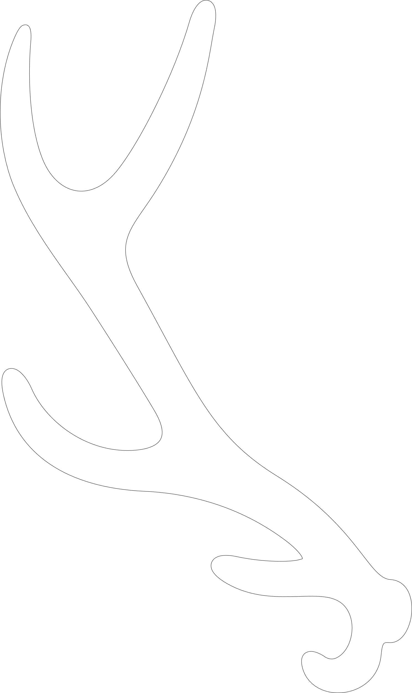

Types of bones ​
LONG BONES
FLAT BONES
BLOCKY BONES
TEETH
HORN and ANTLER

Slide 11
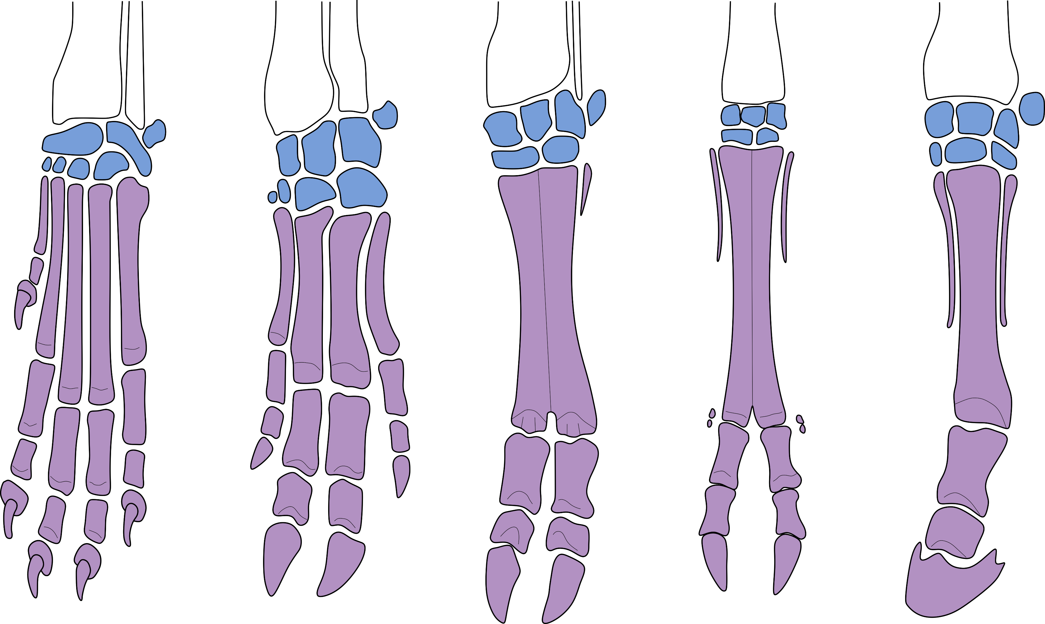
Bone comparisons: foot
Carpal
bones
Metacarpal bones
SHEEP/
GOAT
DOG
PIG
COW
HORSE

Slide 12
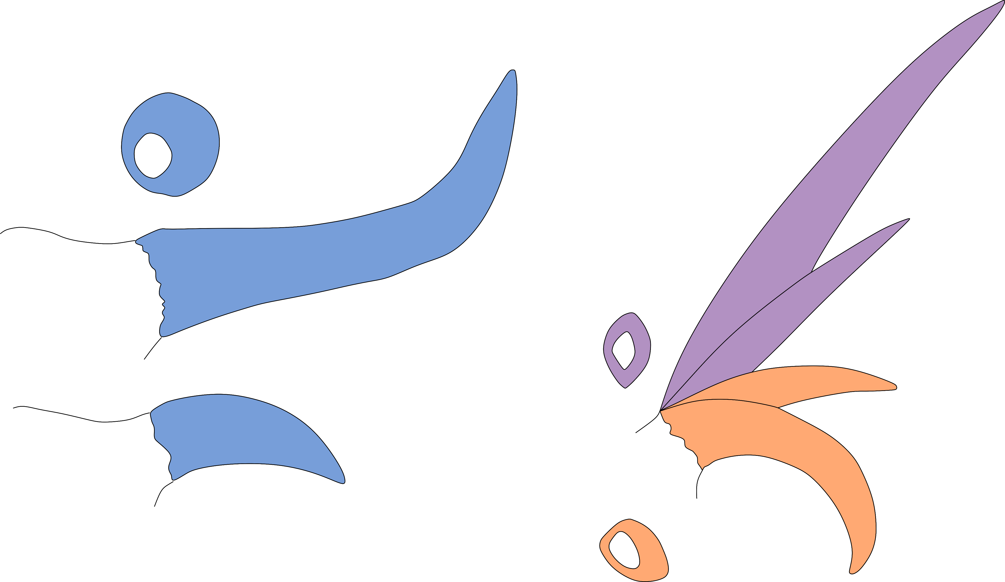
Bone comparisons: horn core
GOAT
Horn section
Skull
COW
Horn section
Skull
Skull
SHEEP
Horn section
To see more animal bone comparisons check the “Beginner's guide to identifying British mammal bones” at British mammal bones identification guide | Natural History Museum

Slide 13
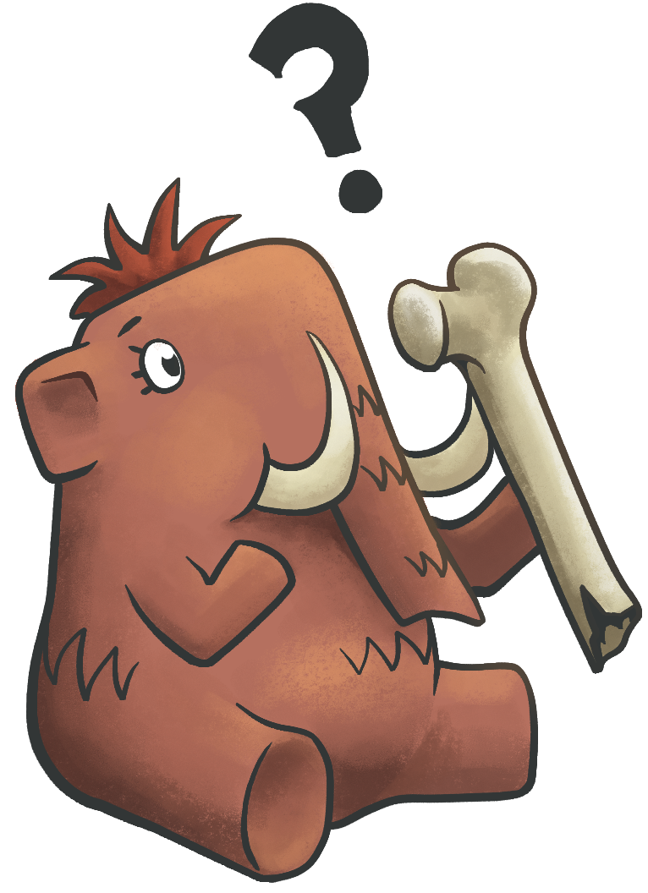
Which bone is it?
Let’s examine
real animal bones
from our A14 dig...
What animal is it from?
Can you see any marks or cuts?

Slide 14
Pottery making
Activity 2

Slide 15
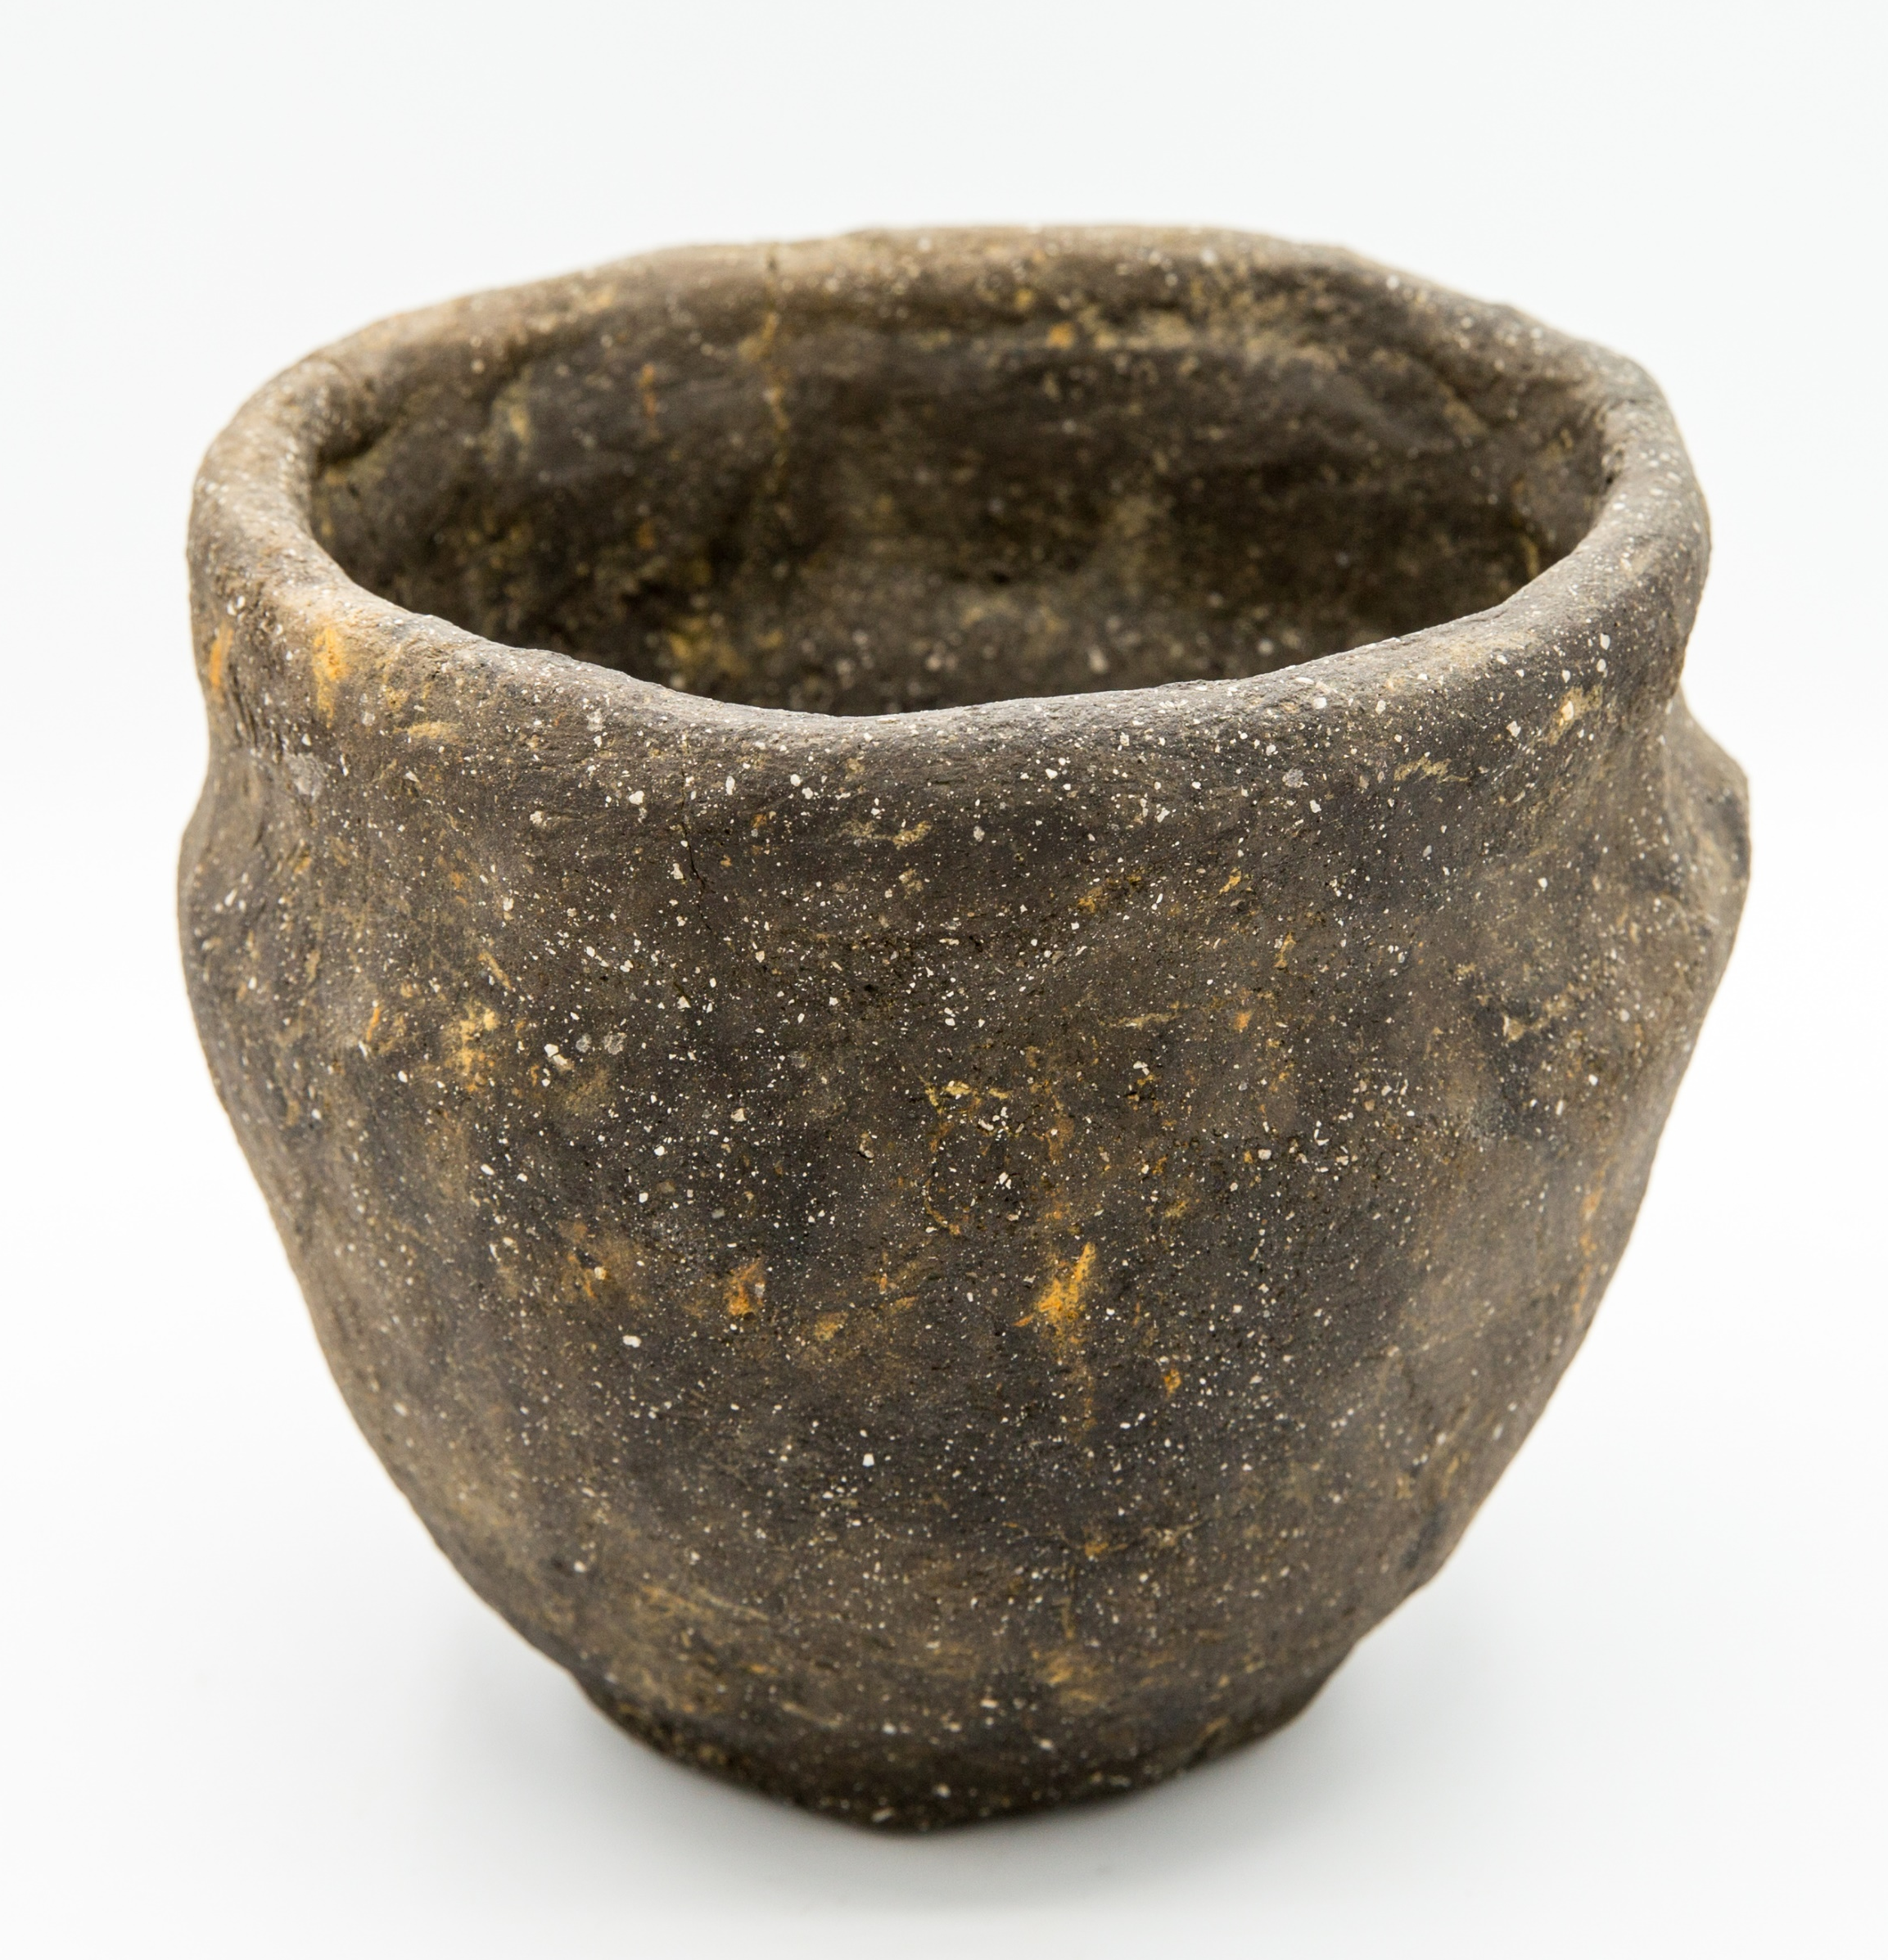
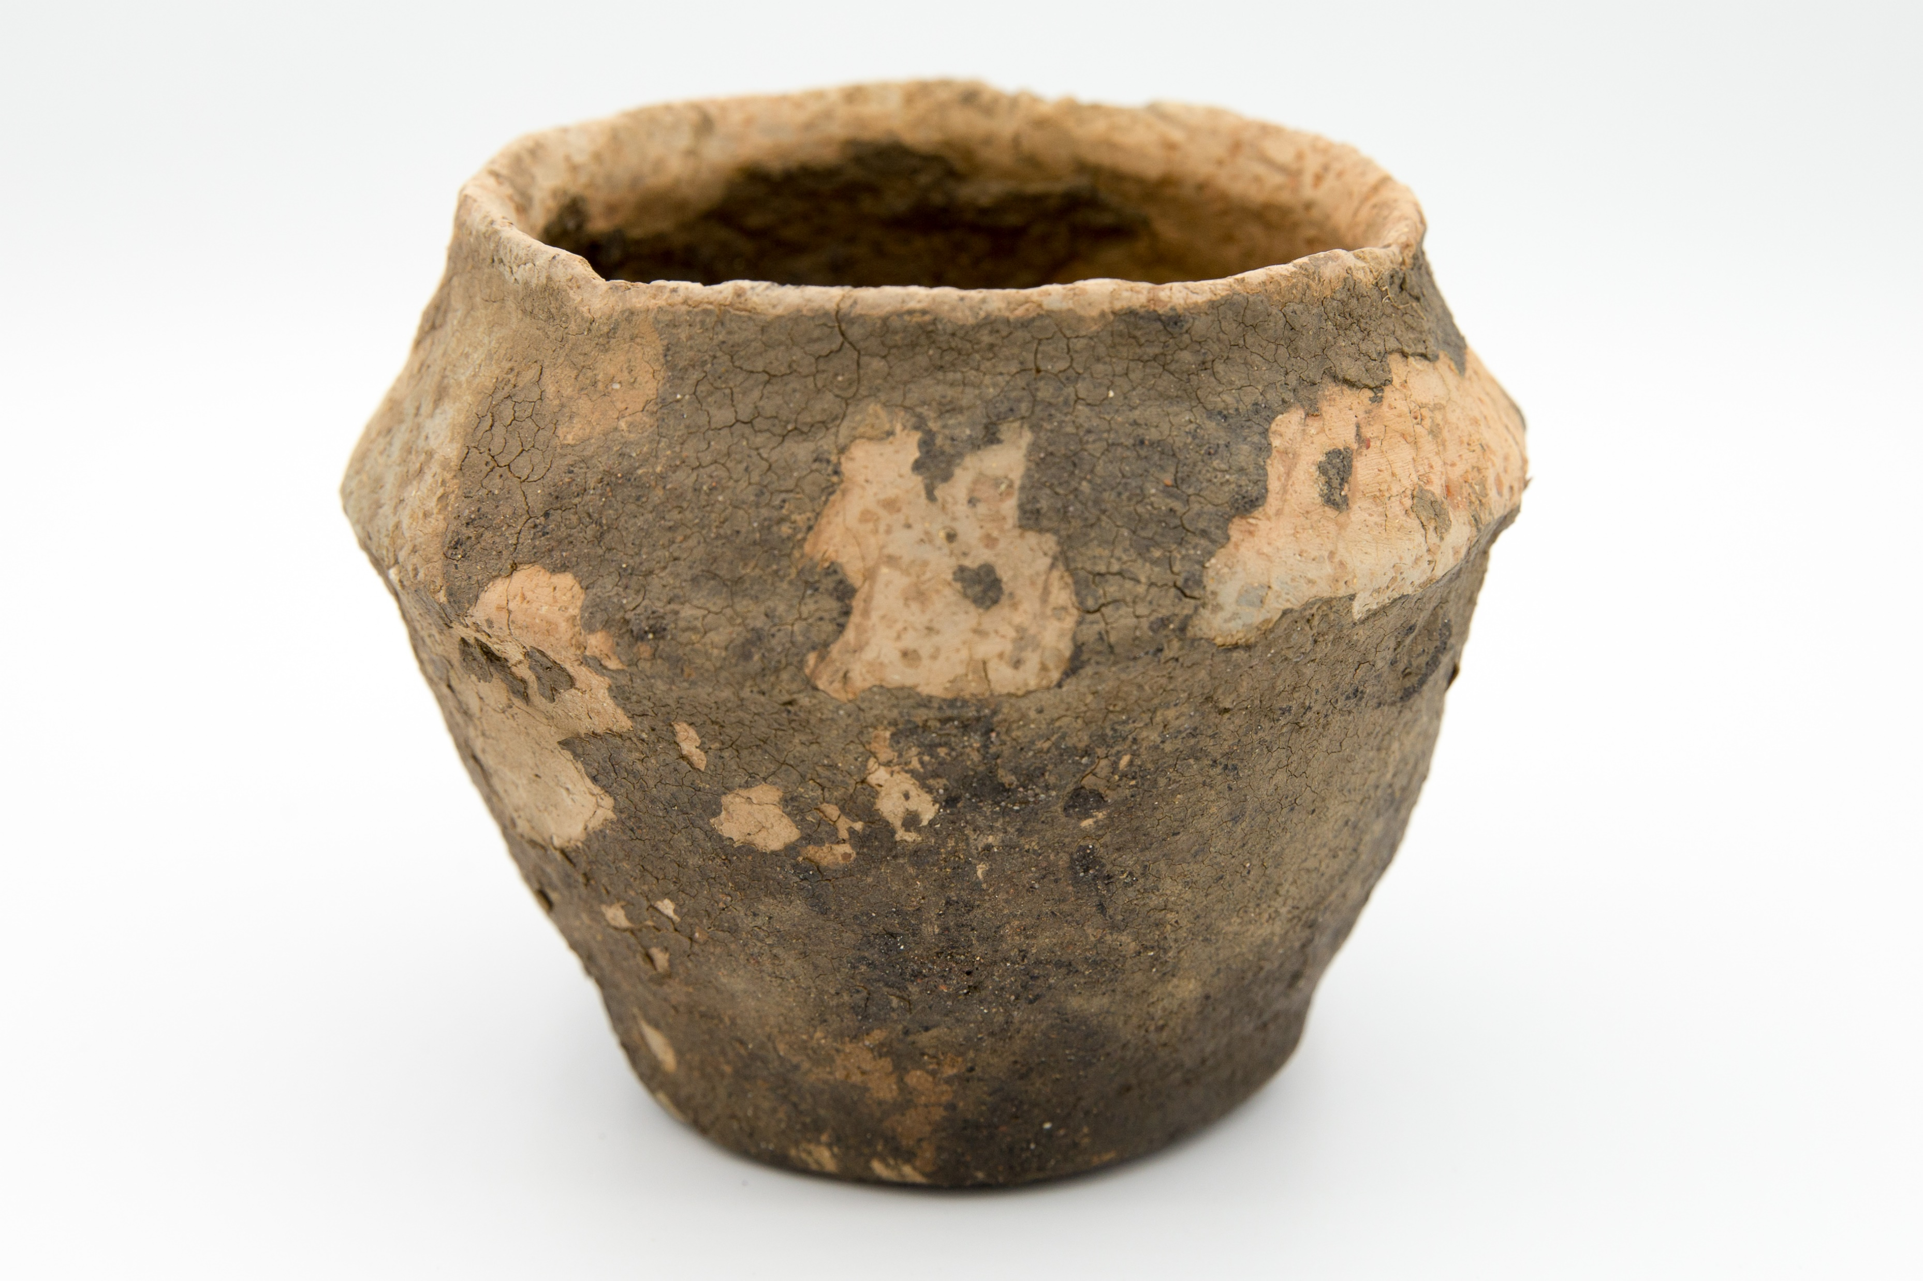
We also found lots of pottery;
most of it was used for eating and cooking.

Slide 16
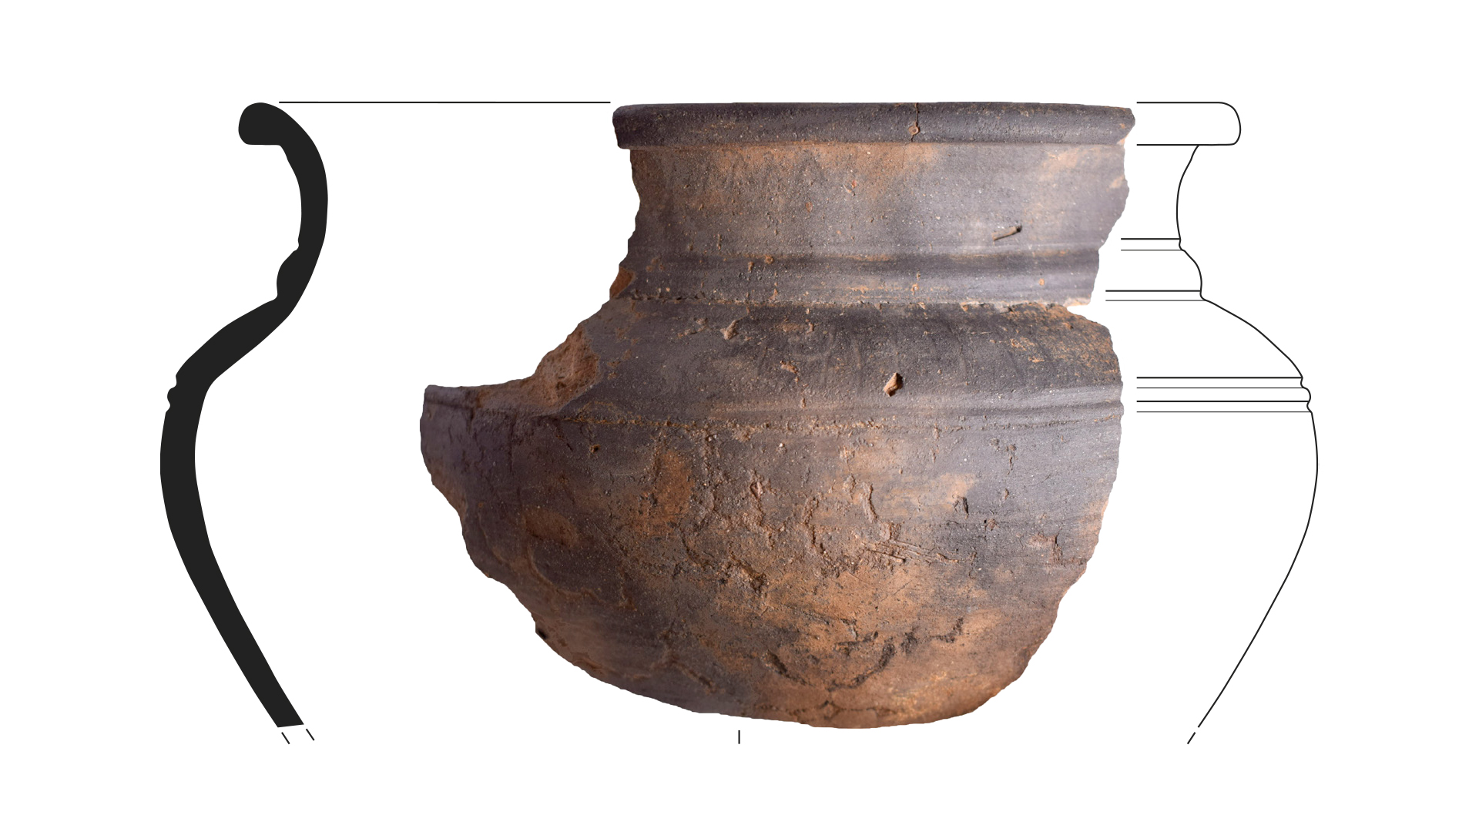
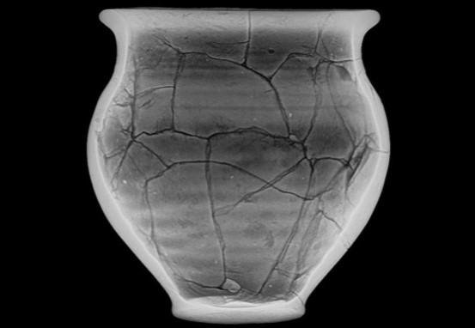
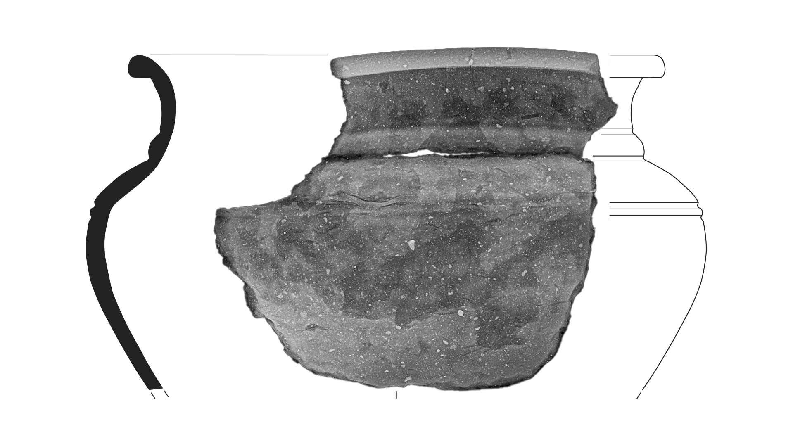
We’ve been using X-rays to
look inside these pots!
These lines show us this pot was made by coiling long ropes of clay

Slide 17
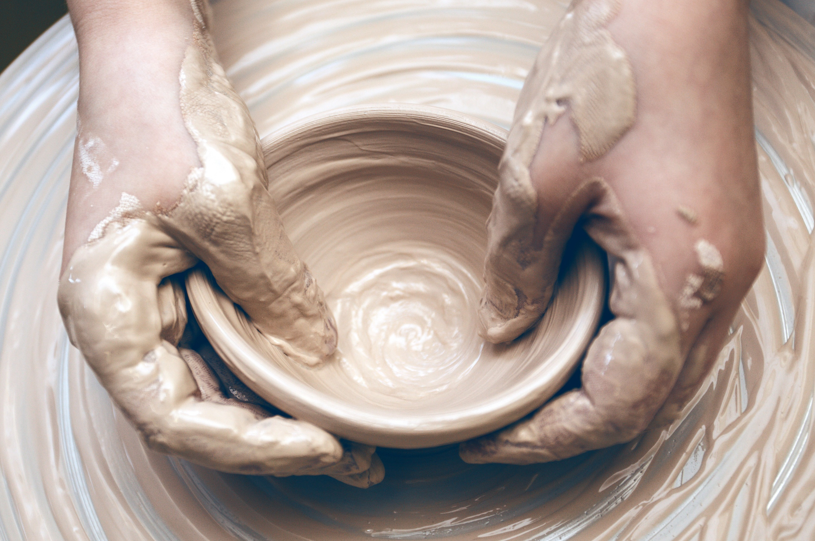
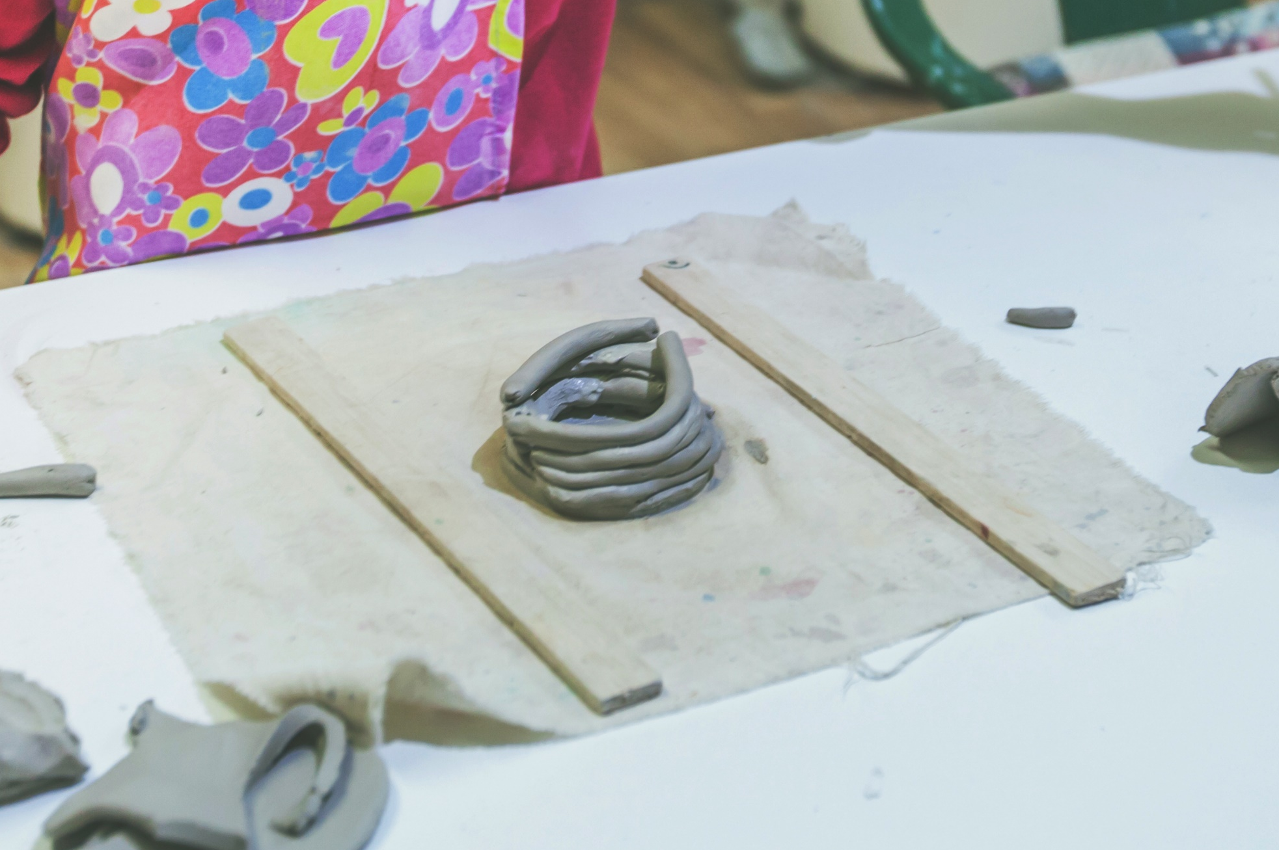
Pinch pots​
or​
Clay coil pots ​
Roll out long “ropes” of clay.
Stack them in circles on top of each other
and pinch them together.
Pinch the ball of clay between your
thumb and fingers to form a bowl shape.

Slide 18

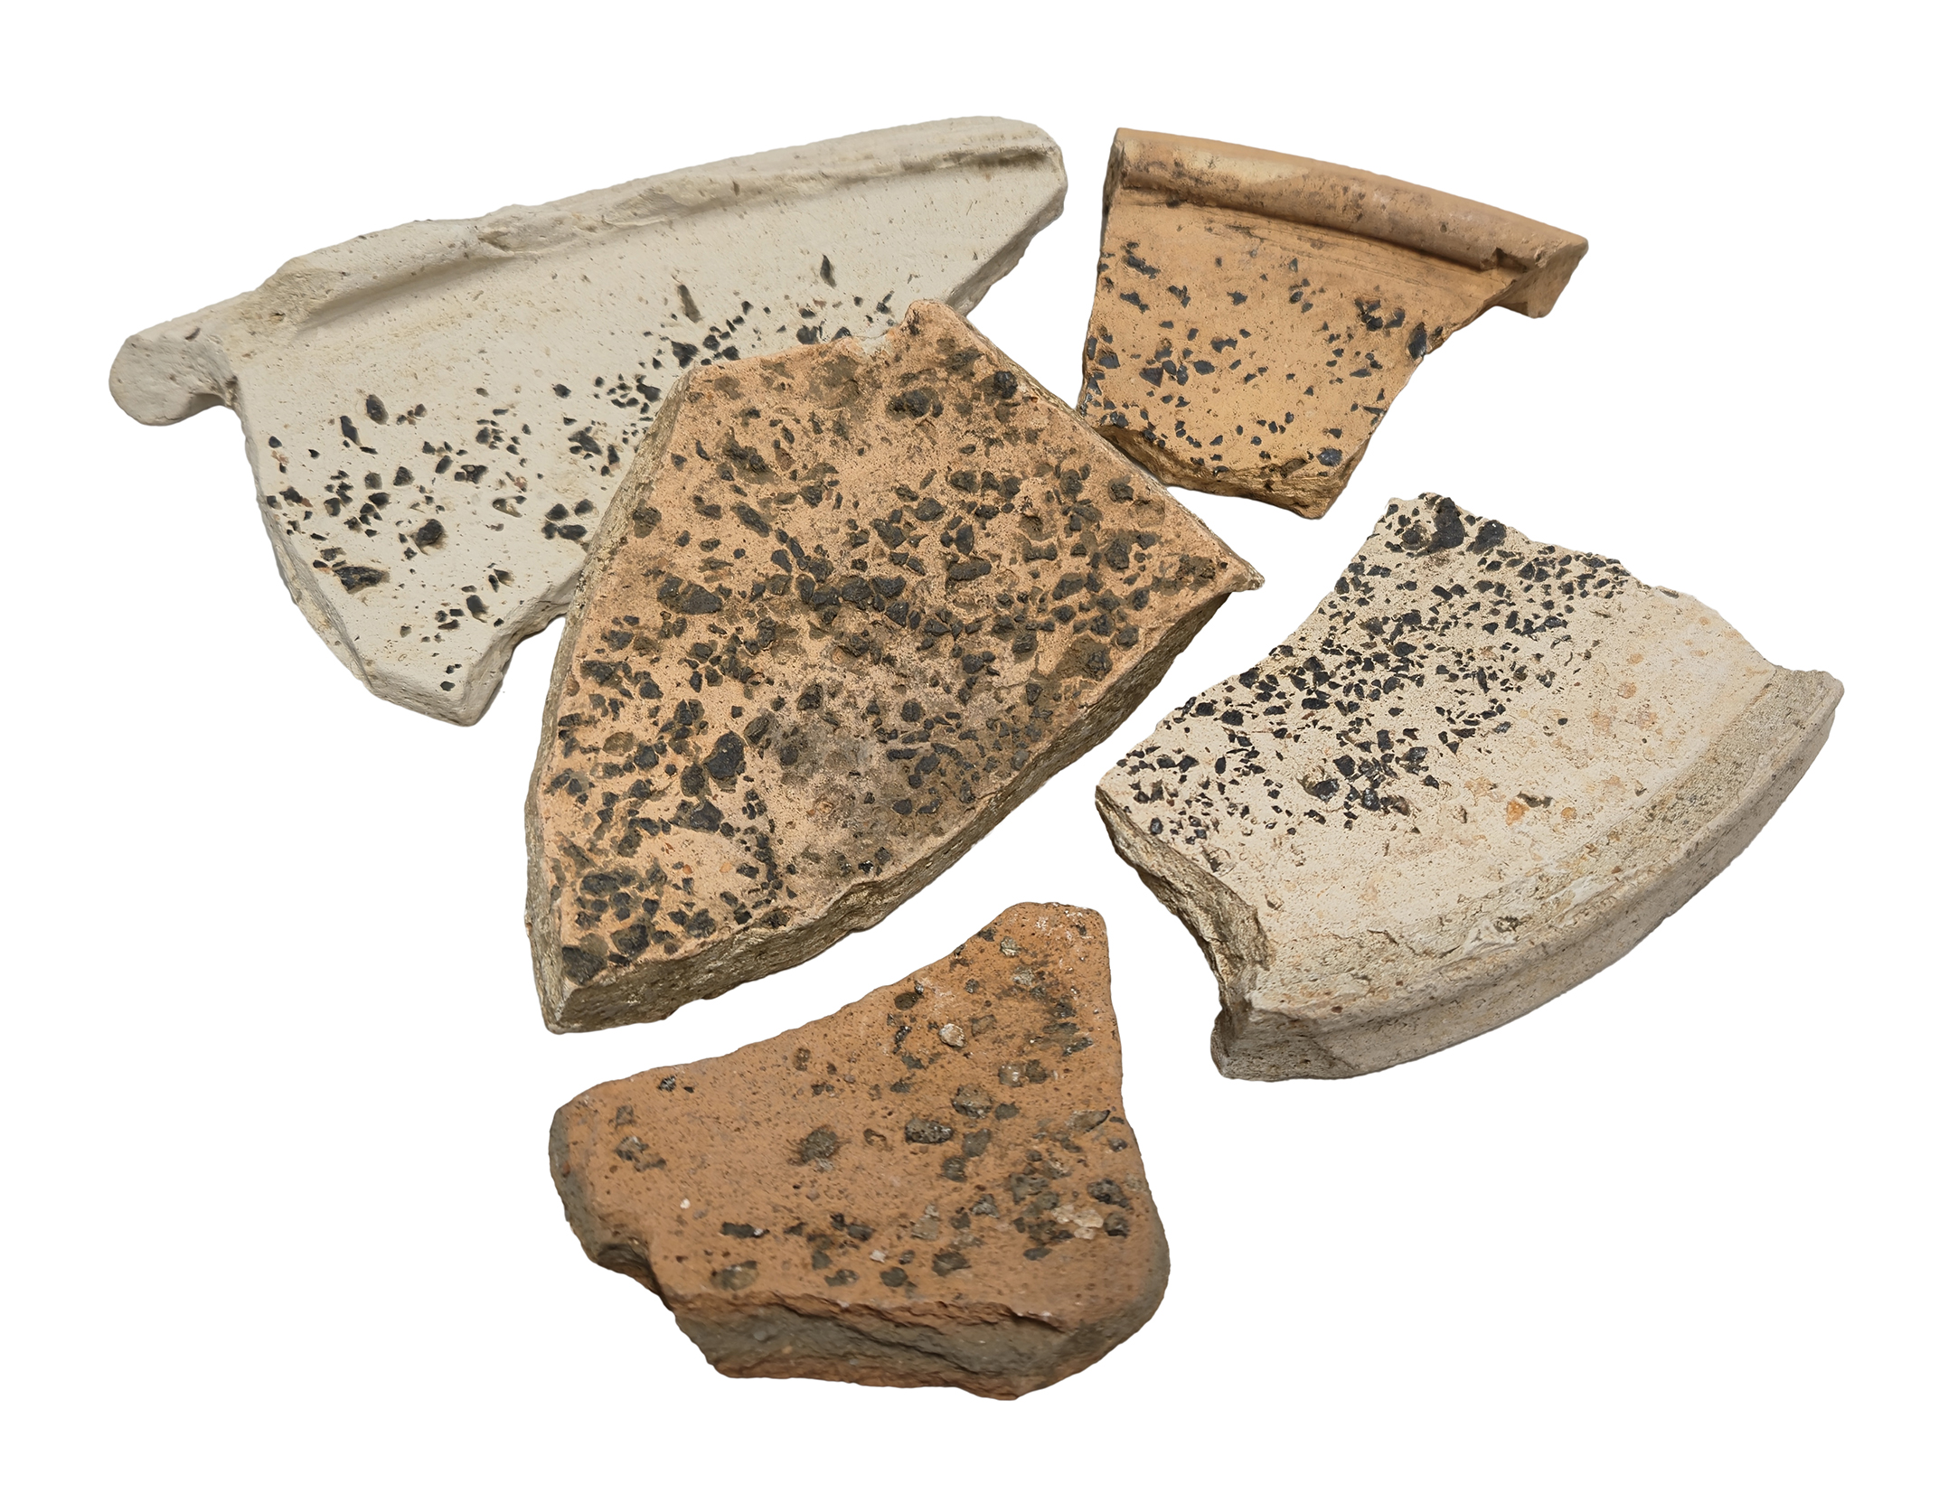
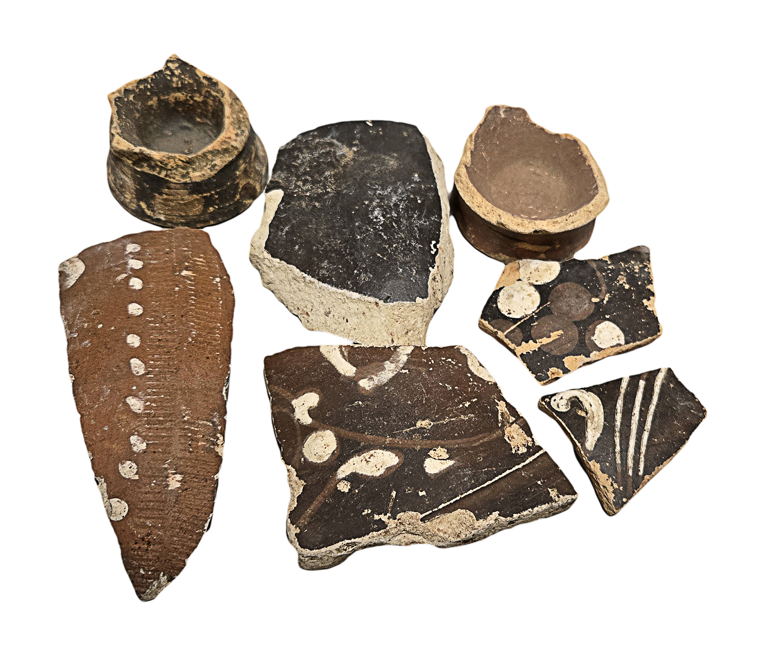
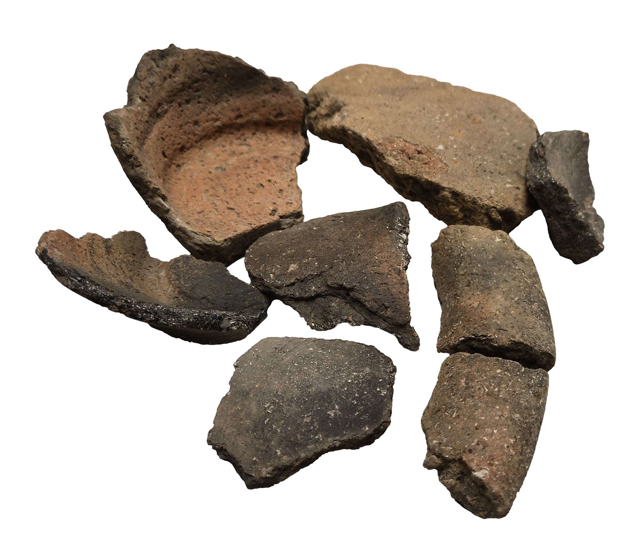
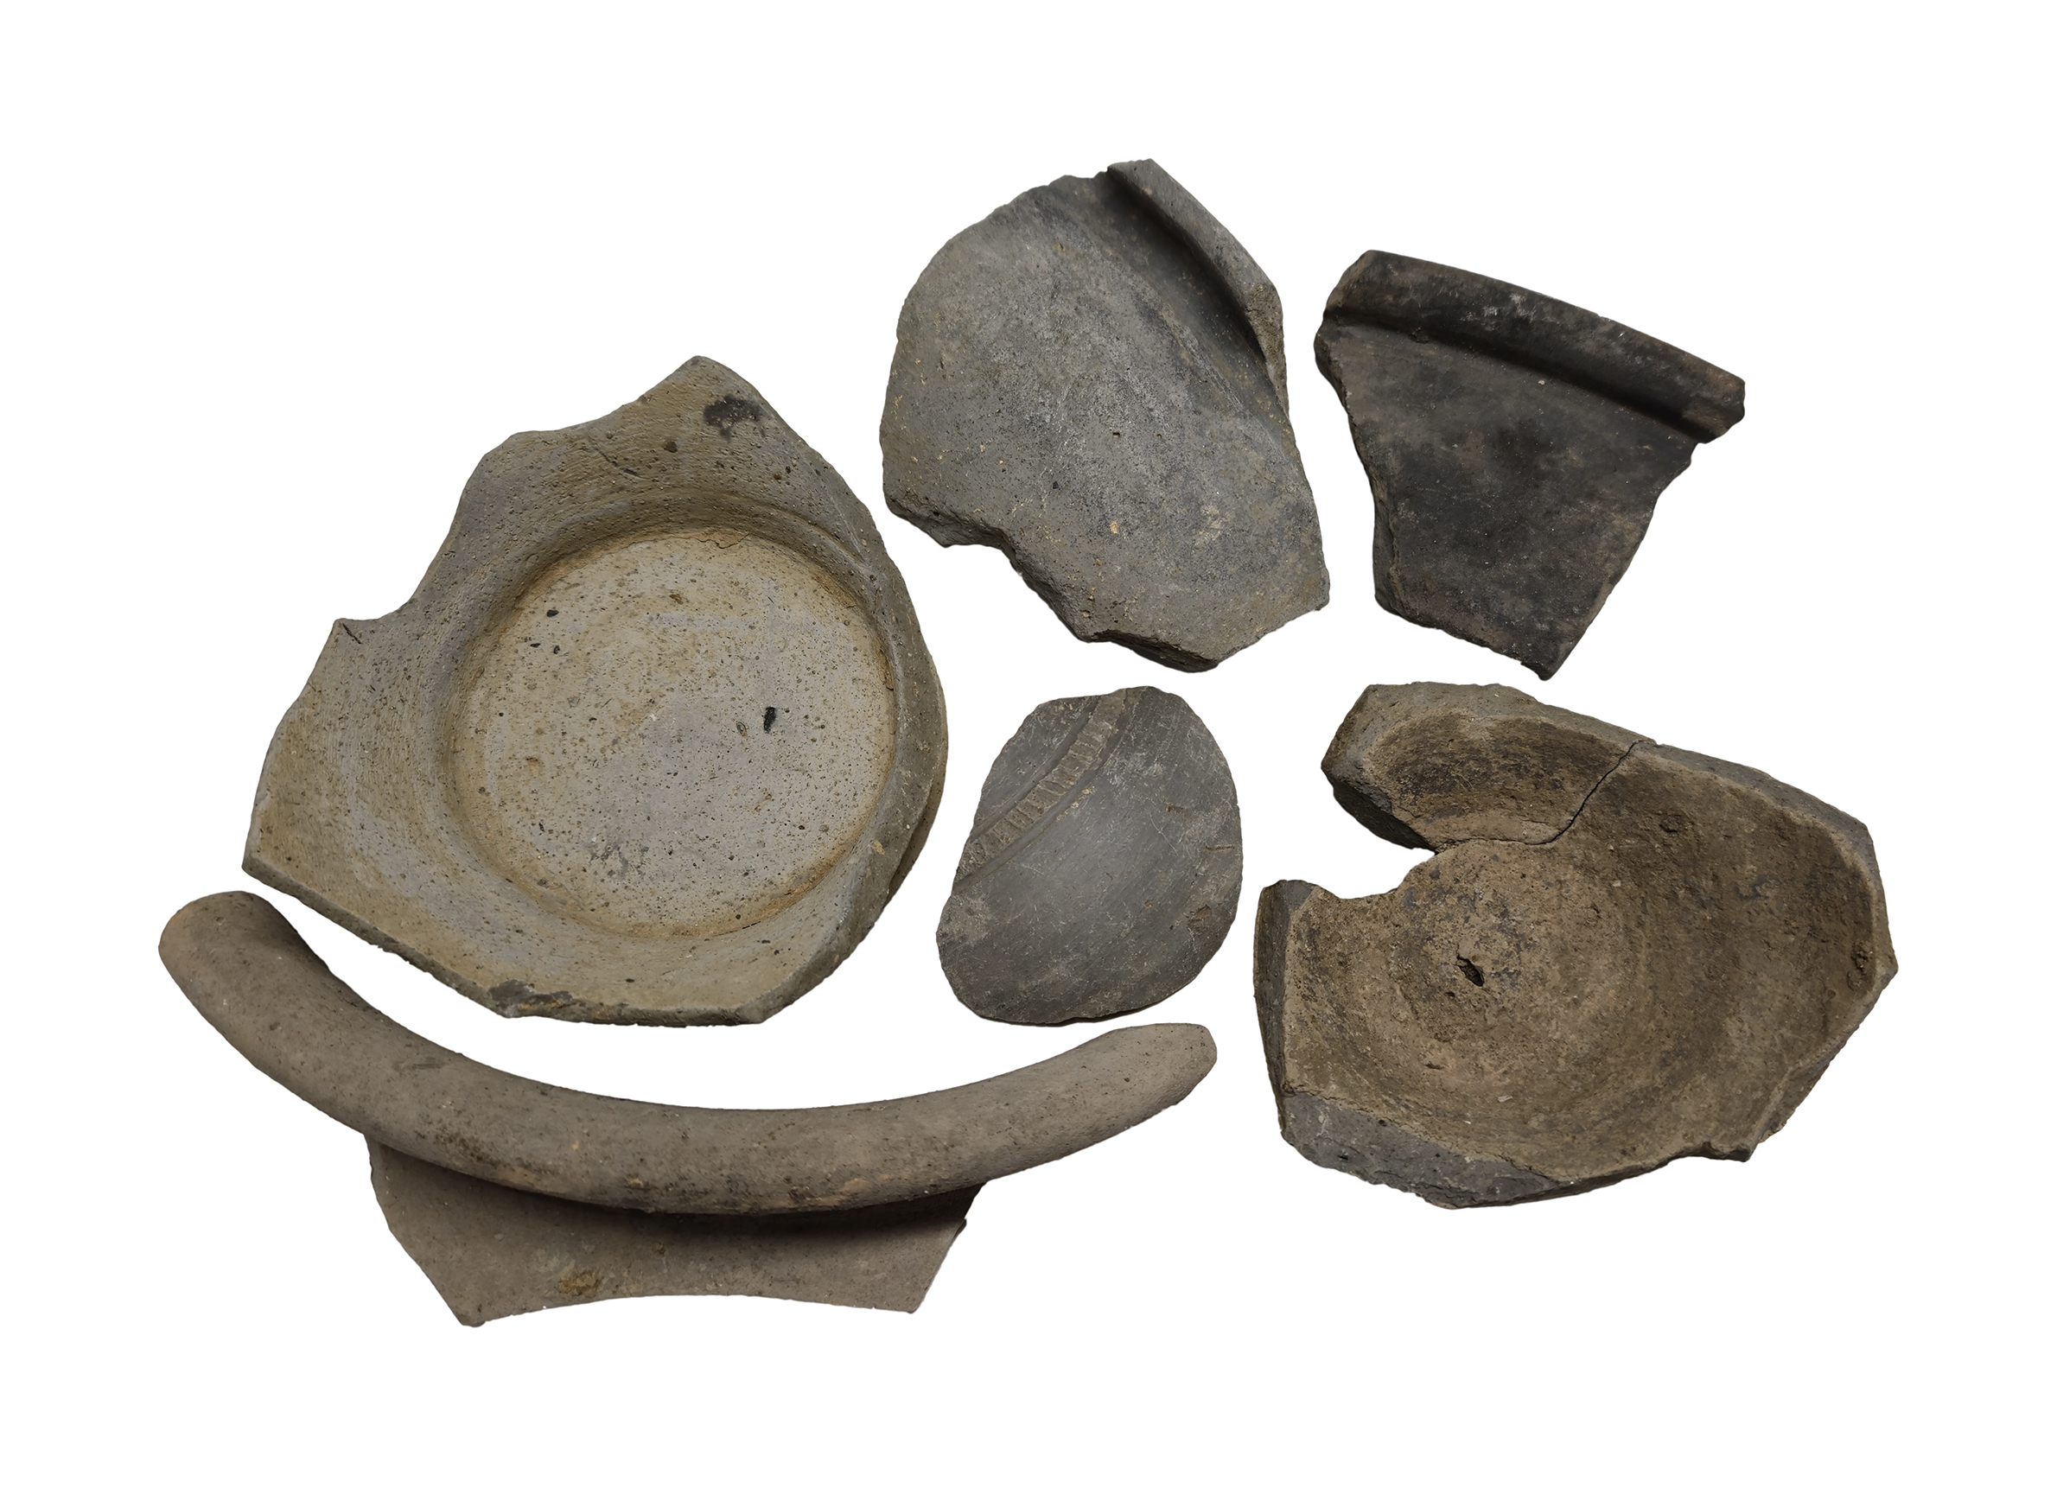
Pottery in the box​
MORTARIA
COLOUR COATED WARE
SHELL TEMPERED
GREYWARES

