Slide 1
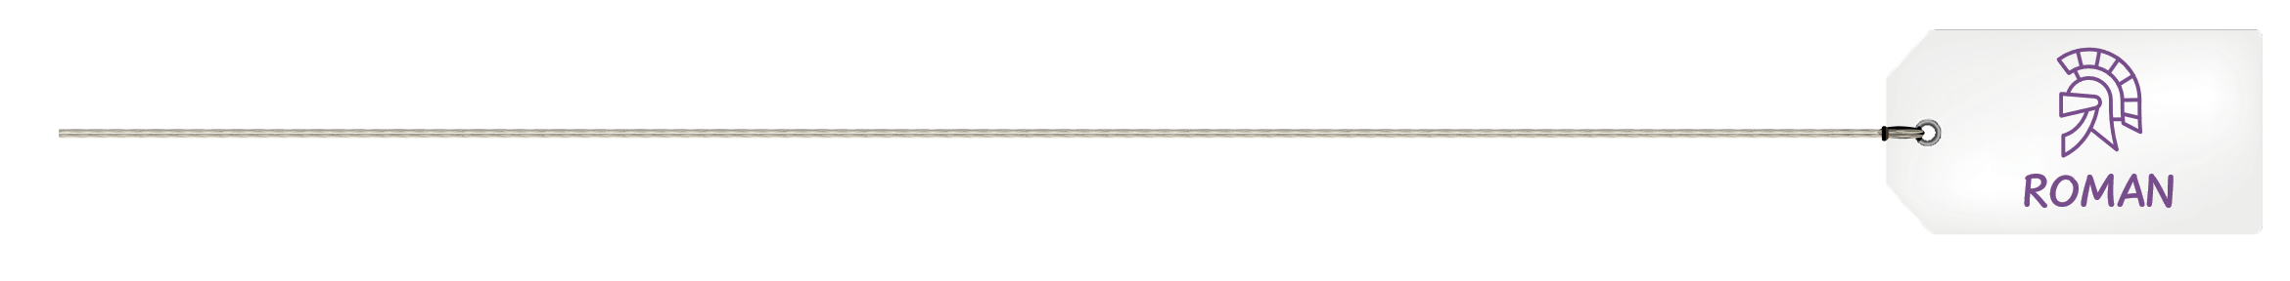
Arrival of
the Romans

Slide 2
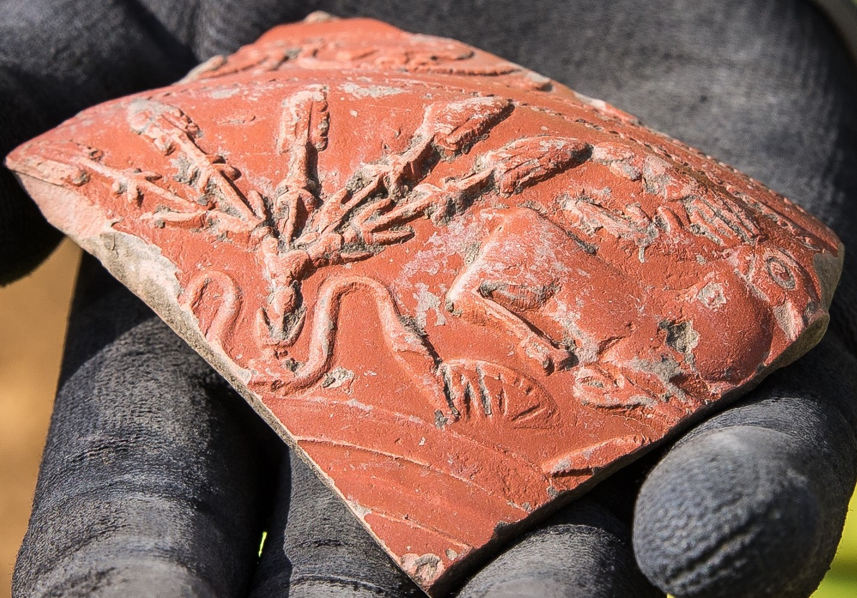
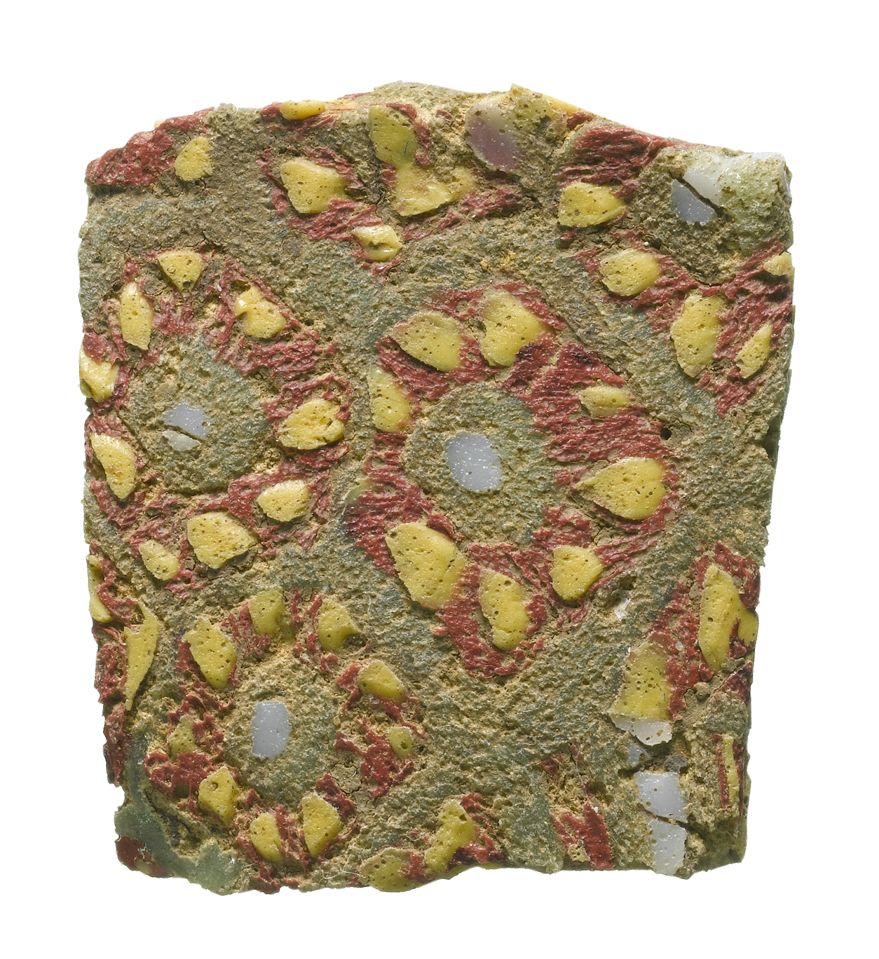


CE 43 - 410
ROMAN PERIOD
Decorated Samian ware pottery
Roman glass
Roman spoon
People in Cambridgeshire traded with the Roman Empire before they invaded

Slide 3

The Romans brought over 50 new foods to Britain.

Slide 4
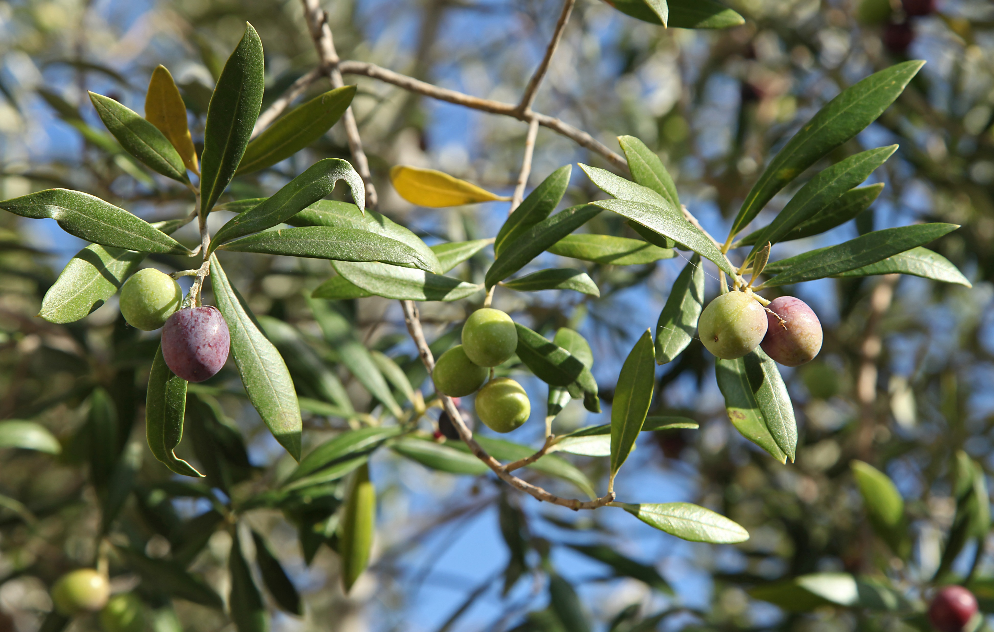
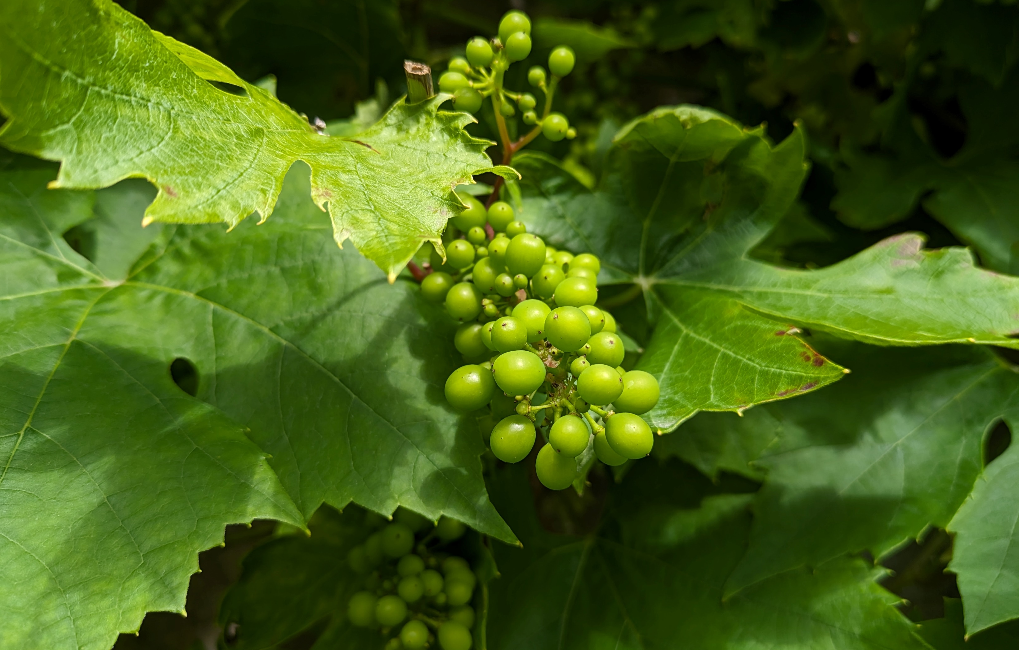
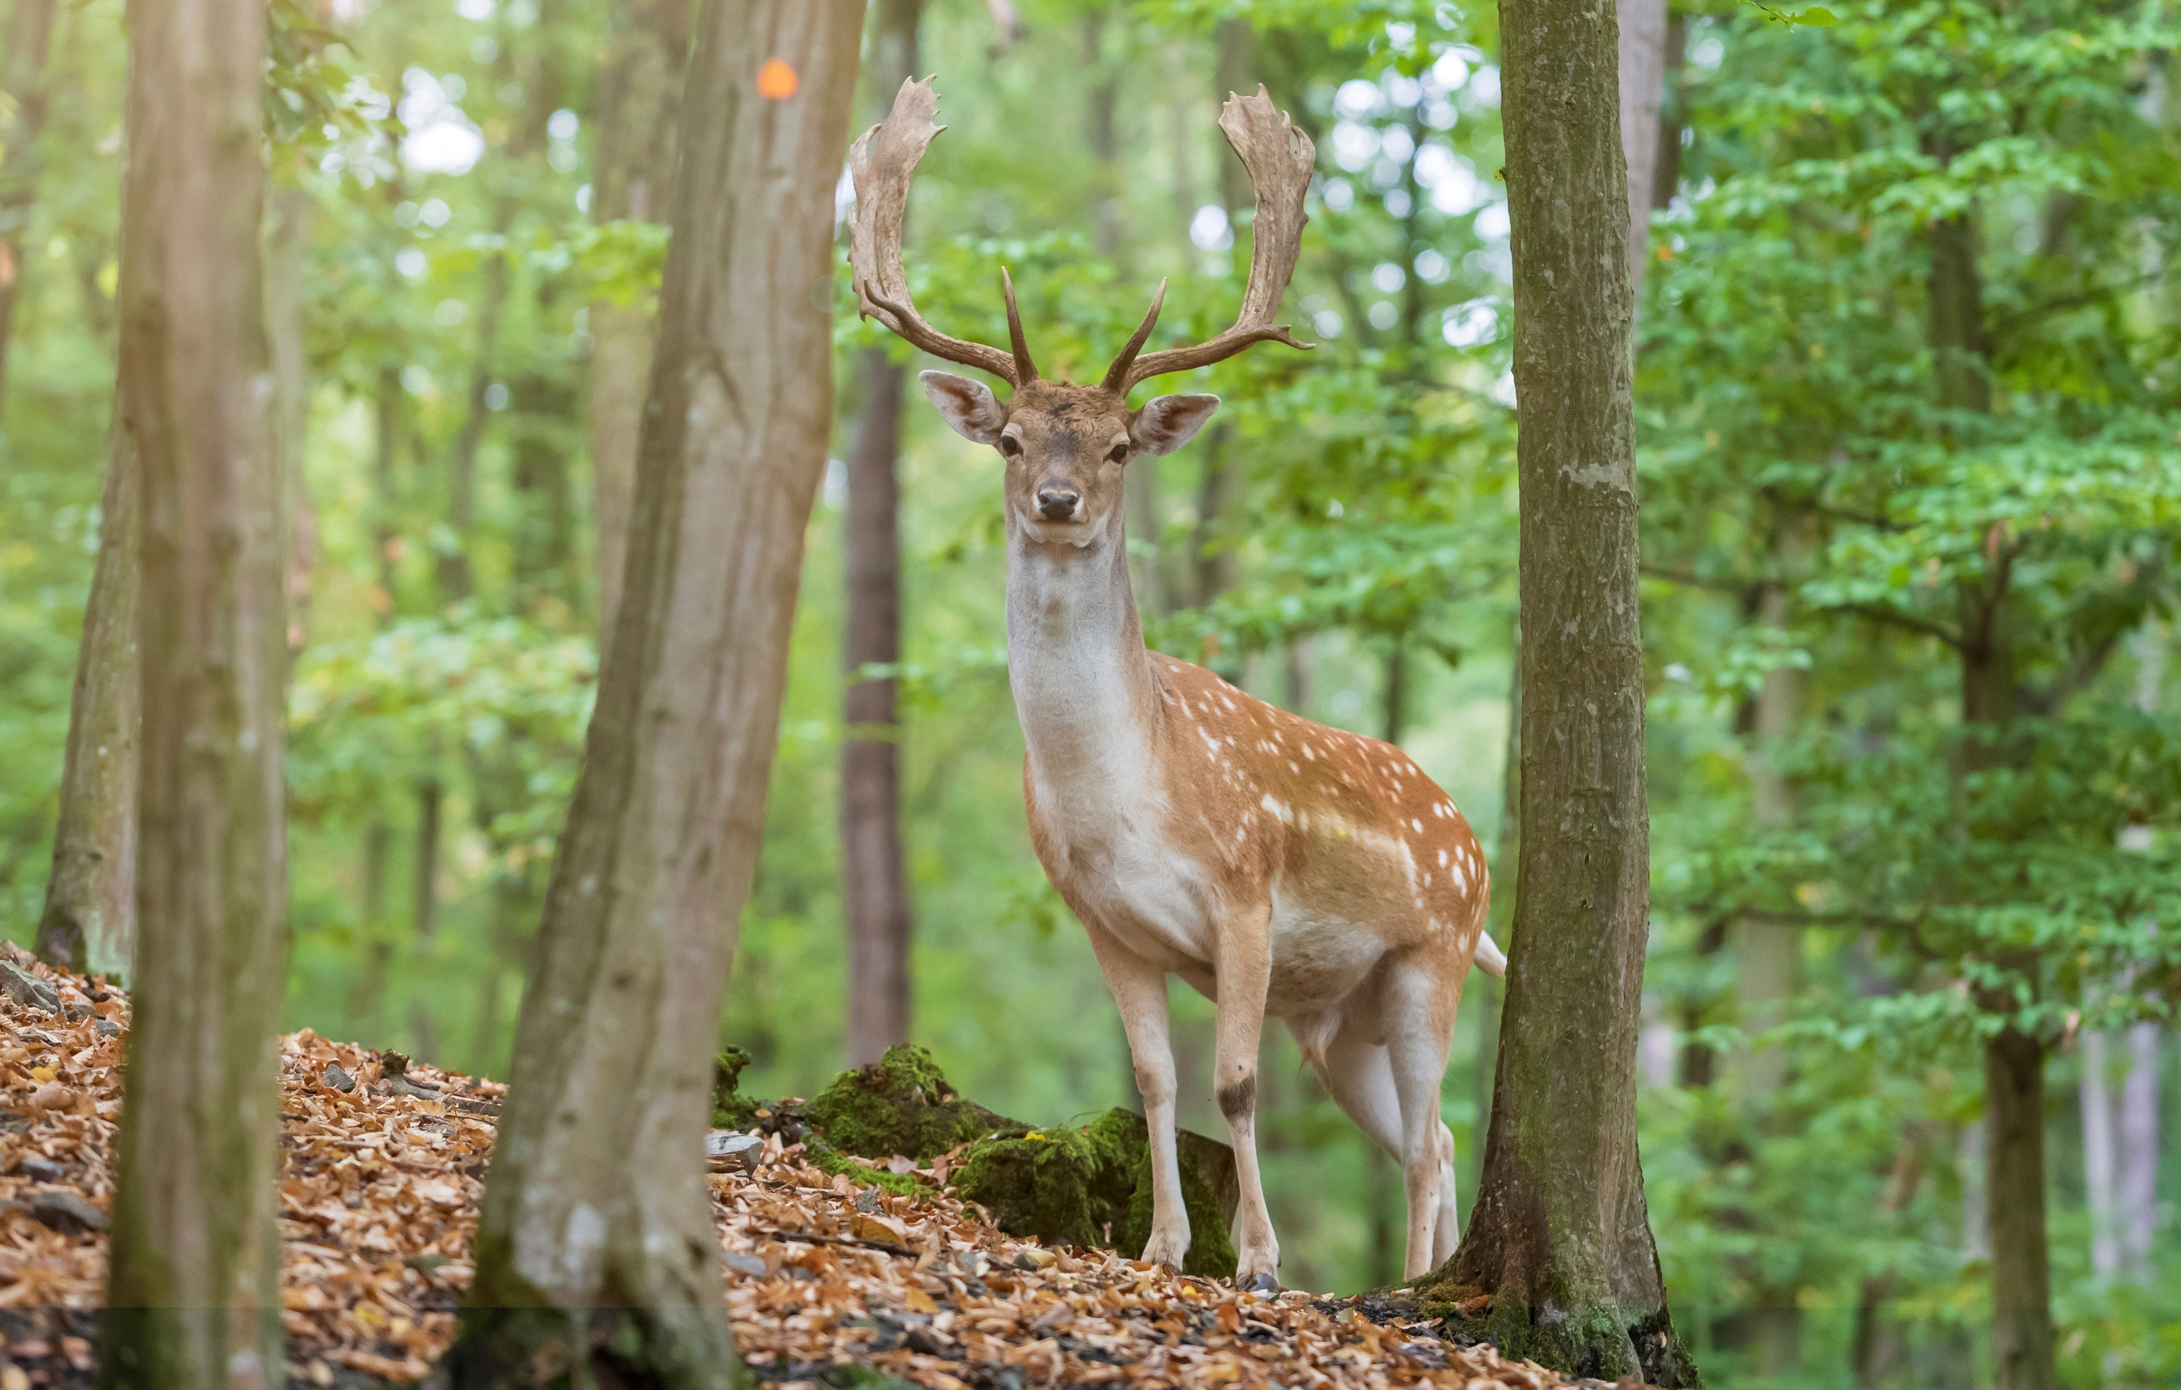
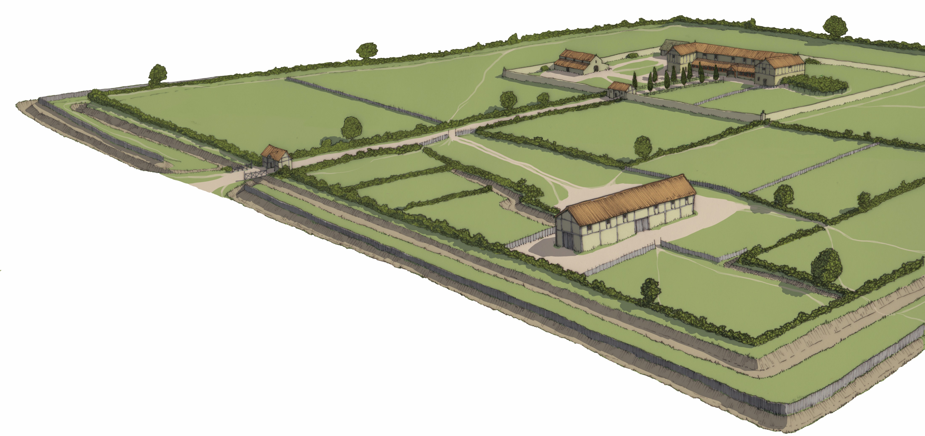

At a Roman estate near the River Great Ouse we found:
Olive stone
Grape pip
Fallow deer bone
It seems like the estate
was home to a wealthy, possibly
important, family!

Slide 5
Now it’s your turn!
Roman activities

Slide 6
Roman coins
Activity 3

Slide 7
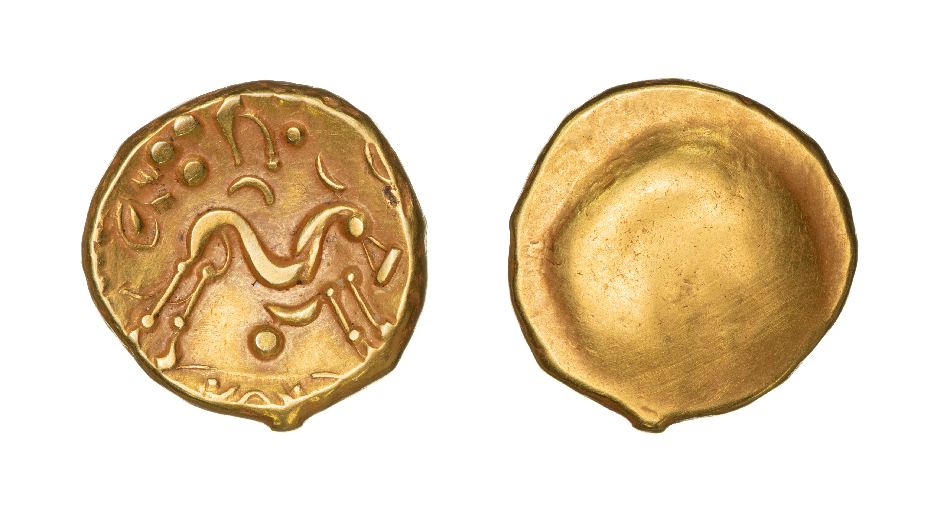
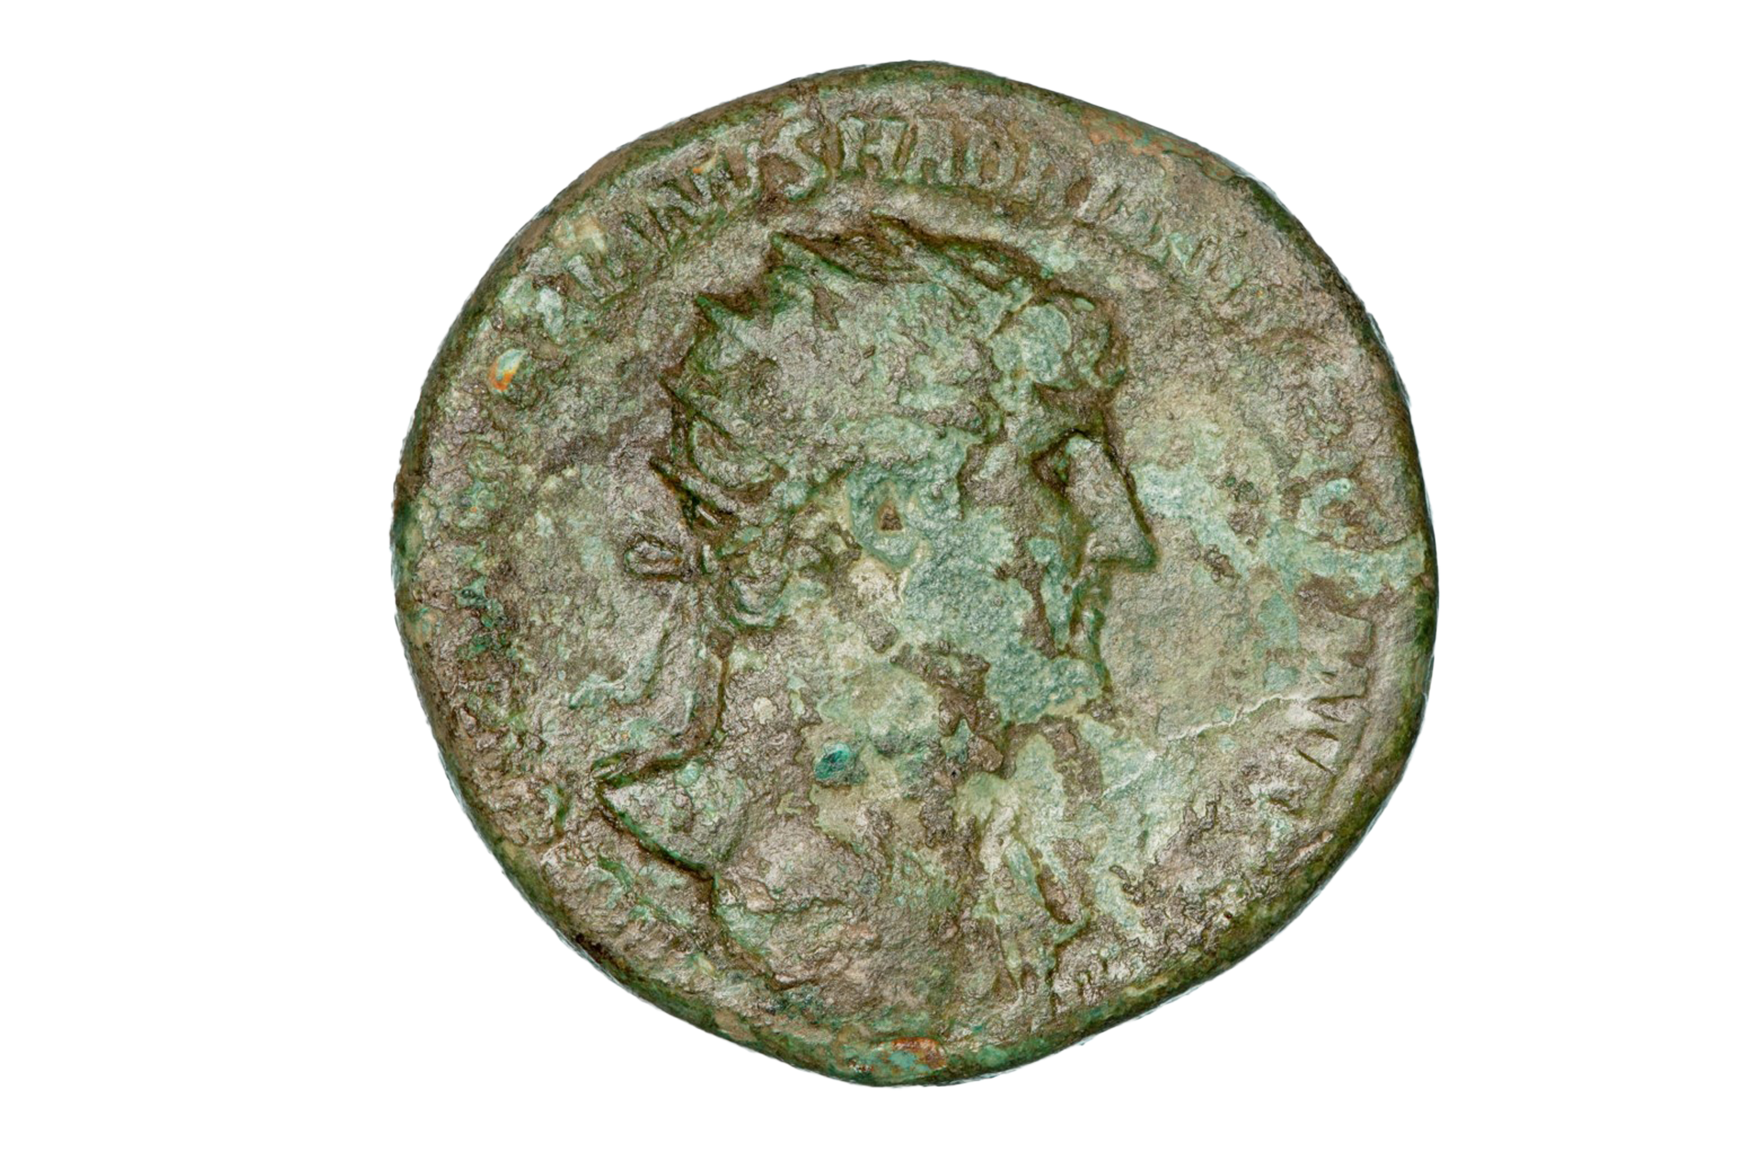
All about coins​
PRE-ROMAN
ROMAN
Coins meant people could
buy and sell things across the whole Roman Empire from Britain to North Africa​
This is a very rare gold coin
from the Iron Age
Do you know that we found almost 1000 coins during our A14 excavations​ (988 to be exact)?

Slide 8
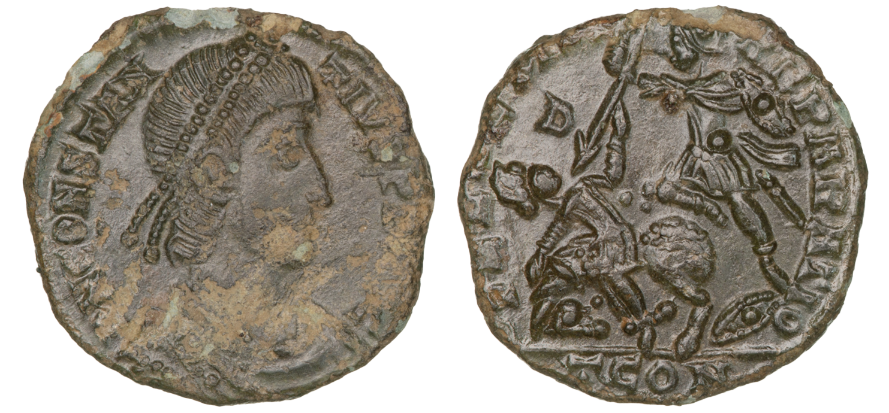
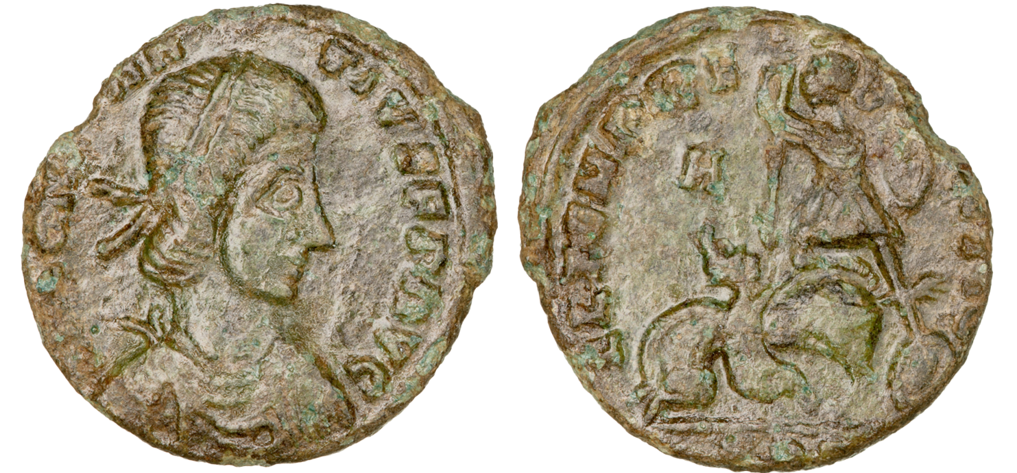
Originals or copies?​
Which do you think is the official coin and why? ​

Slide 9
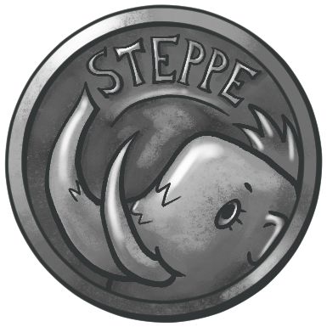
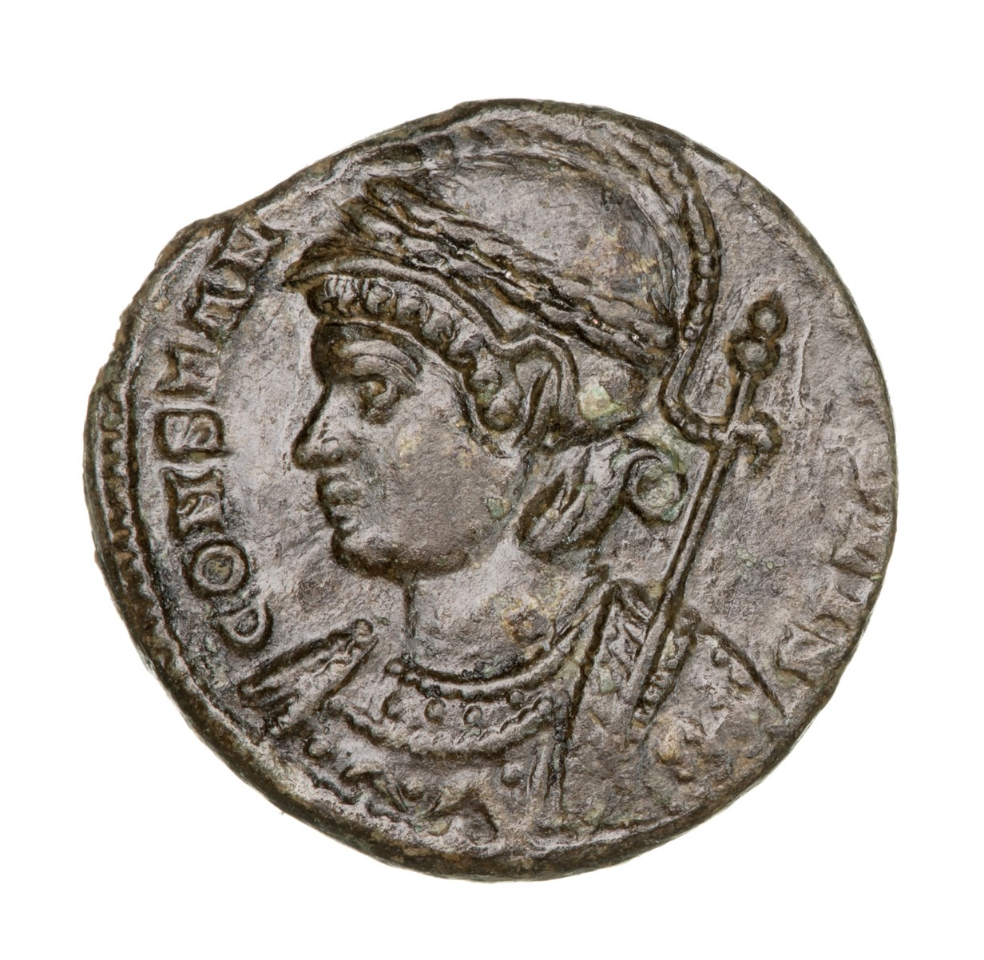
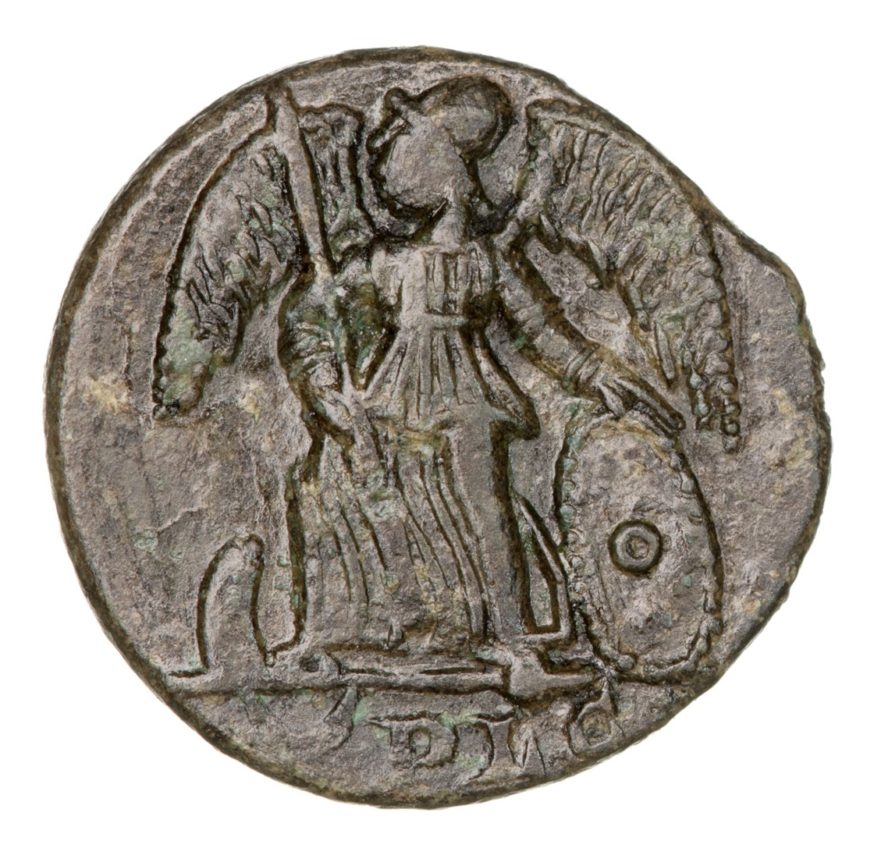
Draw your own coin!​
Draw a picture of yourself wearing a crown or a helmet.
Make sure to show that you look like a very important person!
On the other side of your coin,
draw something that represents you!
FRONT
BACK
Then write your name around the edge.
You can add us, rius, a, or ria to make your name sound Roman!
This could be your favourite animal, or something ​
that you enjoy or are proud of.

Slide 10
Snakes and Ladders
Activity 4

Slide 11

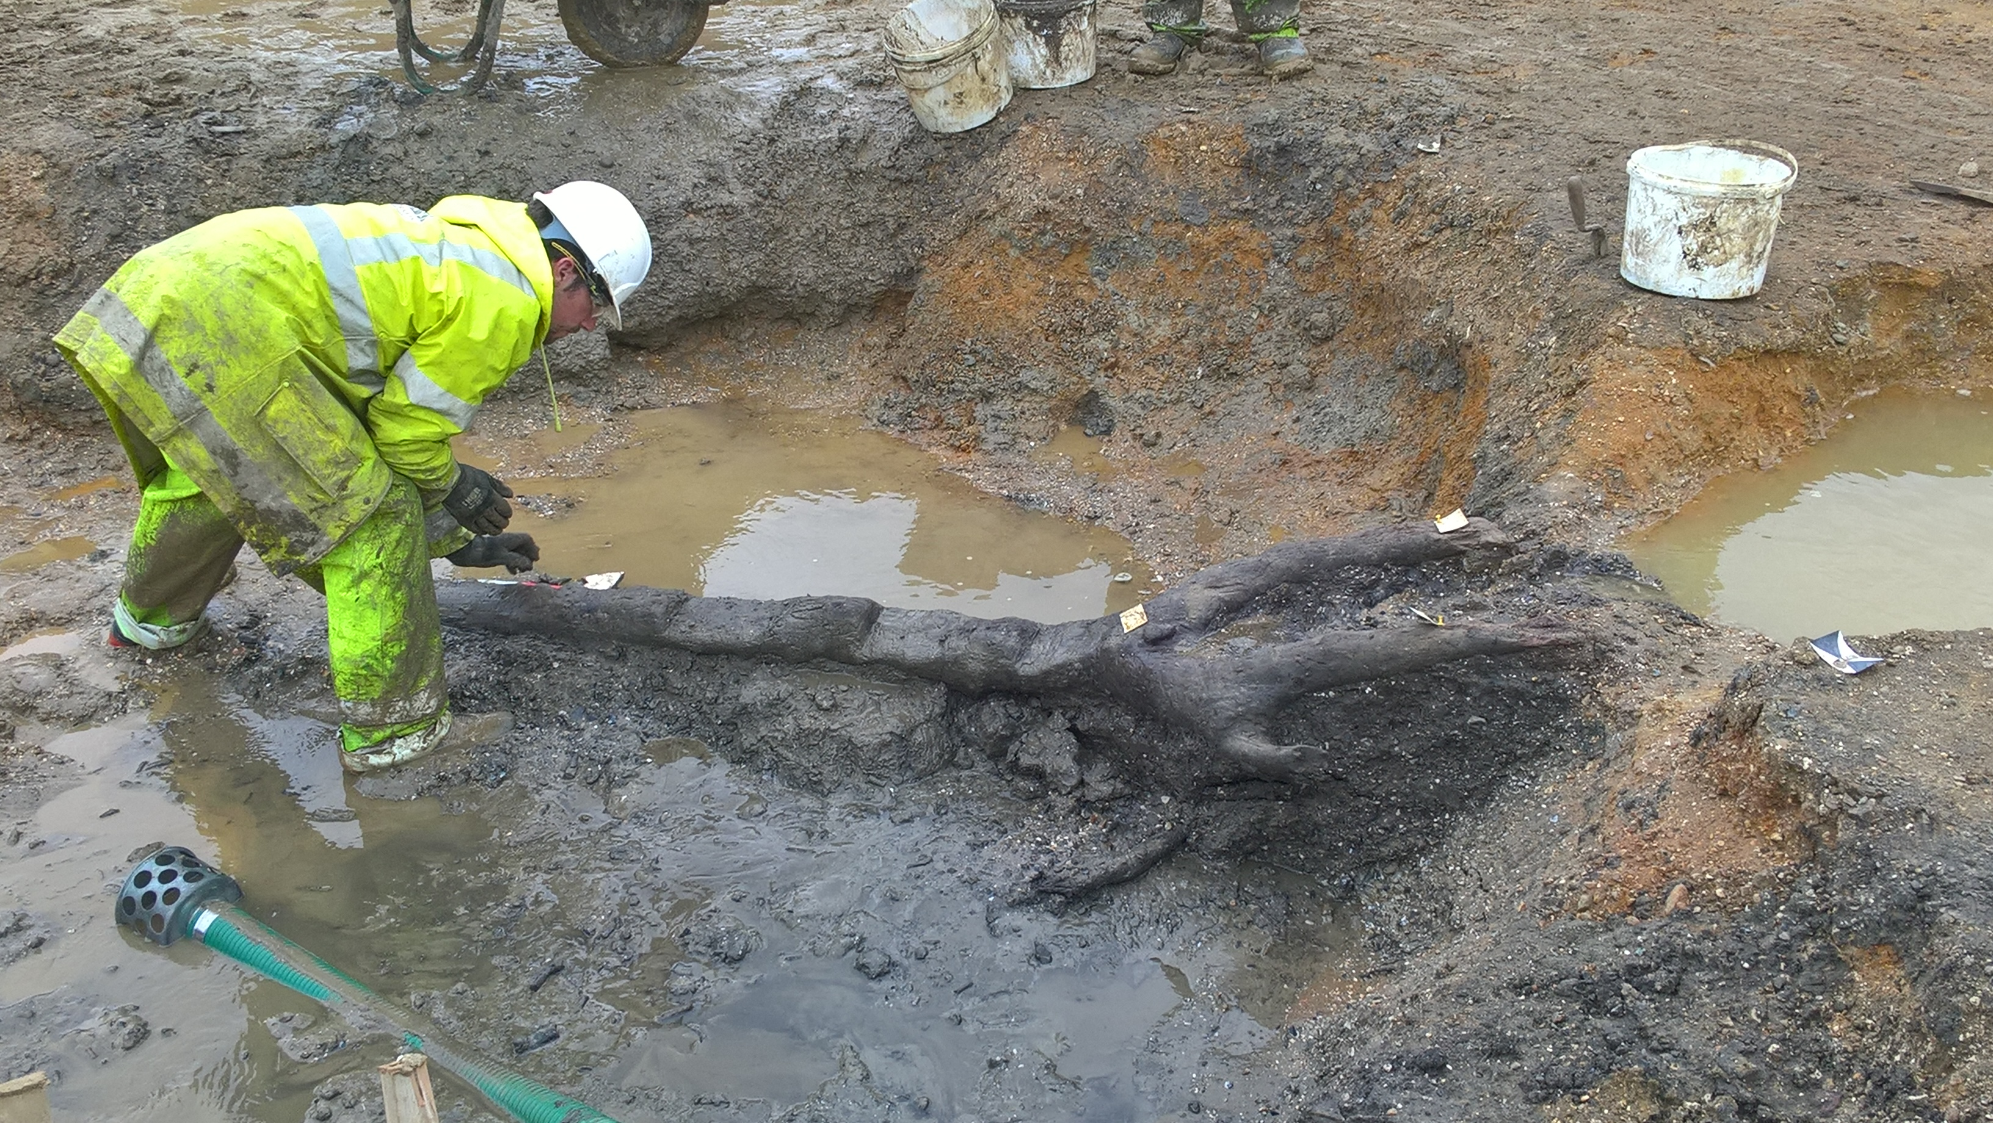
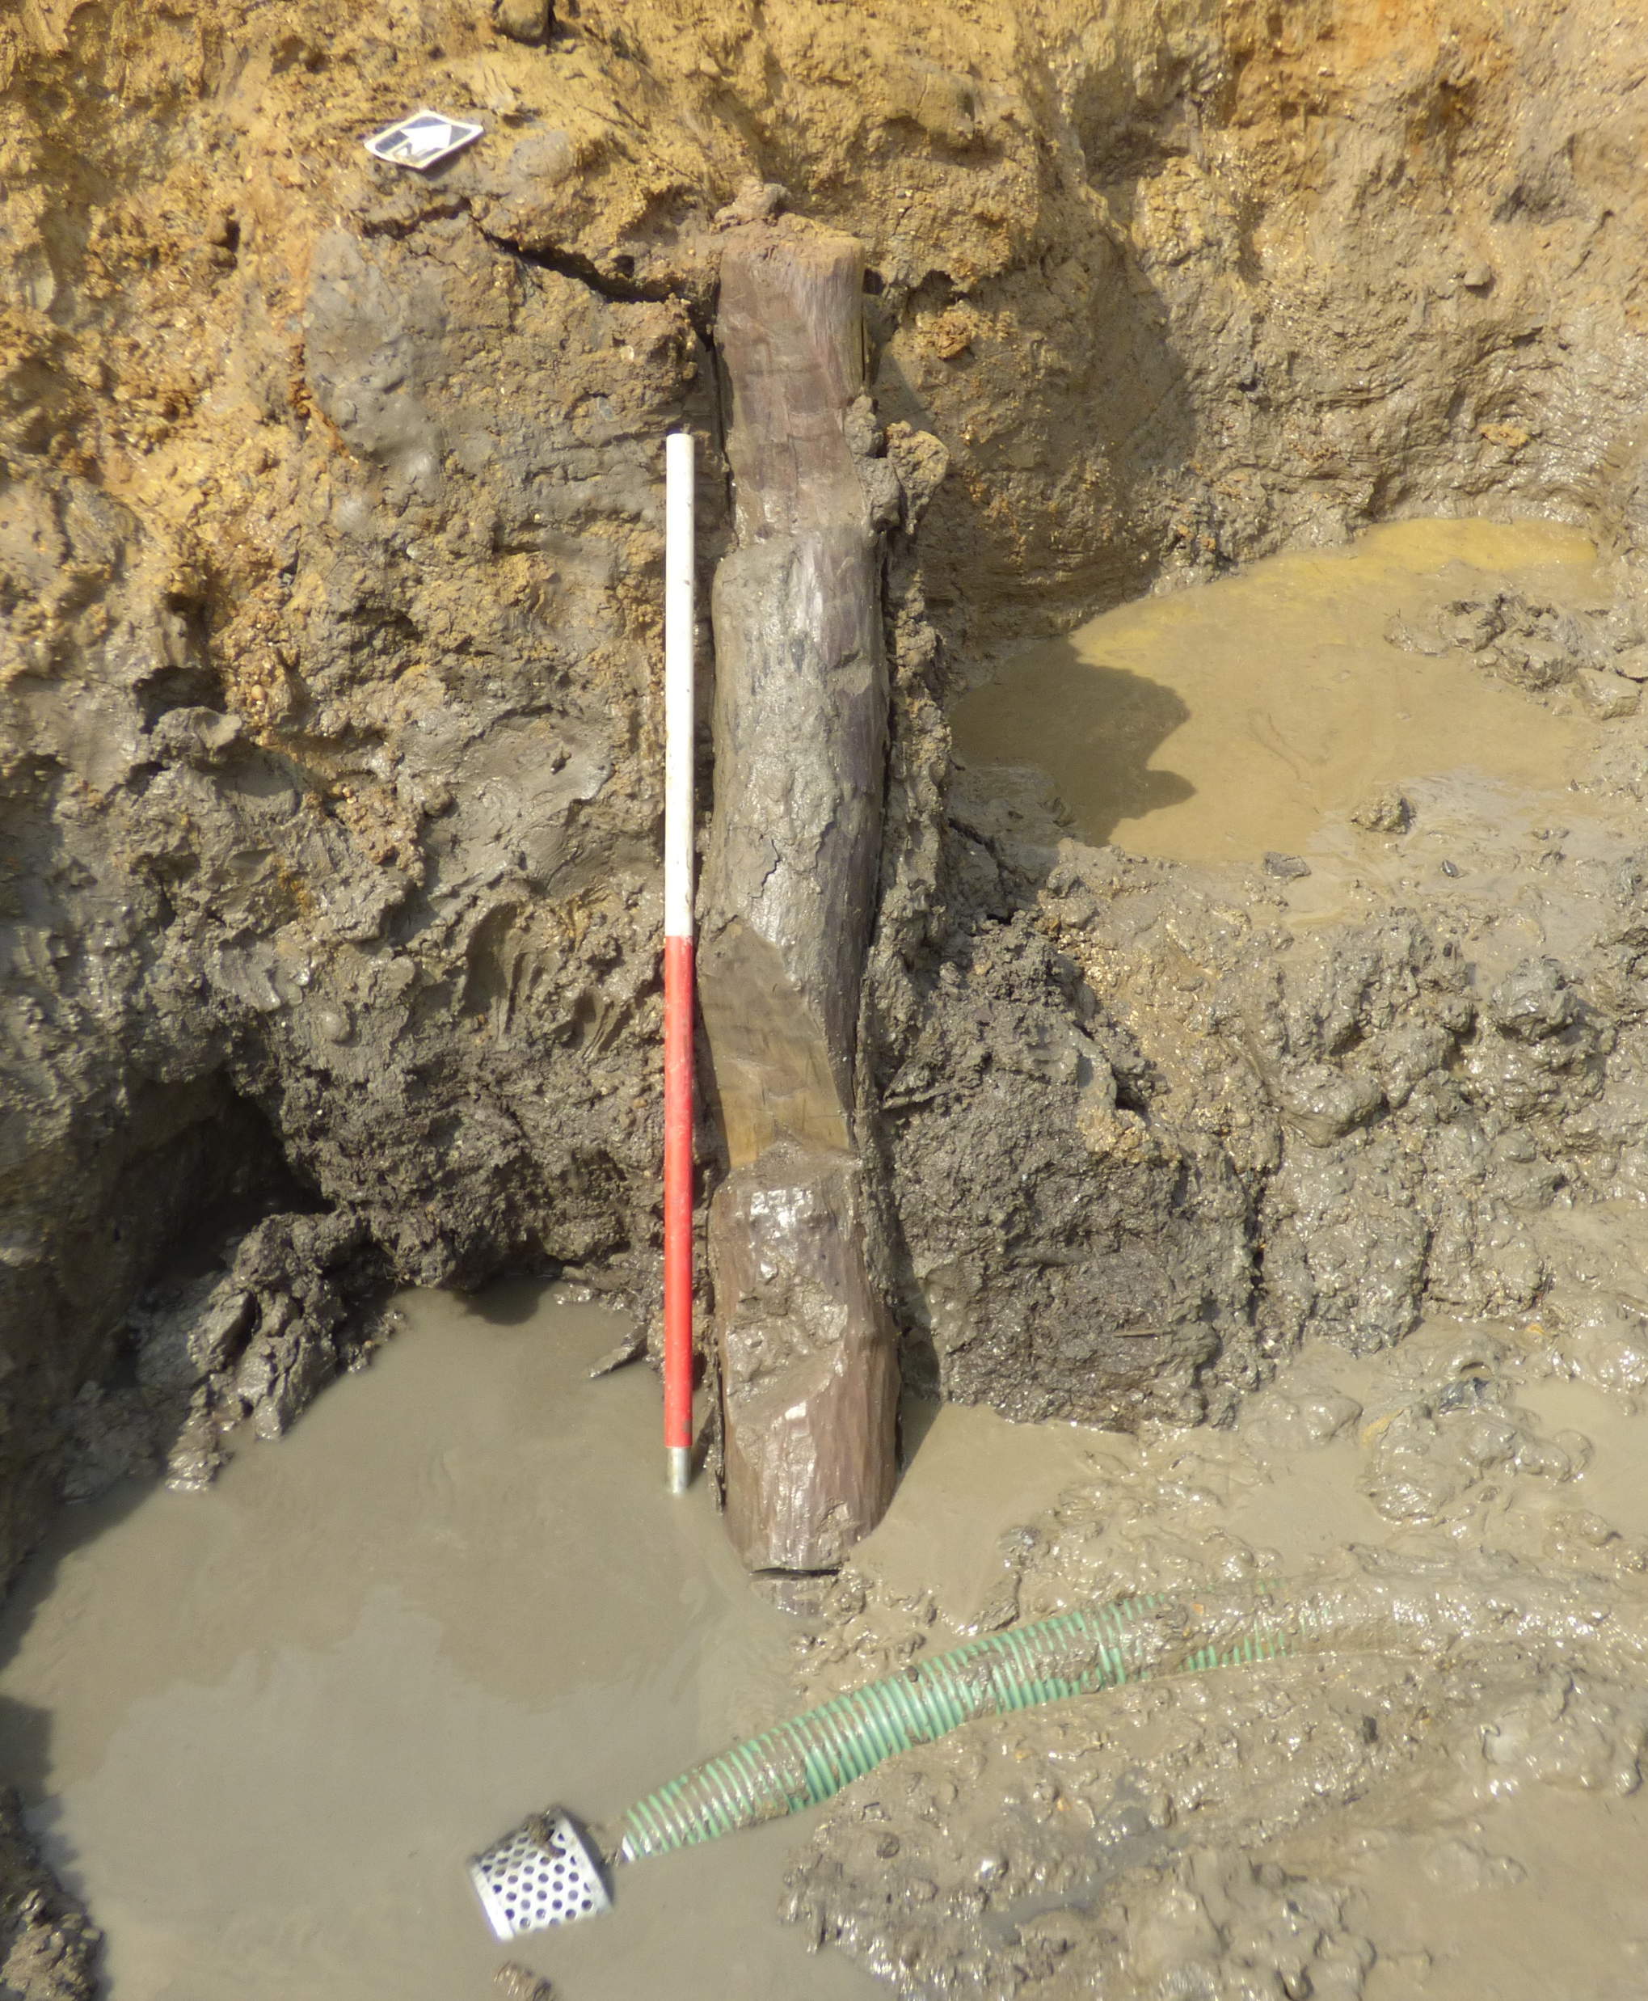
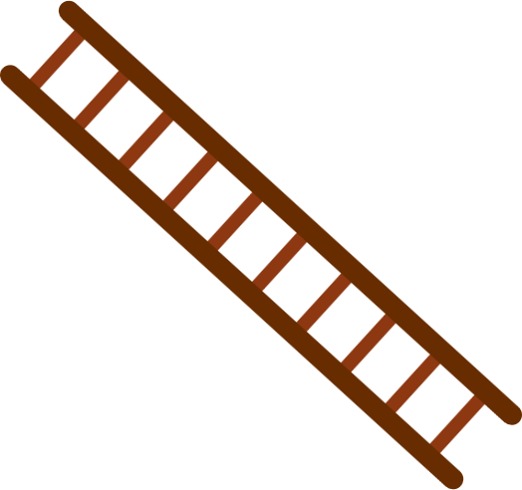

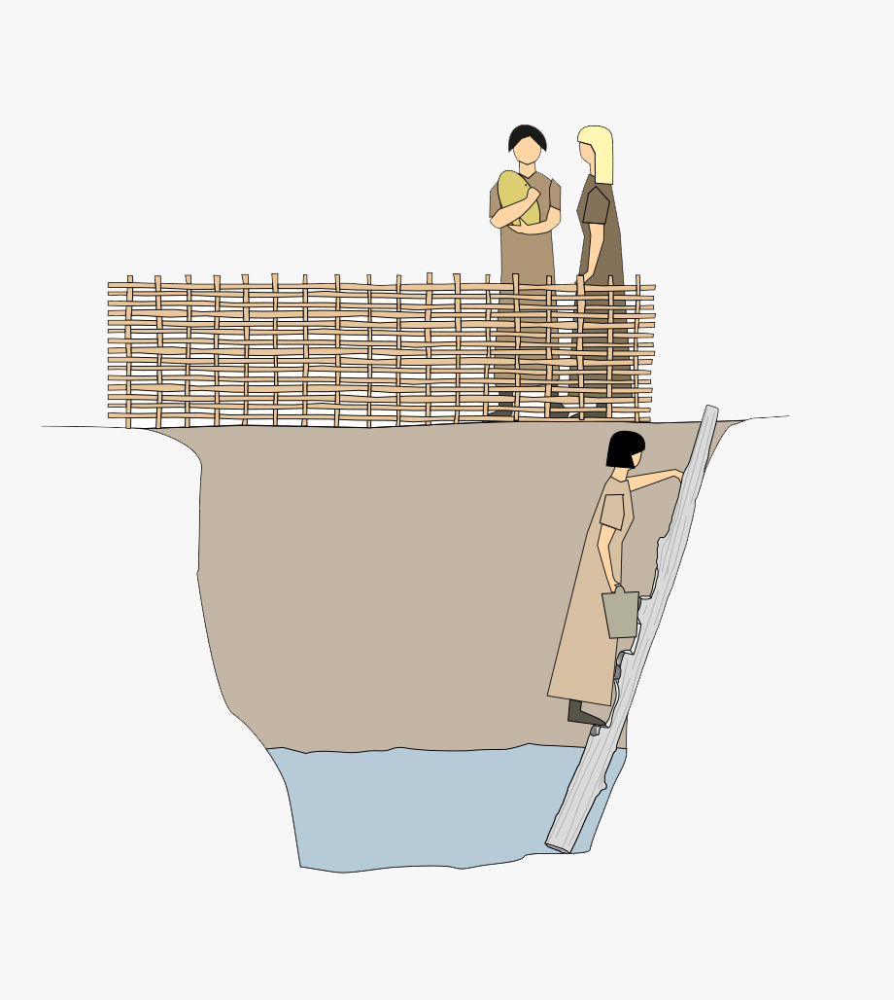
Roman snakes and ladders​
Let’s find out what the Romans
brought to Britain!
The Romans didn’t introduce ladders to Britain. They were already here.​
LADDER
SNAKE
ROMAN
NON ROMAN
We found ladders from the
Iron Age (750 BCE – CE 43) during our A14 excavations.​
​
They were used to carry
water out of wells.
If you land on something
Roman, use the ladder to move up to a new square
If you land on something that isn’t Roman, slide down to the bottom of the snake
The first player or team to get to end is the winner.

Slide 12
Historic Homes
Activity 5

Slide 13
Building materials through the ages​
EARLY
MEDIEVAL
POST
MEDIEVAL
IRON AGE
ROMAN
MEDIEVAL
CONTEMPORARY
750 BCE - 43 CE
CE 43 - 410
CE 410 - 1066
1066 - 1450
1450 - 1780
1780 - TODAY
STRAW
WOOD
WATTLE AND DAUB
EARTH
STONE TESSERAE
BRICK, CERAMIC, TESSERAE AND TILES
SLATE

Slide 14
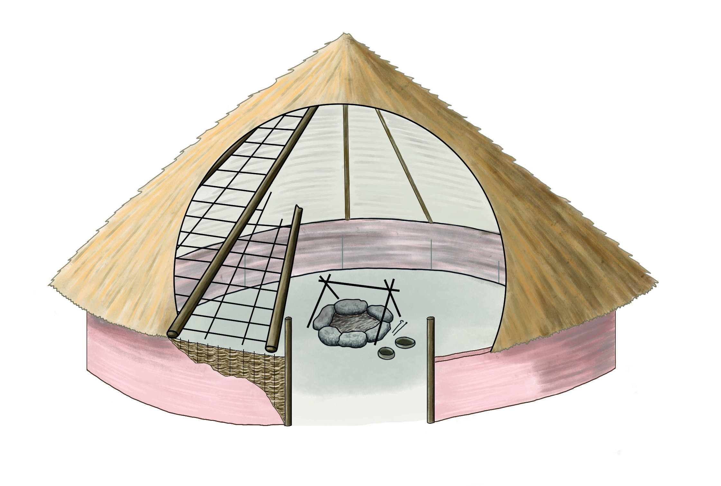


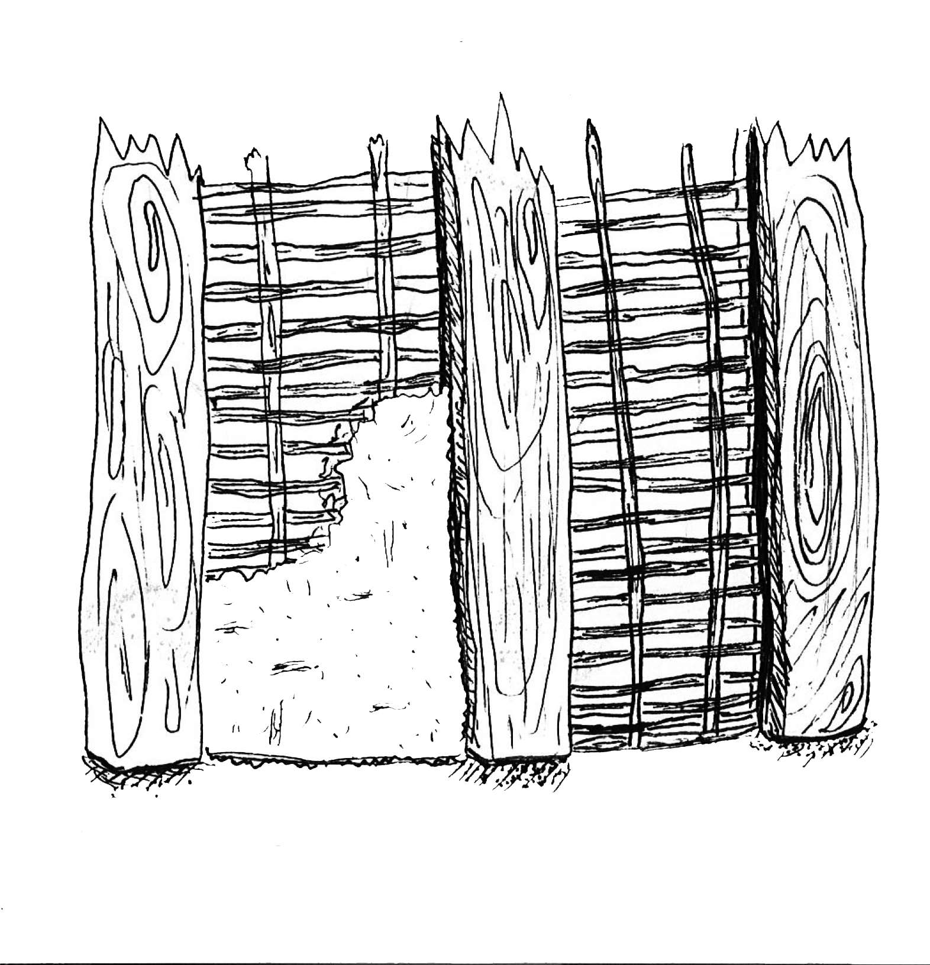

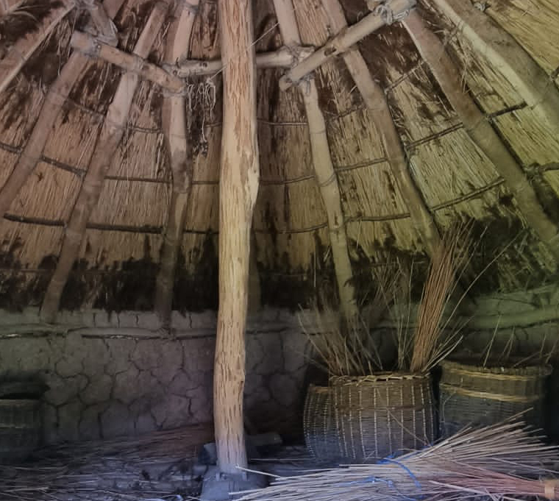

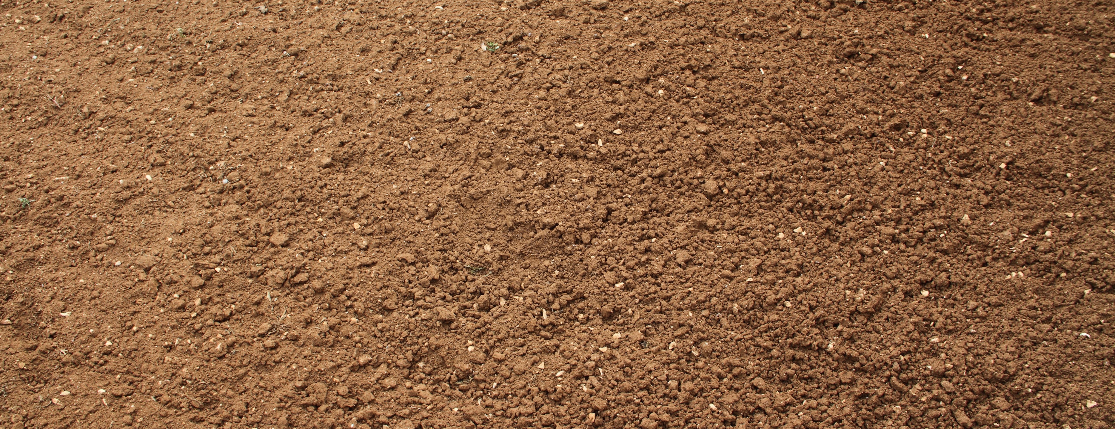
Iron Age roundhouse
WALLS:
Wattle and daub
ROOF:
Thatched roof
Wattle
Wooden frame
Straw
Timber posts
Daub
FLOOR:
Earth floor

Slide 15
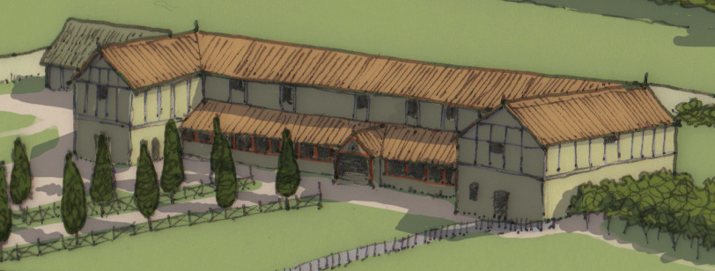
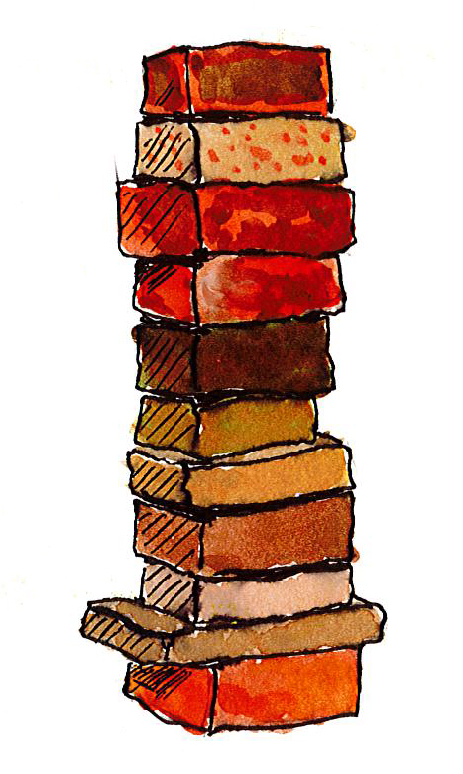
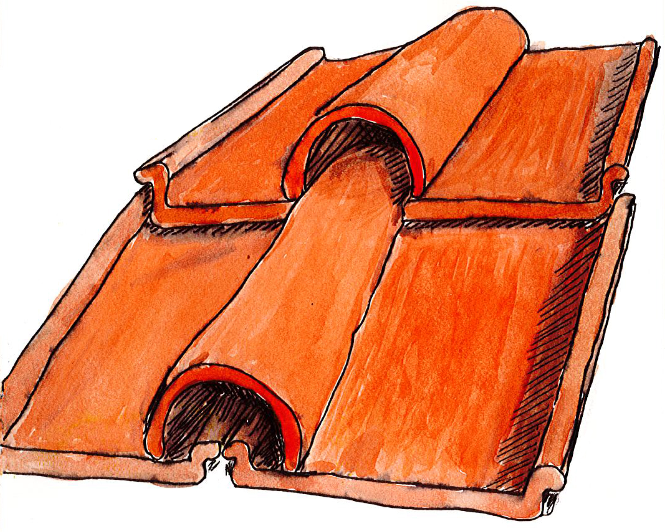
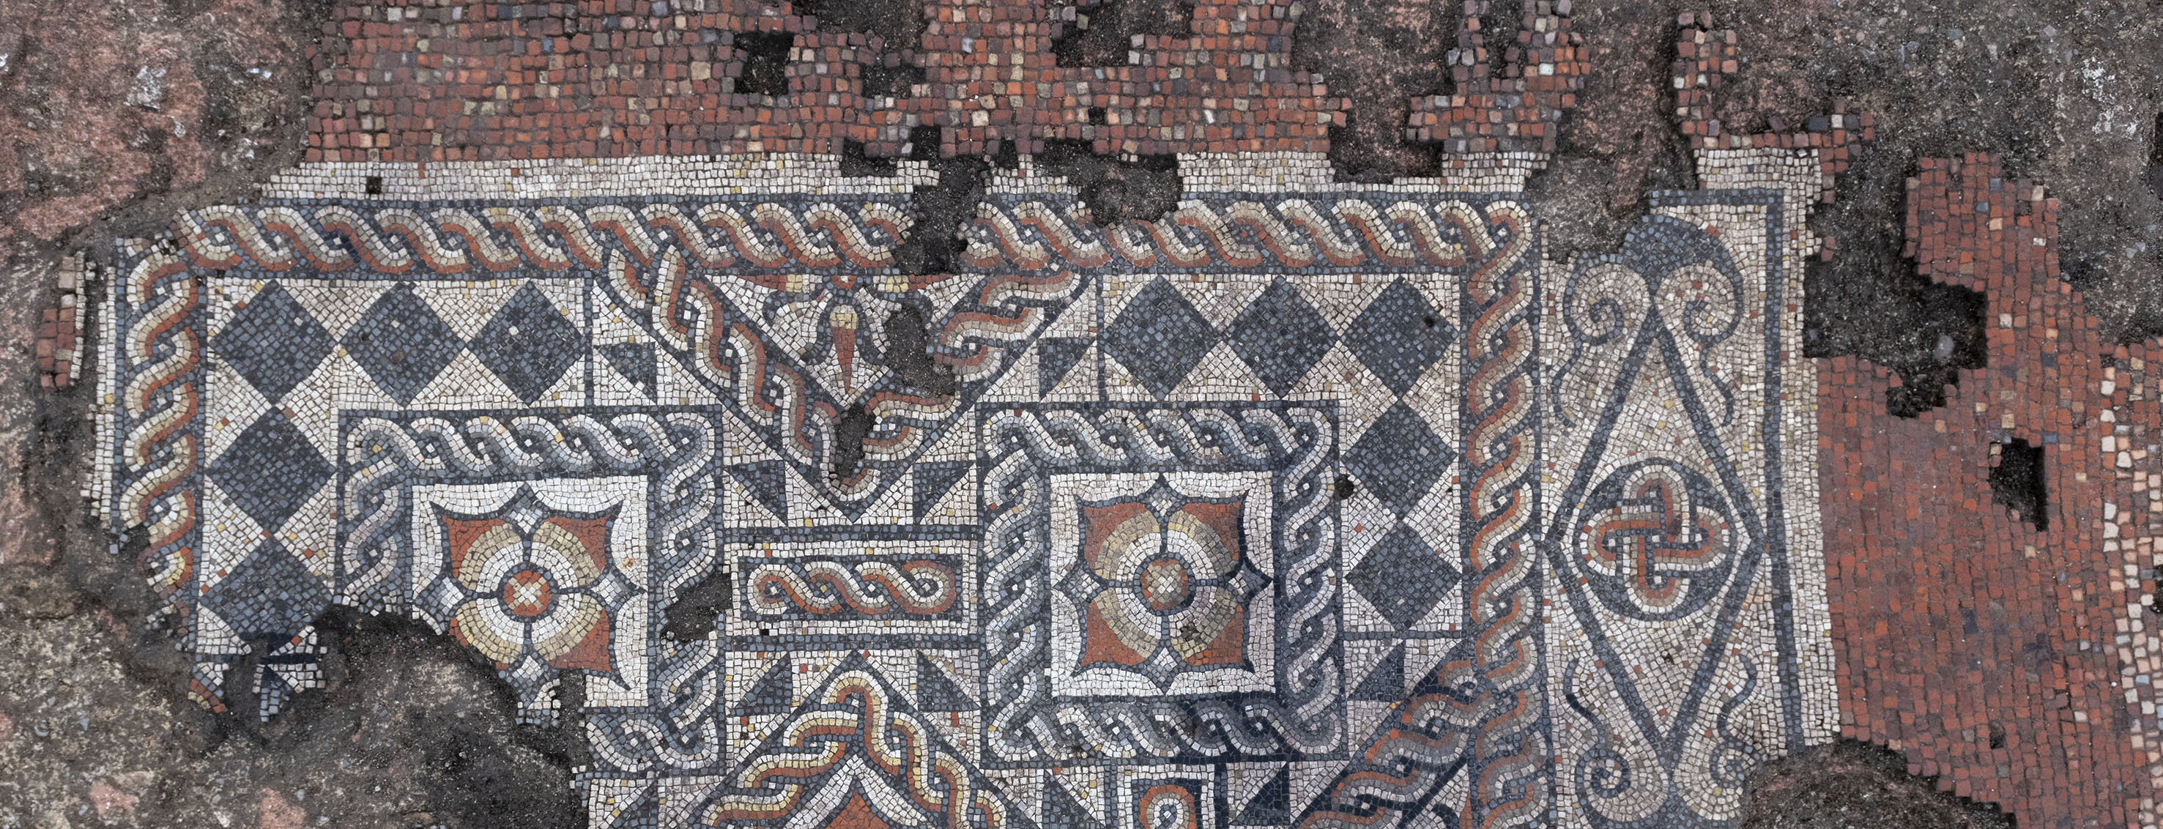
Roman villa
WALLS:
Bricks
ROOF:
Tiled roof
Imbrex
FLOOR:
Mosaics and tile floors
Tegula

Slide 16
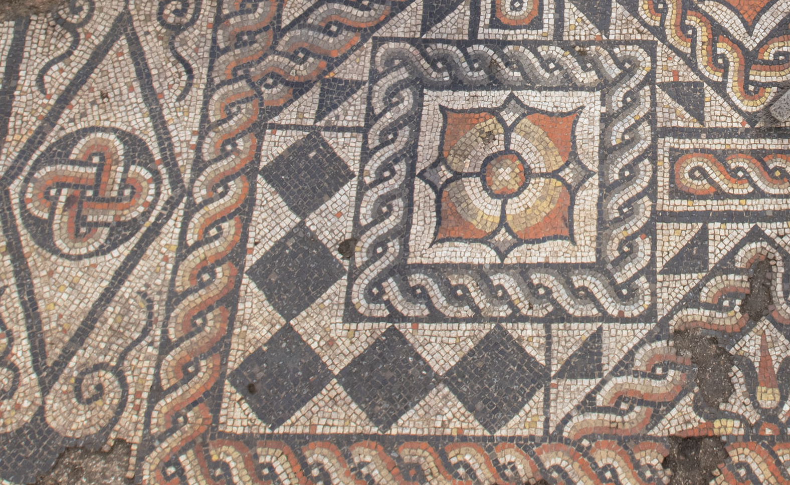
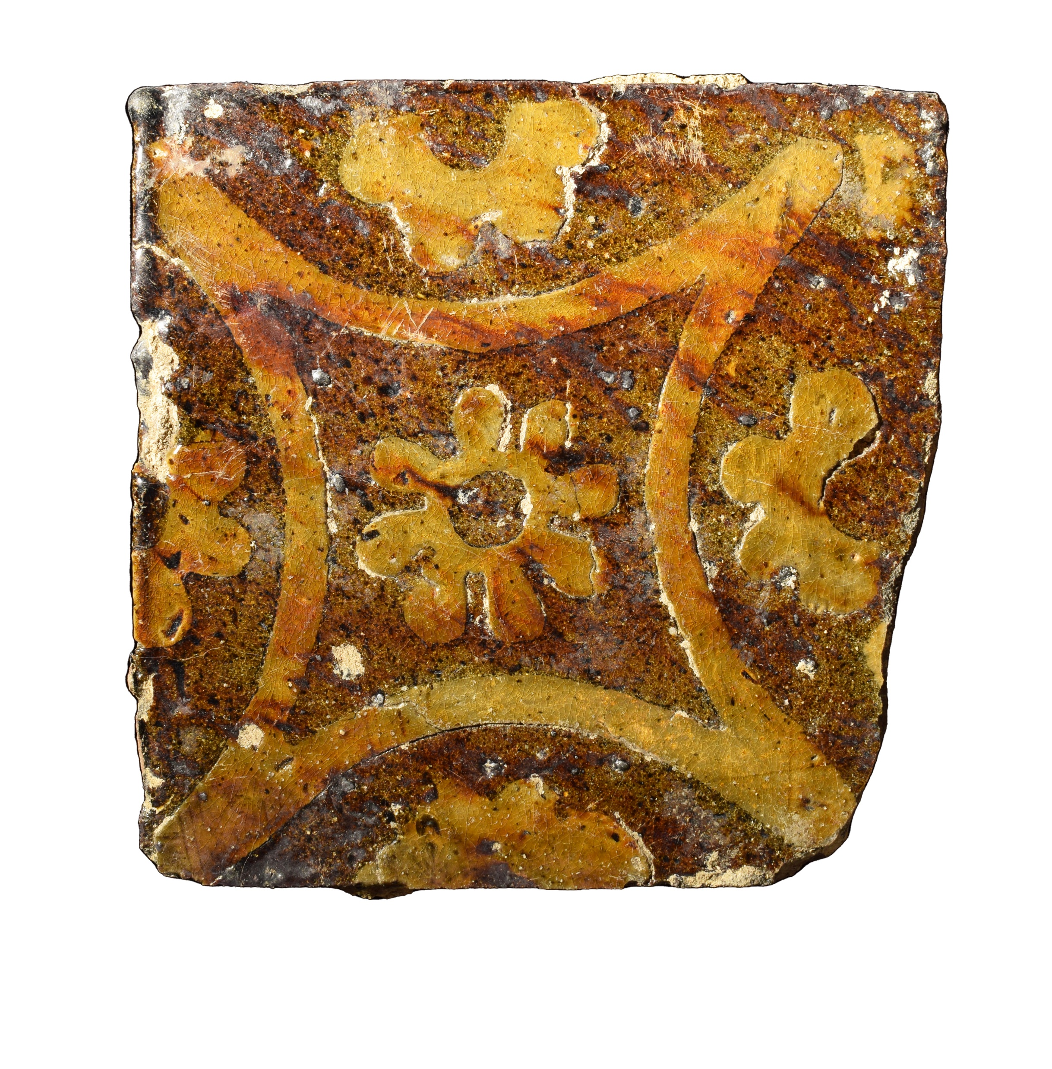
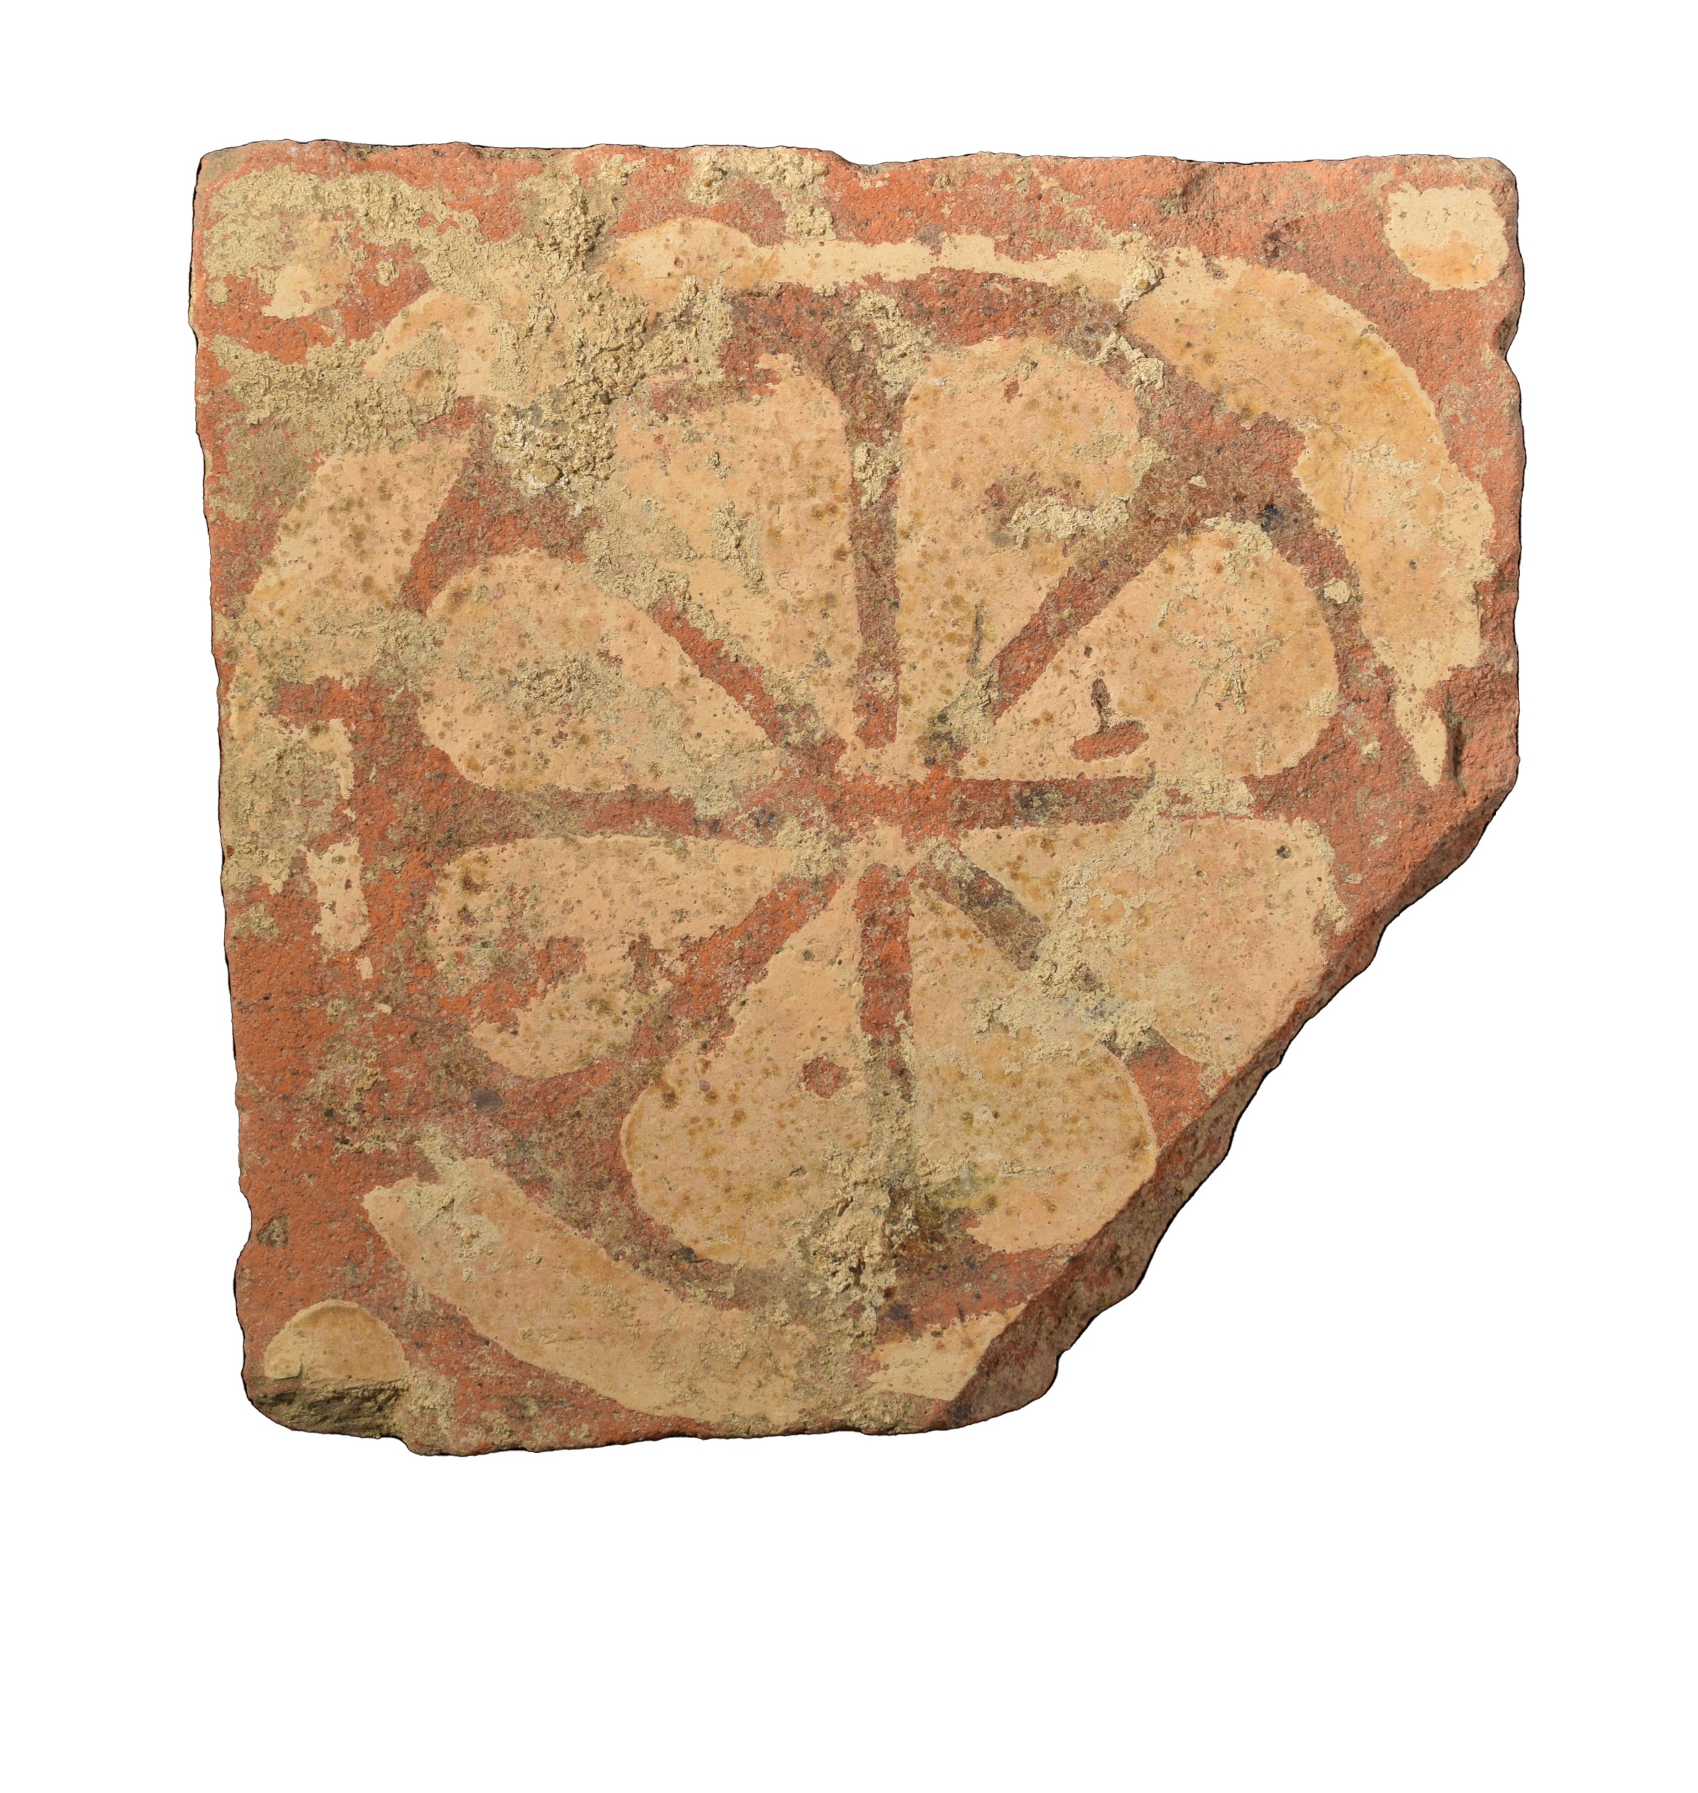
Building materials: floors
EARTH FLOOR
CERAMIC TESSERAE
MOSAIC
TILES

Slide 17
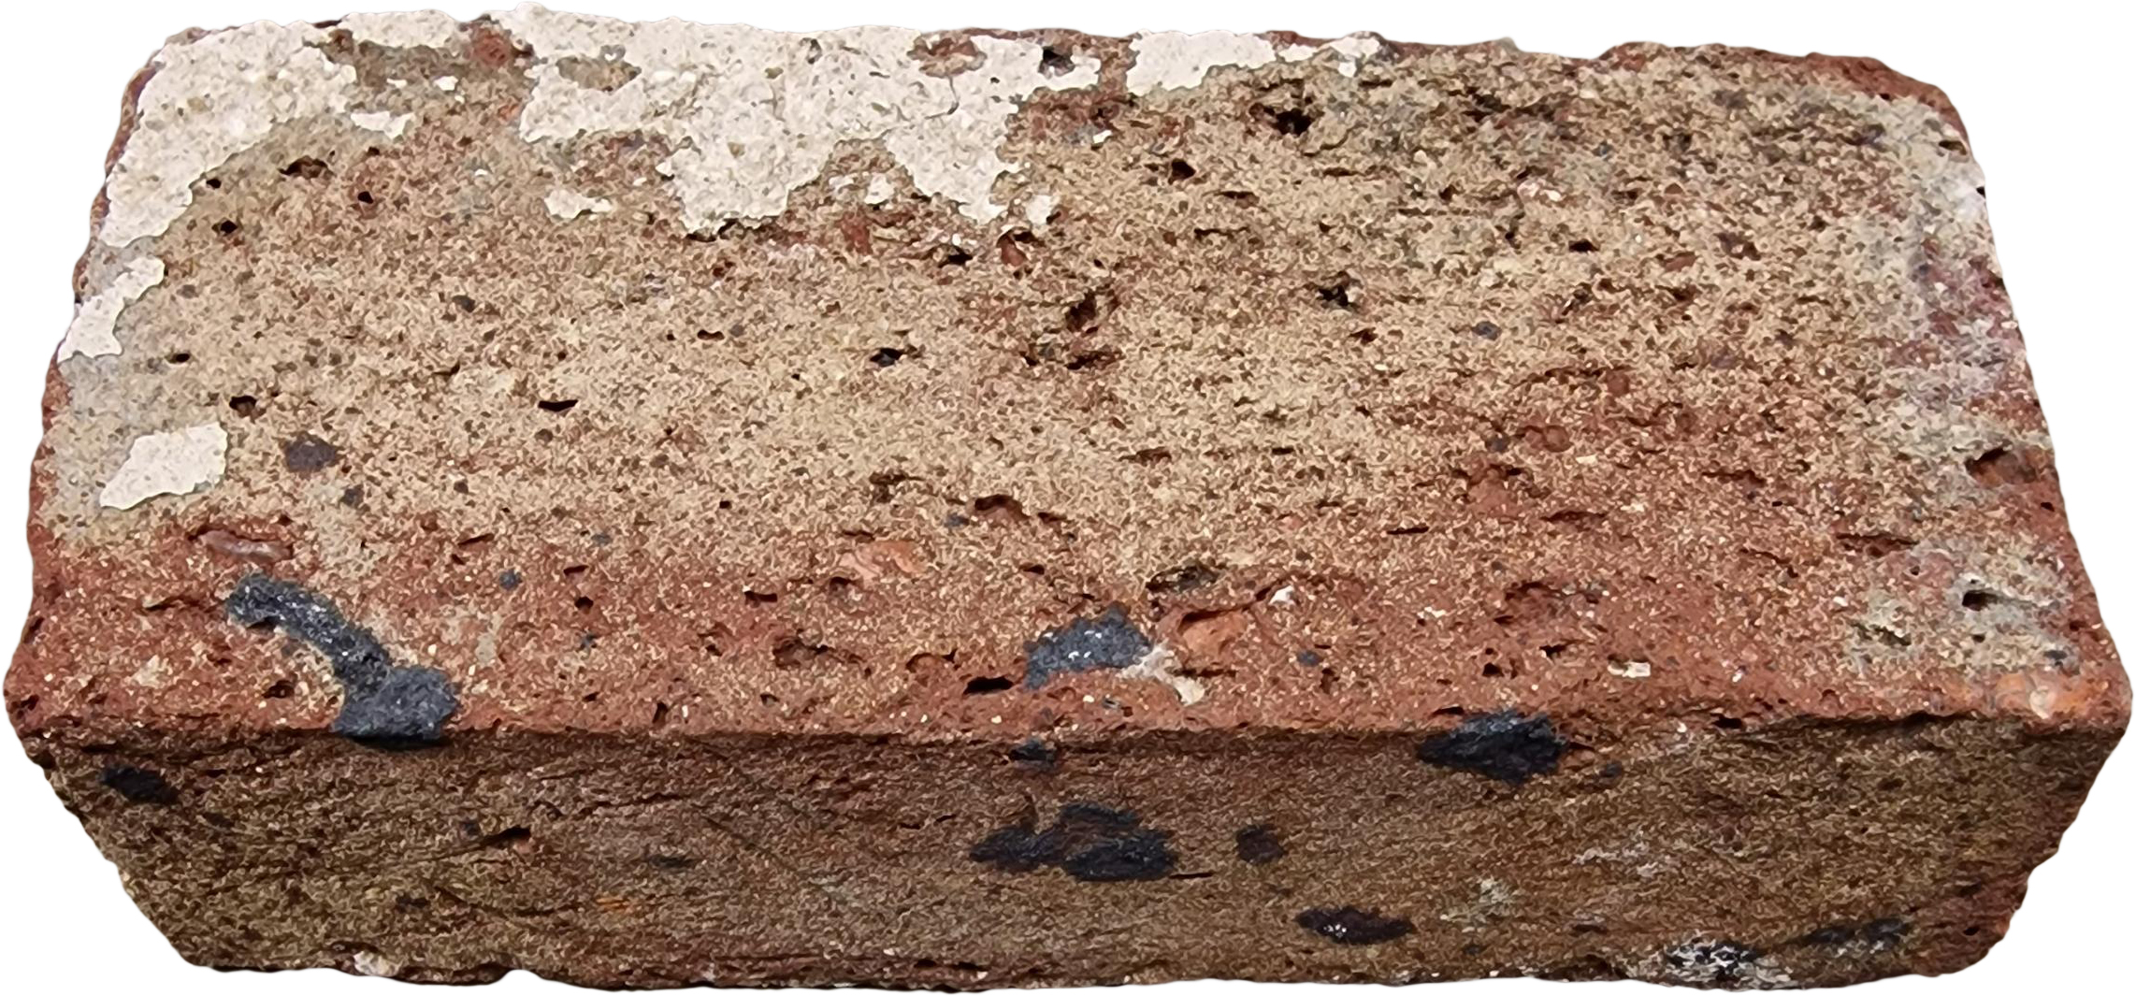
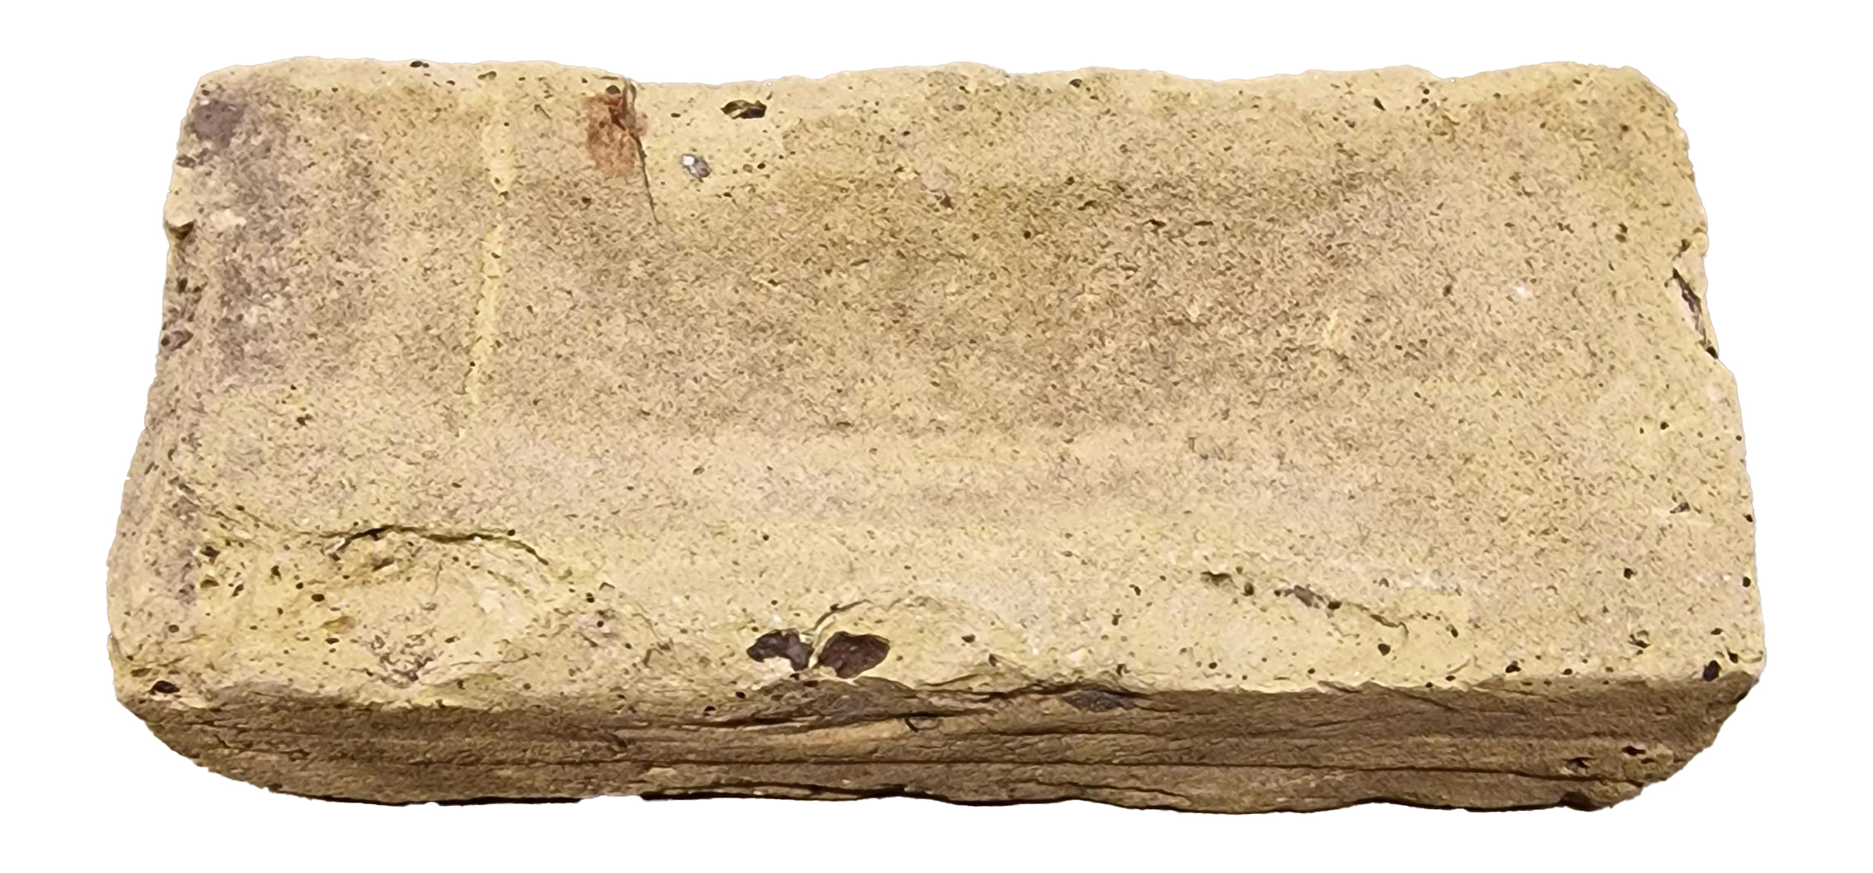
Building materials:
walls
WATTLE and DAUB
BRICKS

Slide 18
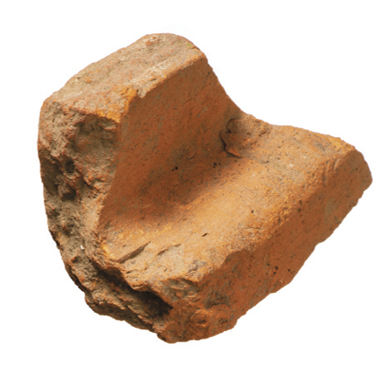
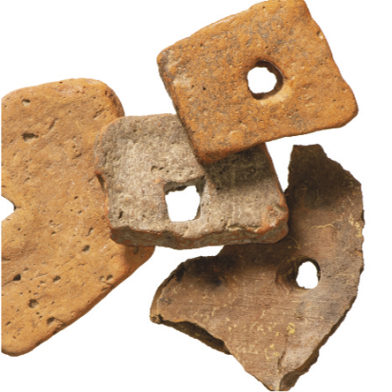
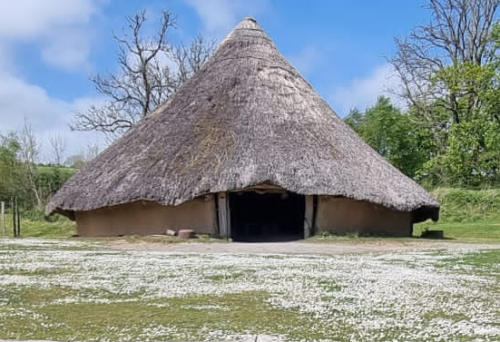
Building materials:
roofs
TEGULA and IMBREX
THATCH
PEG TILE
Notes:
Central image: part of a tegula
Right image: fragments of peg tiles

