Slide 1


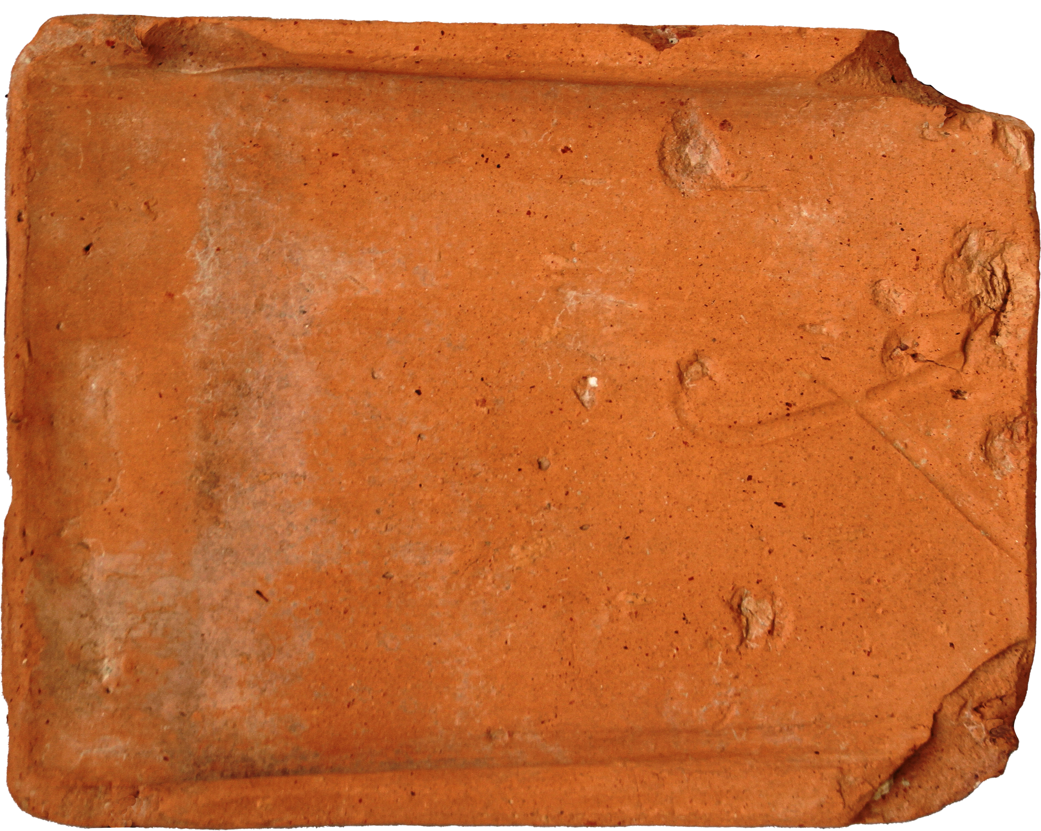




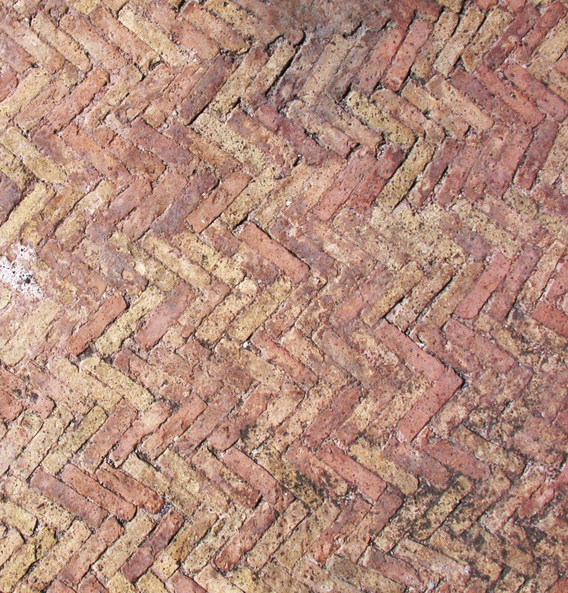
Building materials in the box​
ROOFING
Tegula
Imbrex
Example of tegulae and imbrices to create a roof
Box flue tile
WALLS
Box Flue tile
A fragment of scored box flue tile
Bipedalis
FLOORING
Bessalis
Pedalis
Opus spicatum
Bessalis
Example of the hypocaust structure
Surviving bessalis of a hypocaust
Notes:
Roofing:
Tegula By Bjoertvedt - Own work, CC BY-SA 4.0, https://commons.wikimedia.org/w/index.php?curid=50110219
Roman halfround roof tile (imbrex), used to cover the gap between two flat tiles (tegulae) By Rijksmuseum van Oudheden, CC BY 3.0 nl, https://commons.wikimedia.org/w/index.php?curid=64787371
Tuiles en terre cuite (tegula et imbrex), site de Saint-Romain-en-Gal By Romainbehar - Own work, CC0, https://commons.wikimedia.org/w/index.php?curid=107019930
Walls:
Roman box-flue tile found in Britain By AgTigress (Own work), CC BY-SA 3.0, https://commons.wikimedia.org/w/index.php?curid=11268350
A large piece of Roman box flue tile By The Portable Antiquities Scheme/ The Trustees of the British Museum, CC BY-SA 2.0, https://commons.wikimedia.org/w/index.php?curid=55420737
Flooring:
Opus spicatum paving in Trajan's Market, Rome, Public Domain, https://commons.wikimedia.org/w/index.php?curid=268278
Brick (bessalis) © The Trustees of the British Museum

