Slide 1

Early Medieval:
Touching and hearing the past

Slide 2
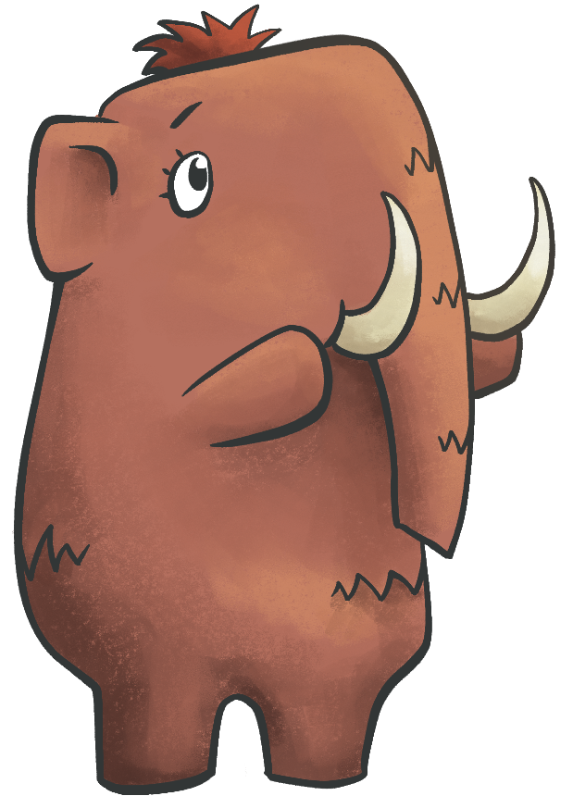
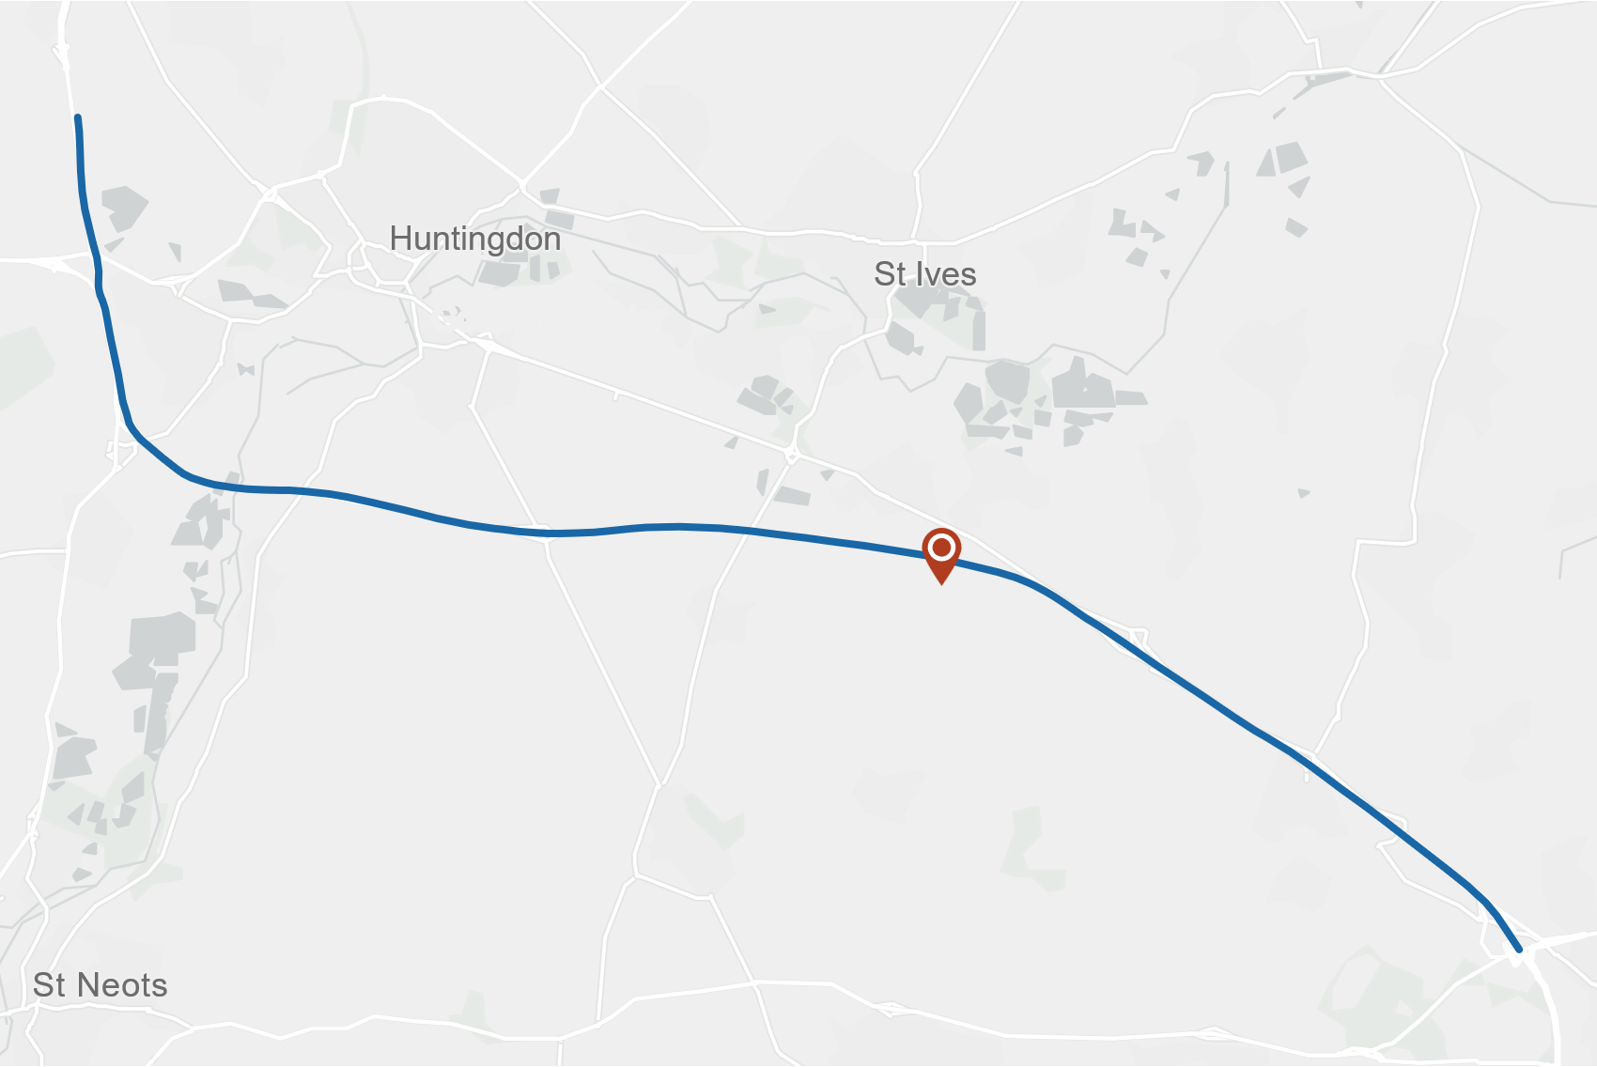
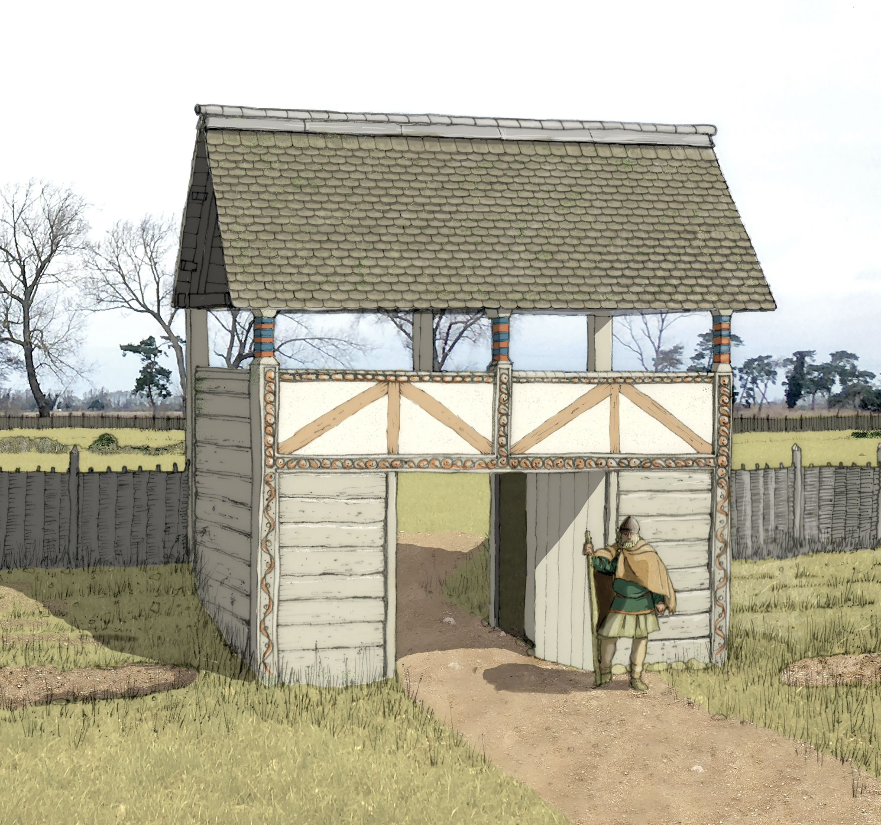
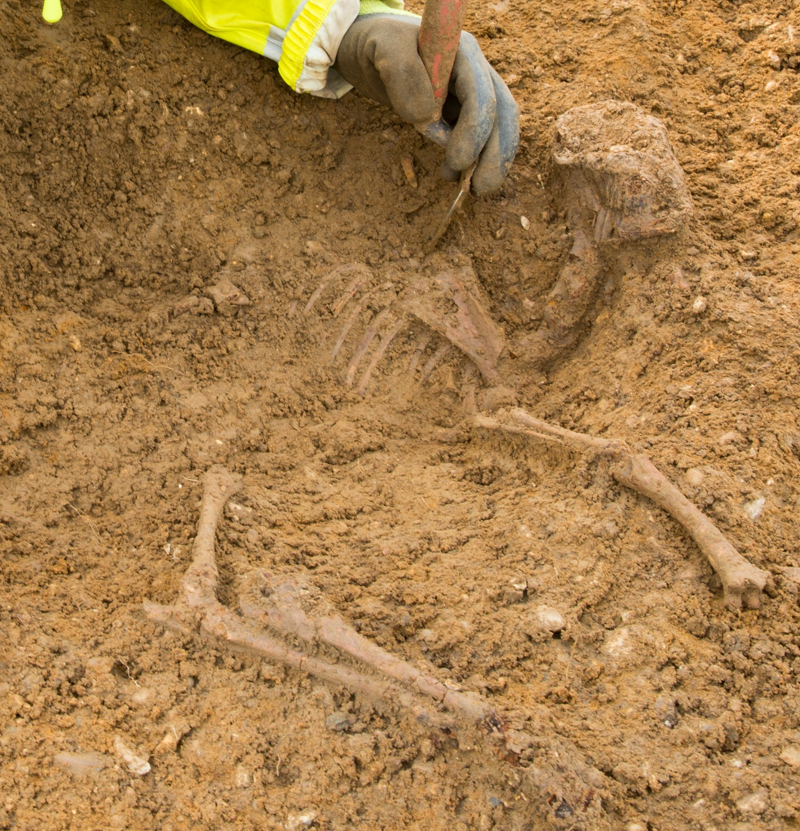
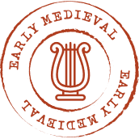
CE 410 - 1066
EARLY MEDIEVAL
We excavated the early medieval settlement of Conington.
In the early medieval period,
most people had to make their own clothes.
They used wool from their sheep.
CONINGTON
Archaeologists excavating lamb remains

Slide 3
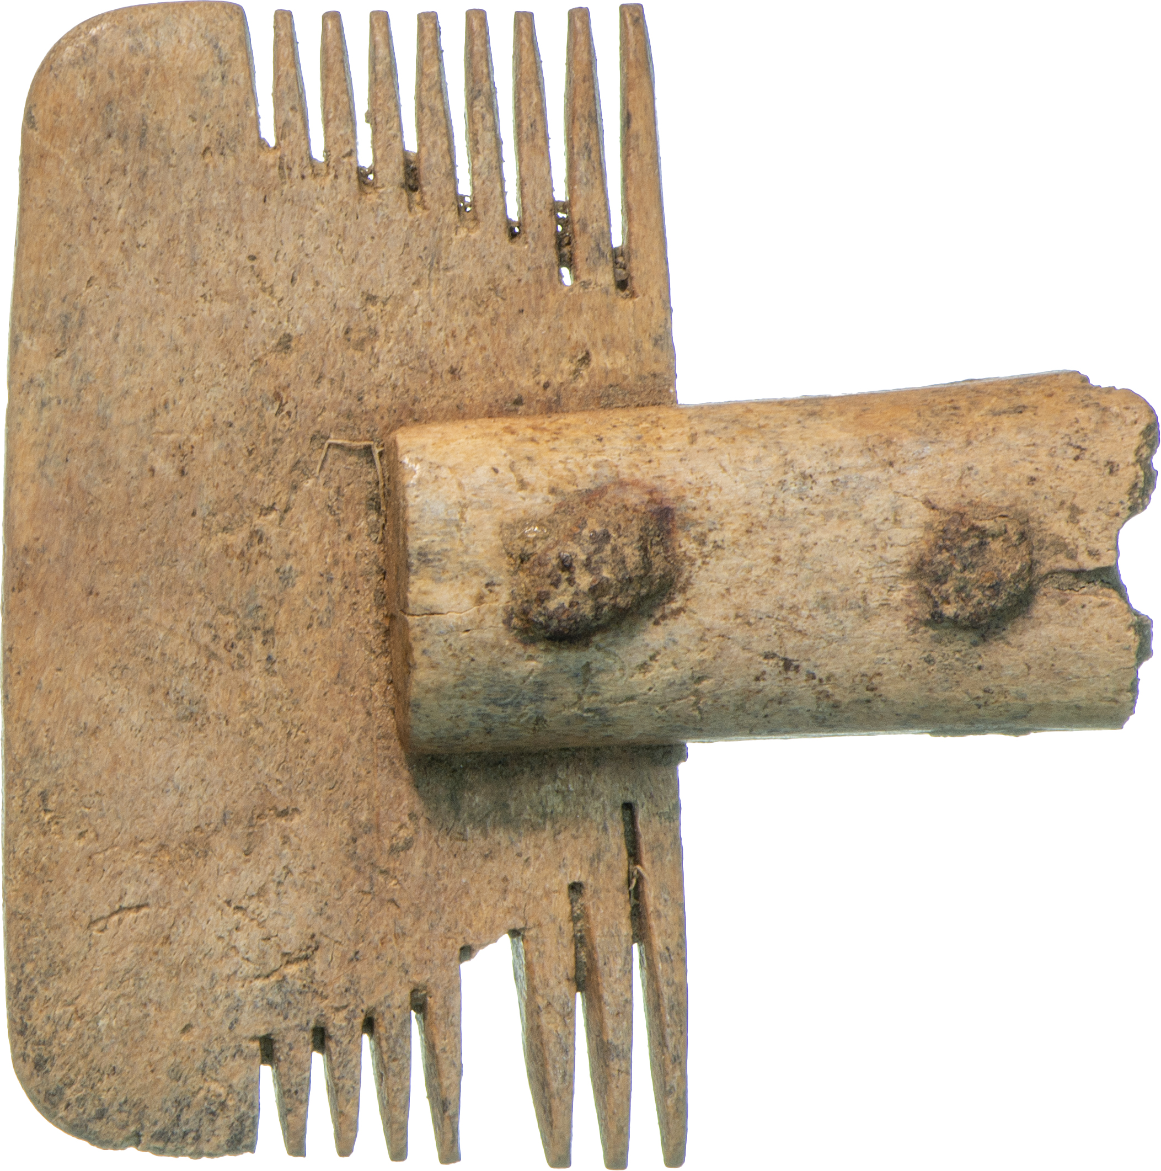
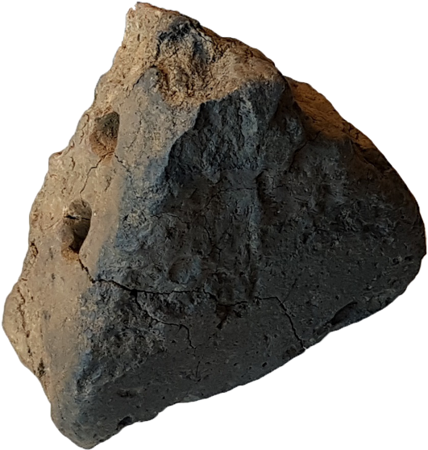
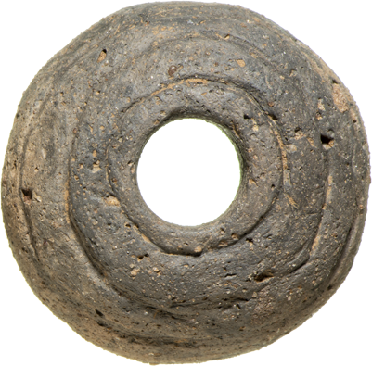

Combs with long teeth
made the wool soft
Spindle whorls twisted and spun
the wool into thread
Loom weights held the thread
tight to weave cloth
We don’t find looms because they were made from wood, which rots ​(breaks down) quickly. Loom weights show us where they were used.

Slide 4
Now it’s your turn!
Early Medieval activities

Slide 5
Weaving
Activity 6

Slide 6
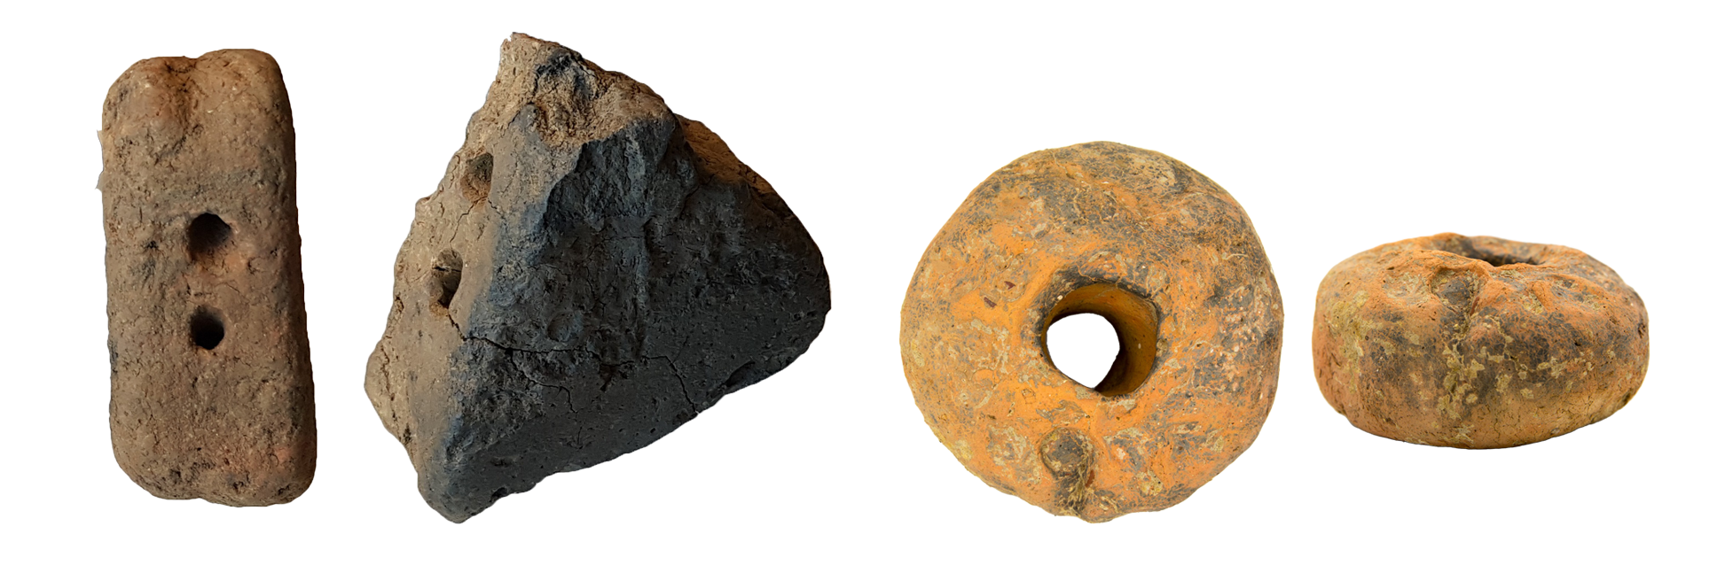
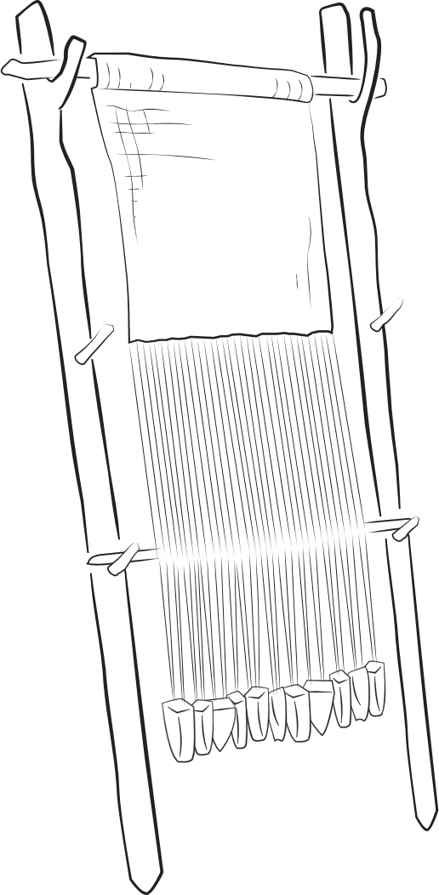
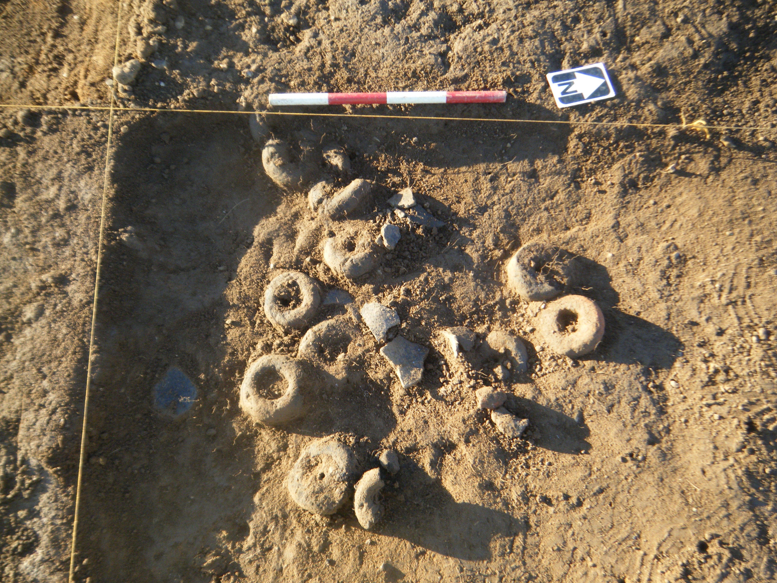
Loom and loom weights​
In early medieval times, clothes were woven
on wooden looms.
Each loom needed up to 30 weights!
WOODEN STRUCTURE
WOVEN
CLOTH
WARP
LOOM WEIGHTS
A group of loom weights as discovered in the ground

Slide 7
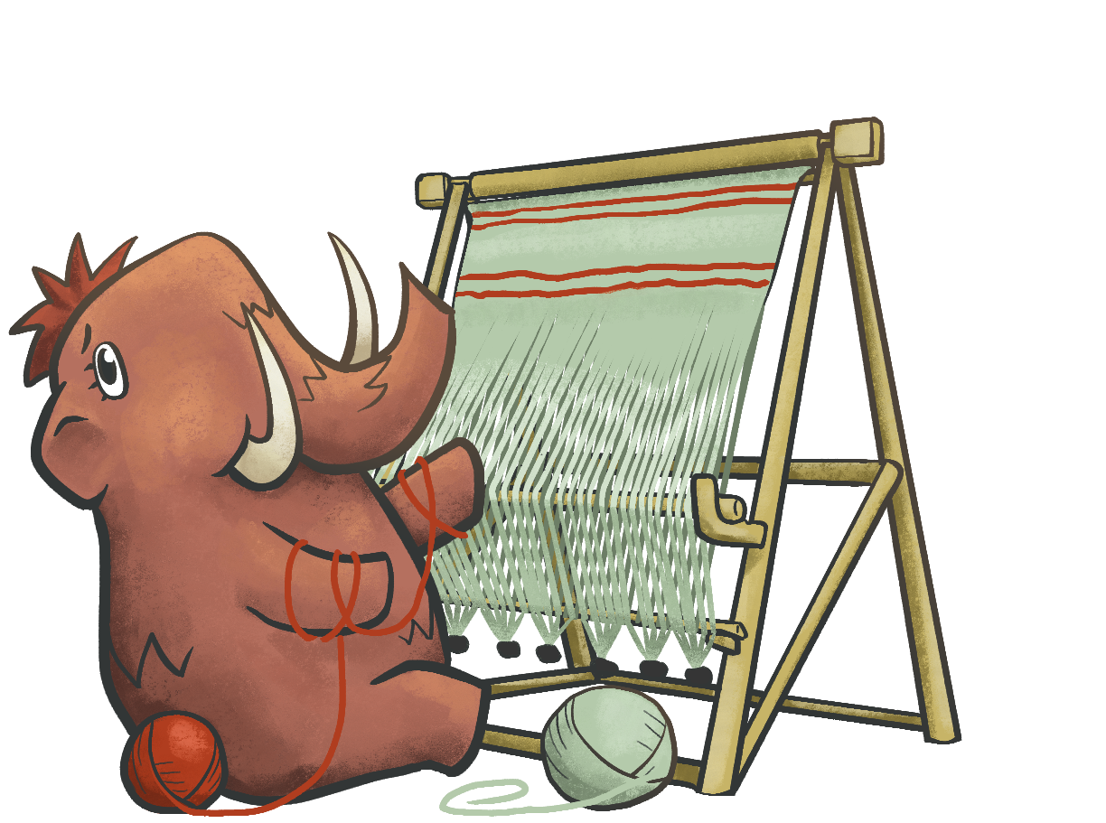

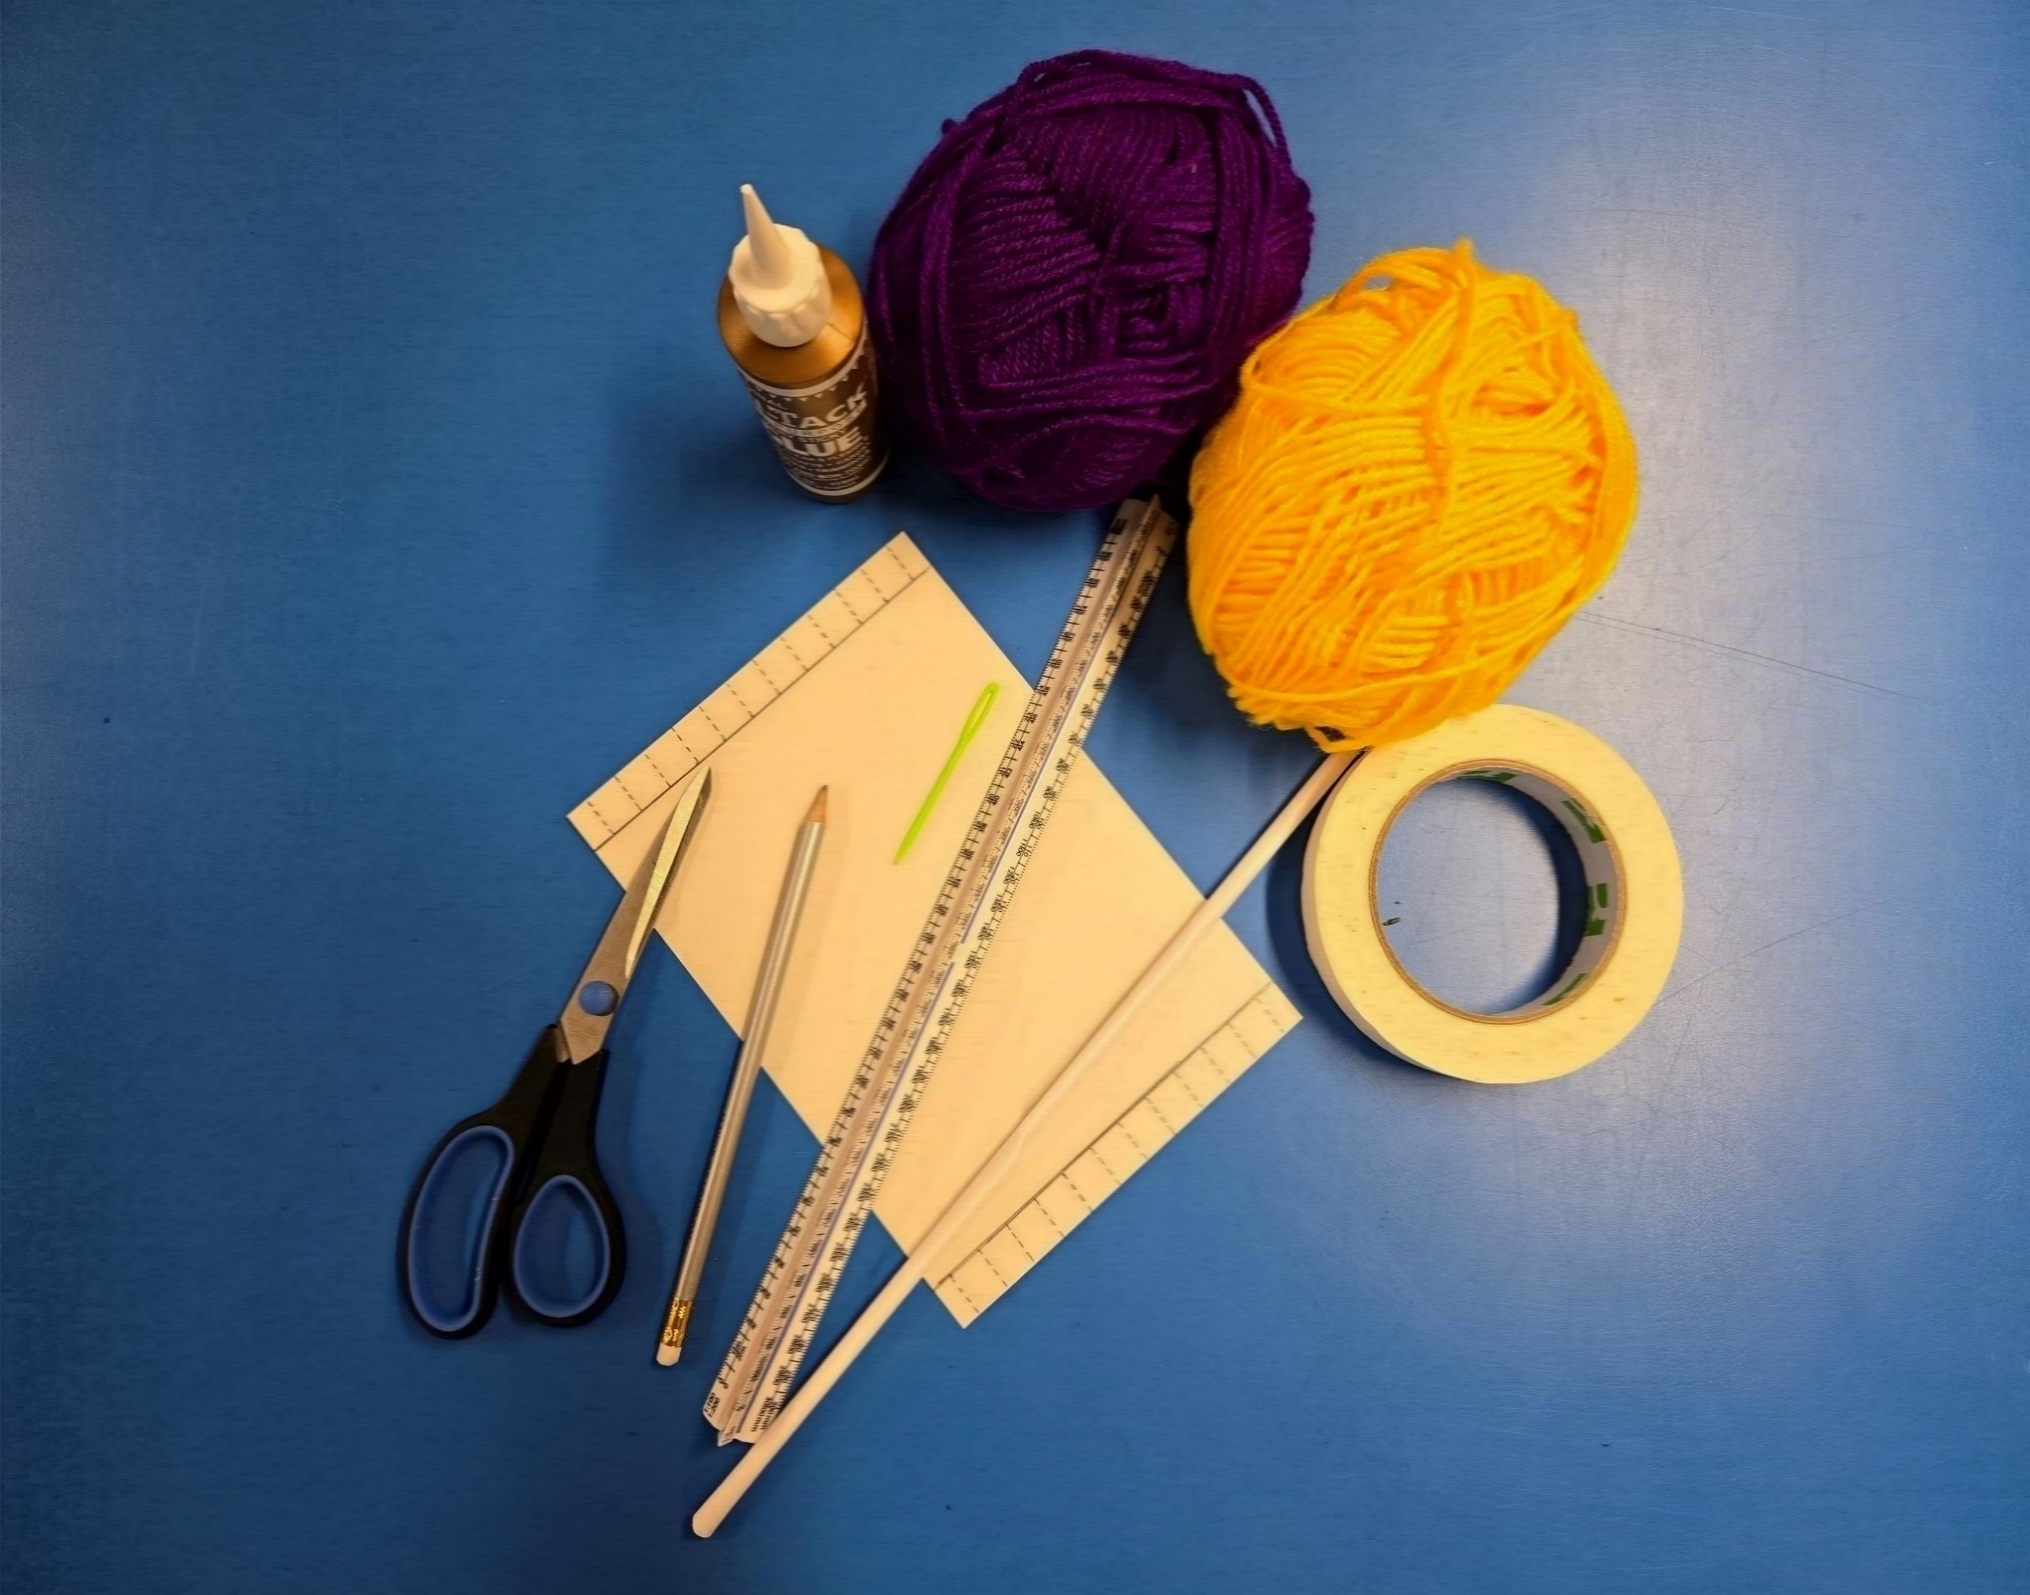
Make your own Medieval cloth!​
For this
activity you
will need:
Scissors
The loom template
Straws
Glue
Tape
Yarn, string / twine, ribbon
Plastic needles
Twigs or sticks

Slide 8
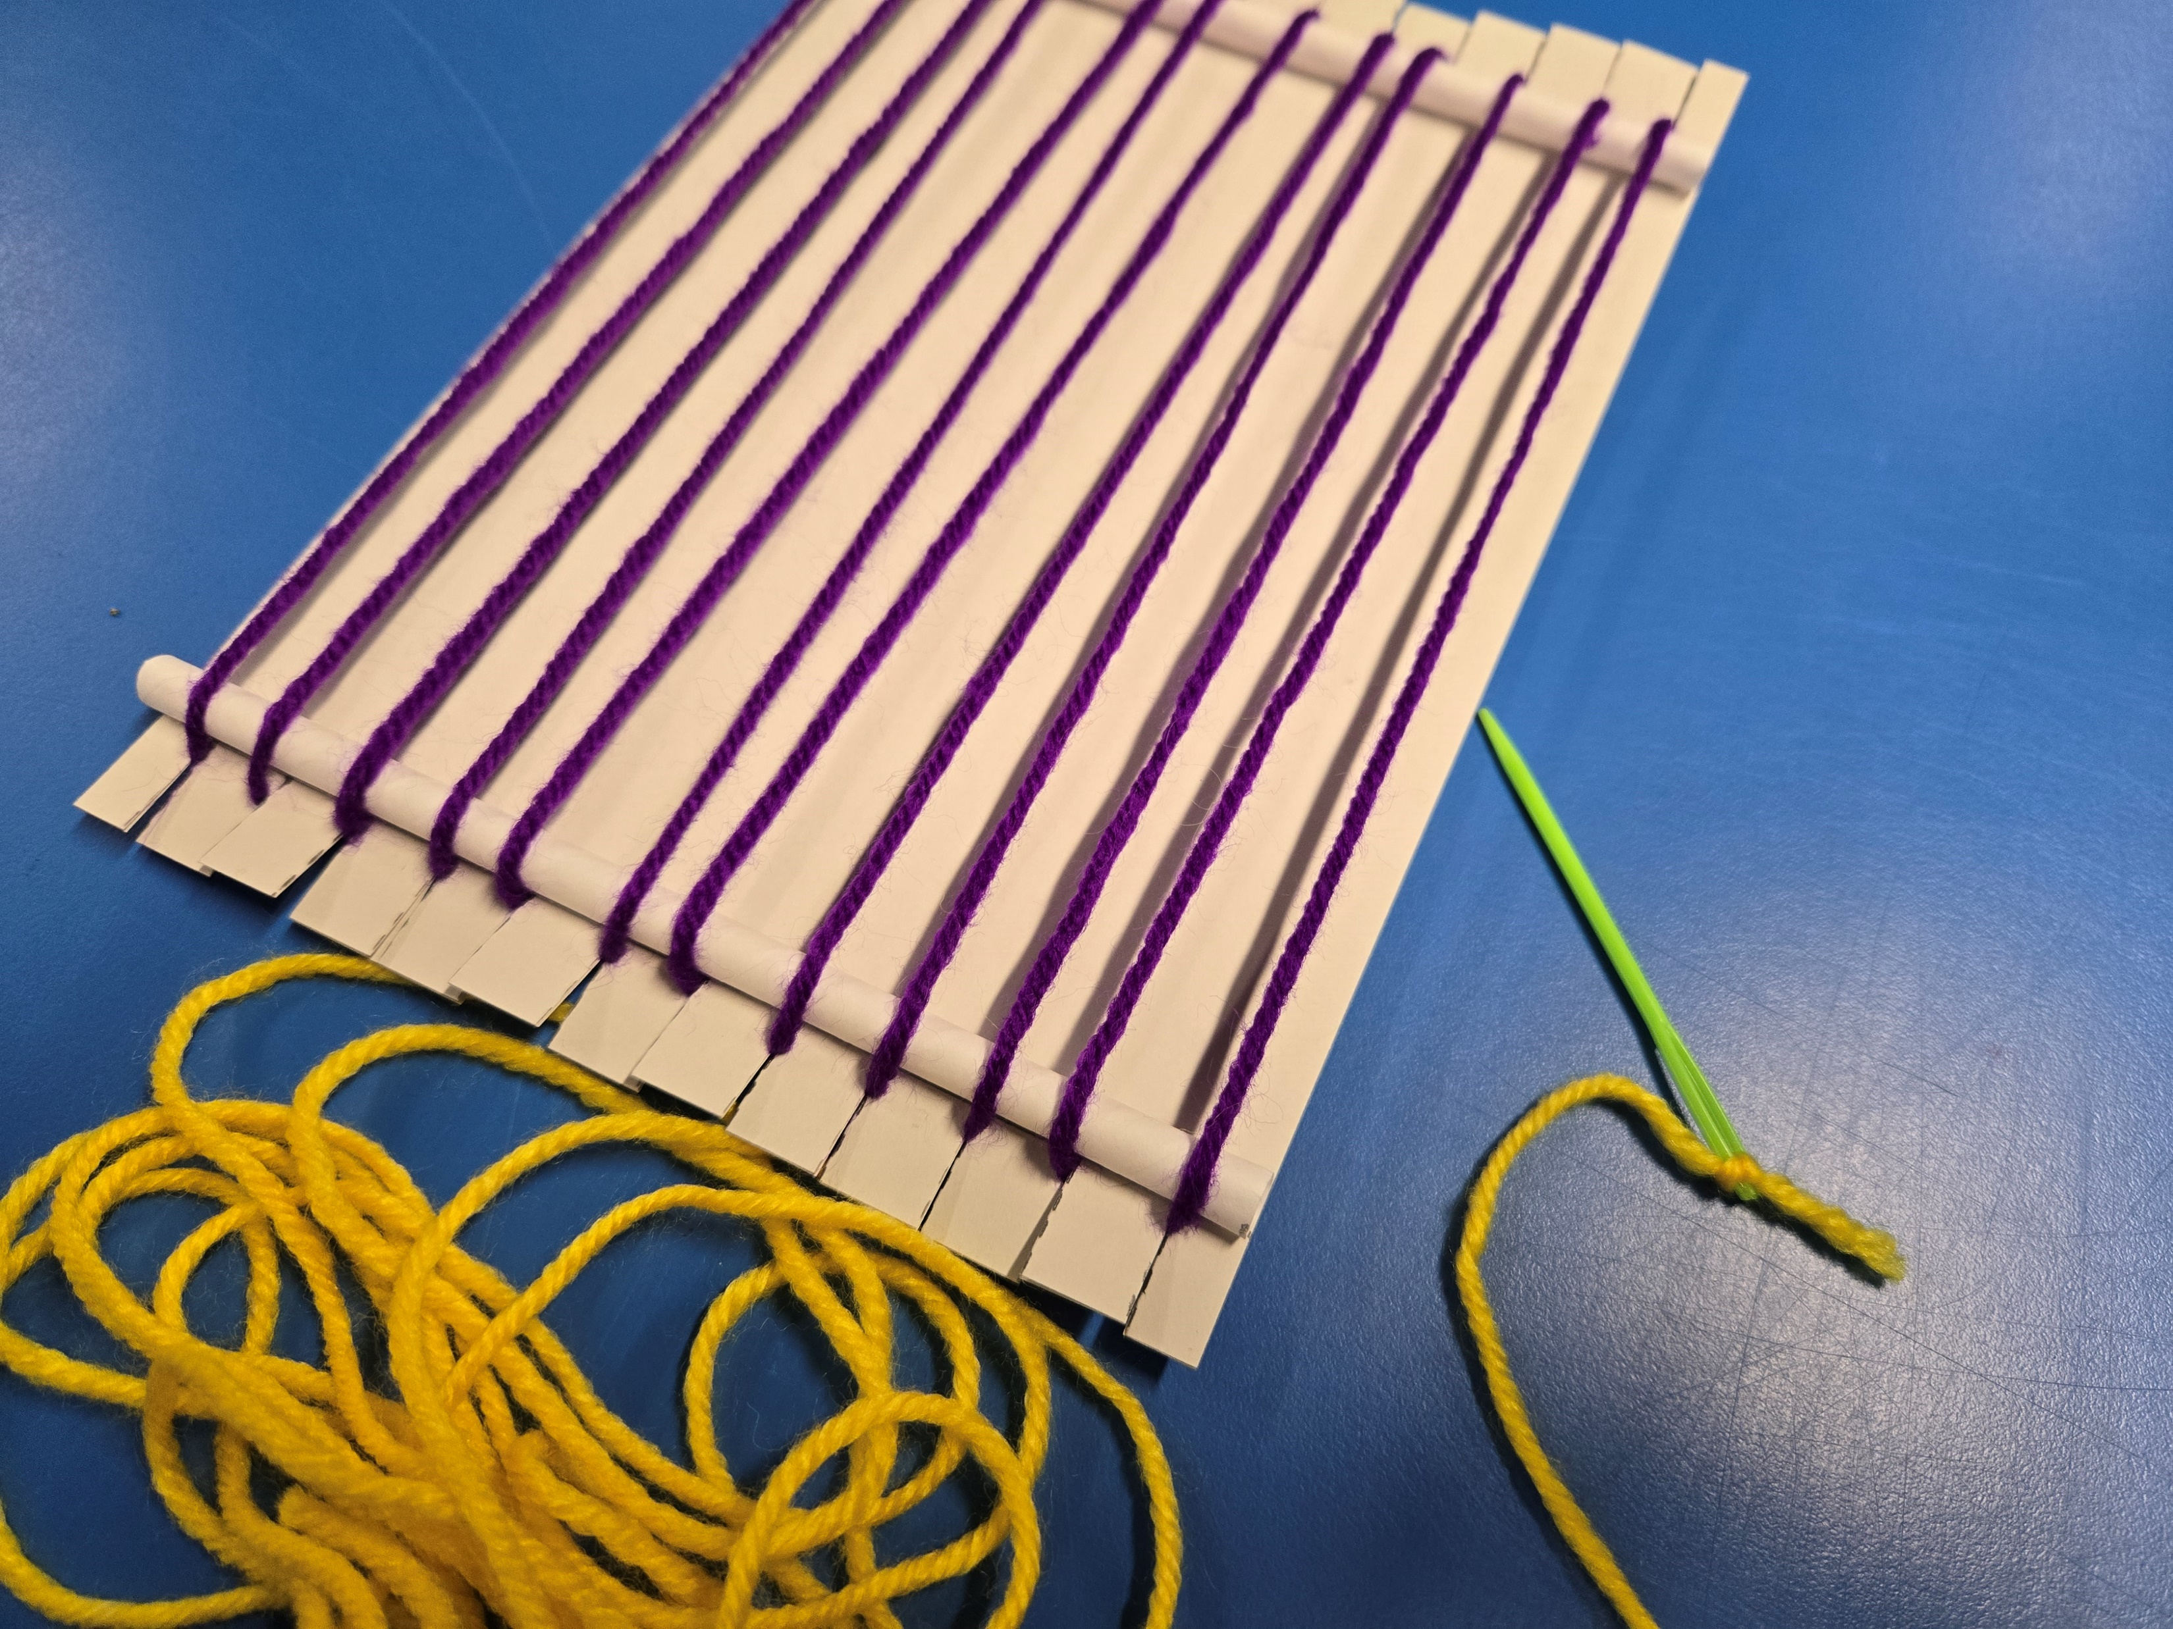
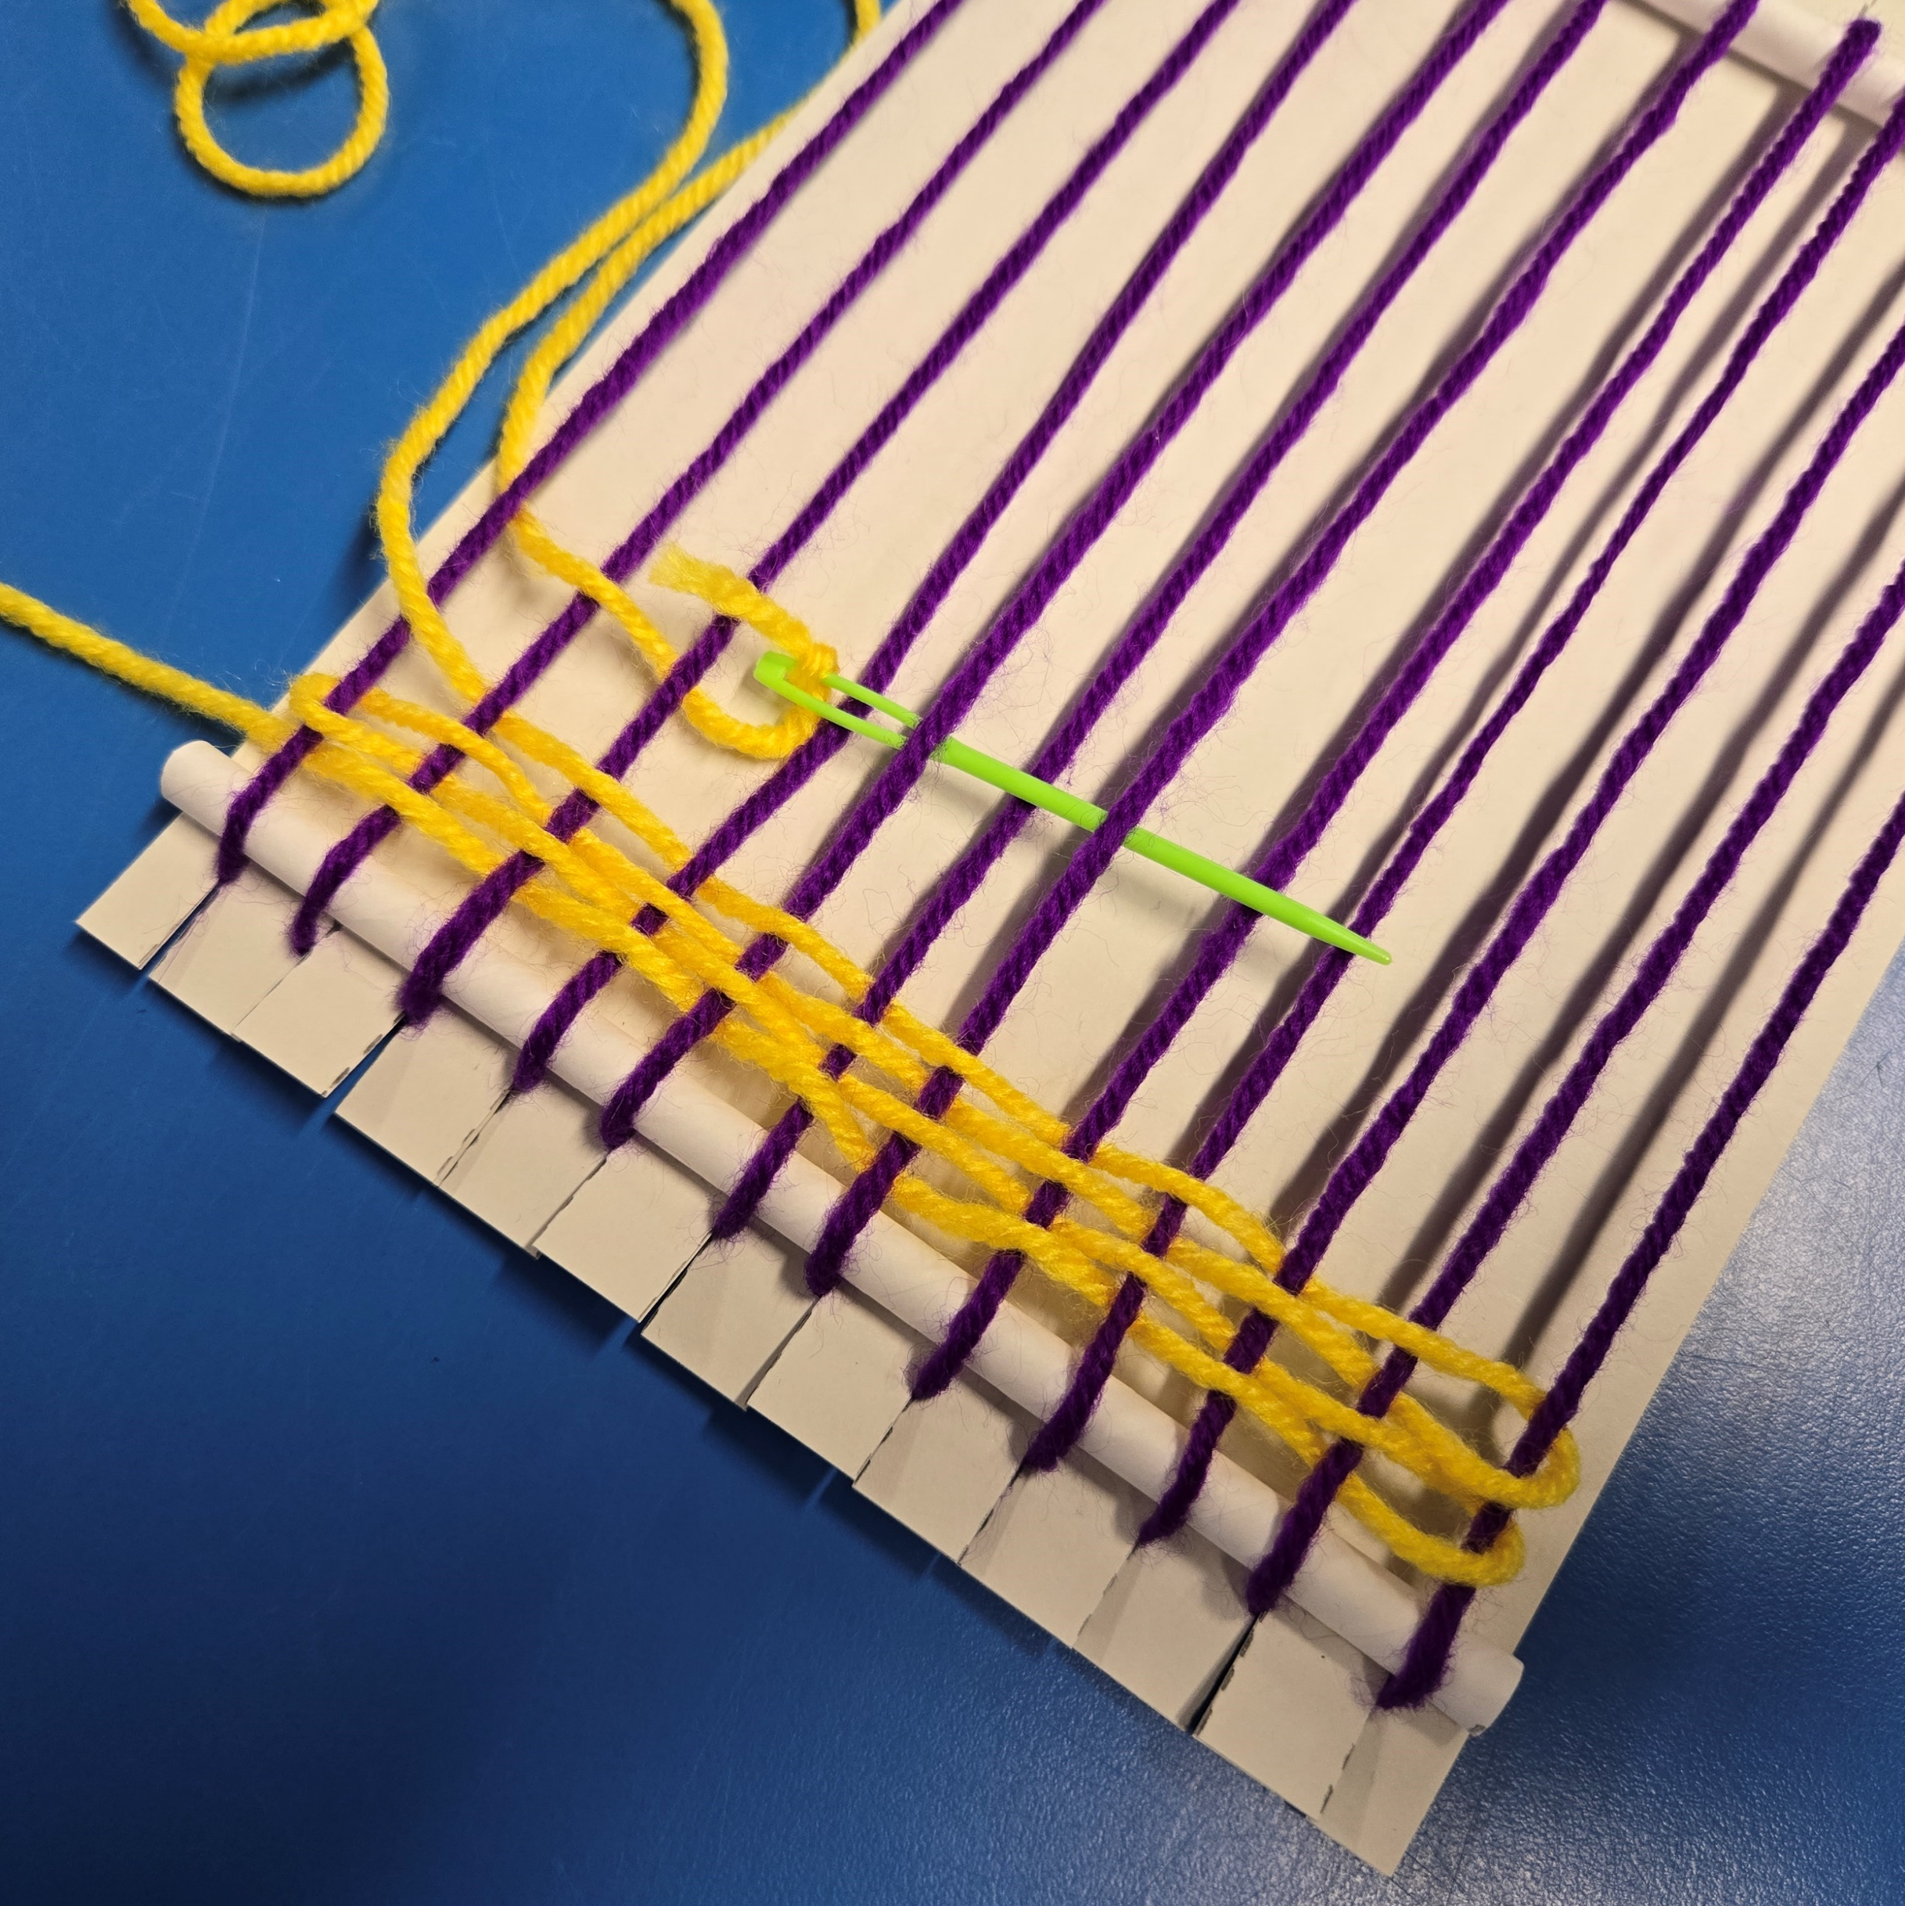
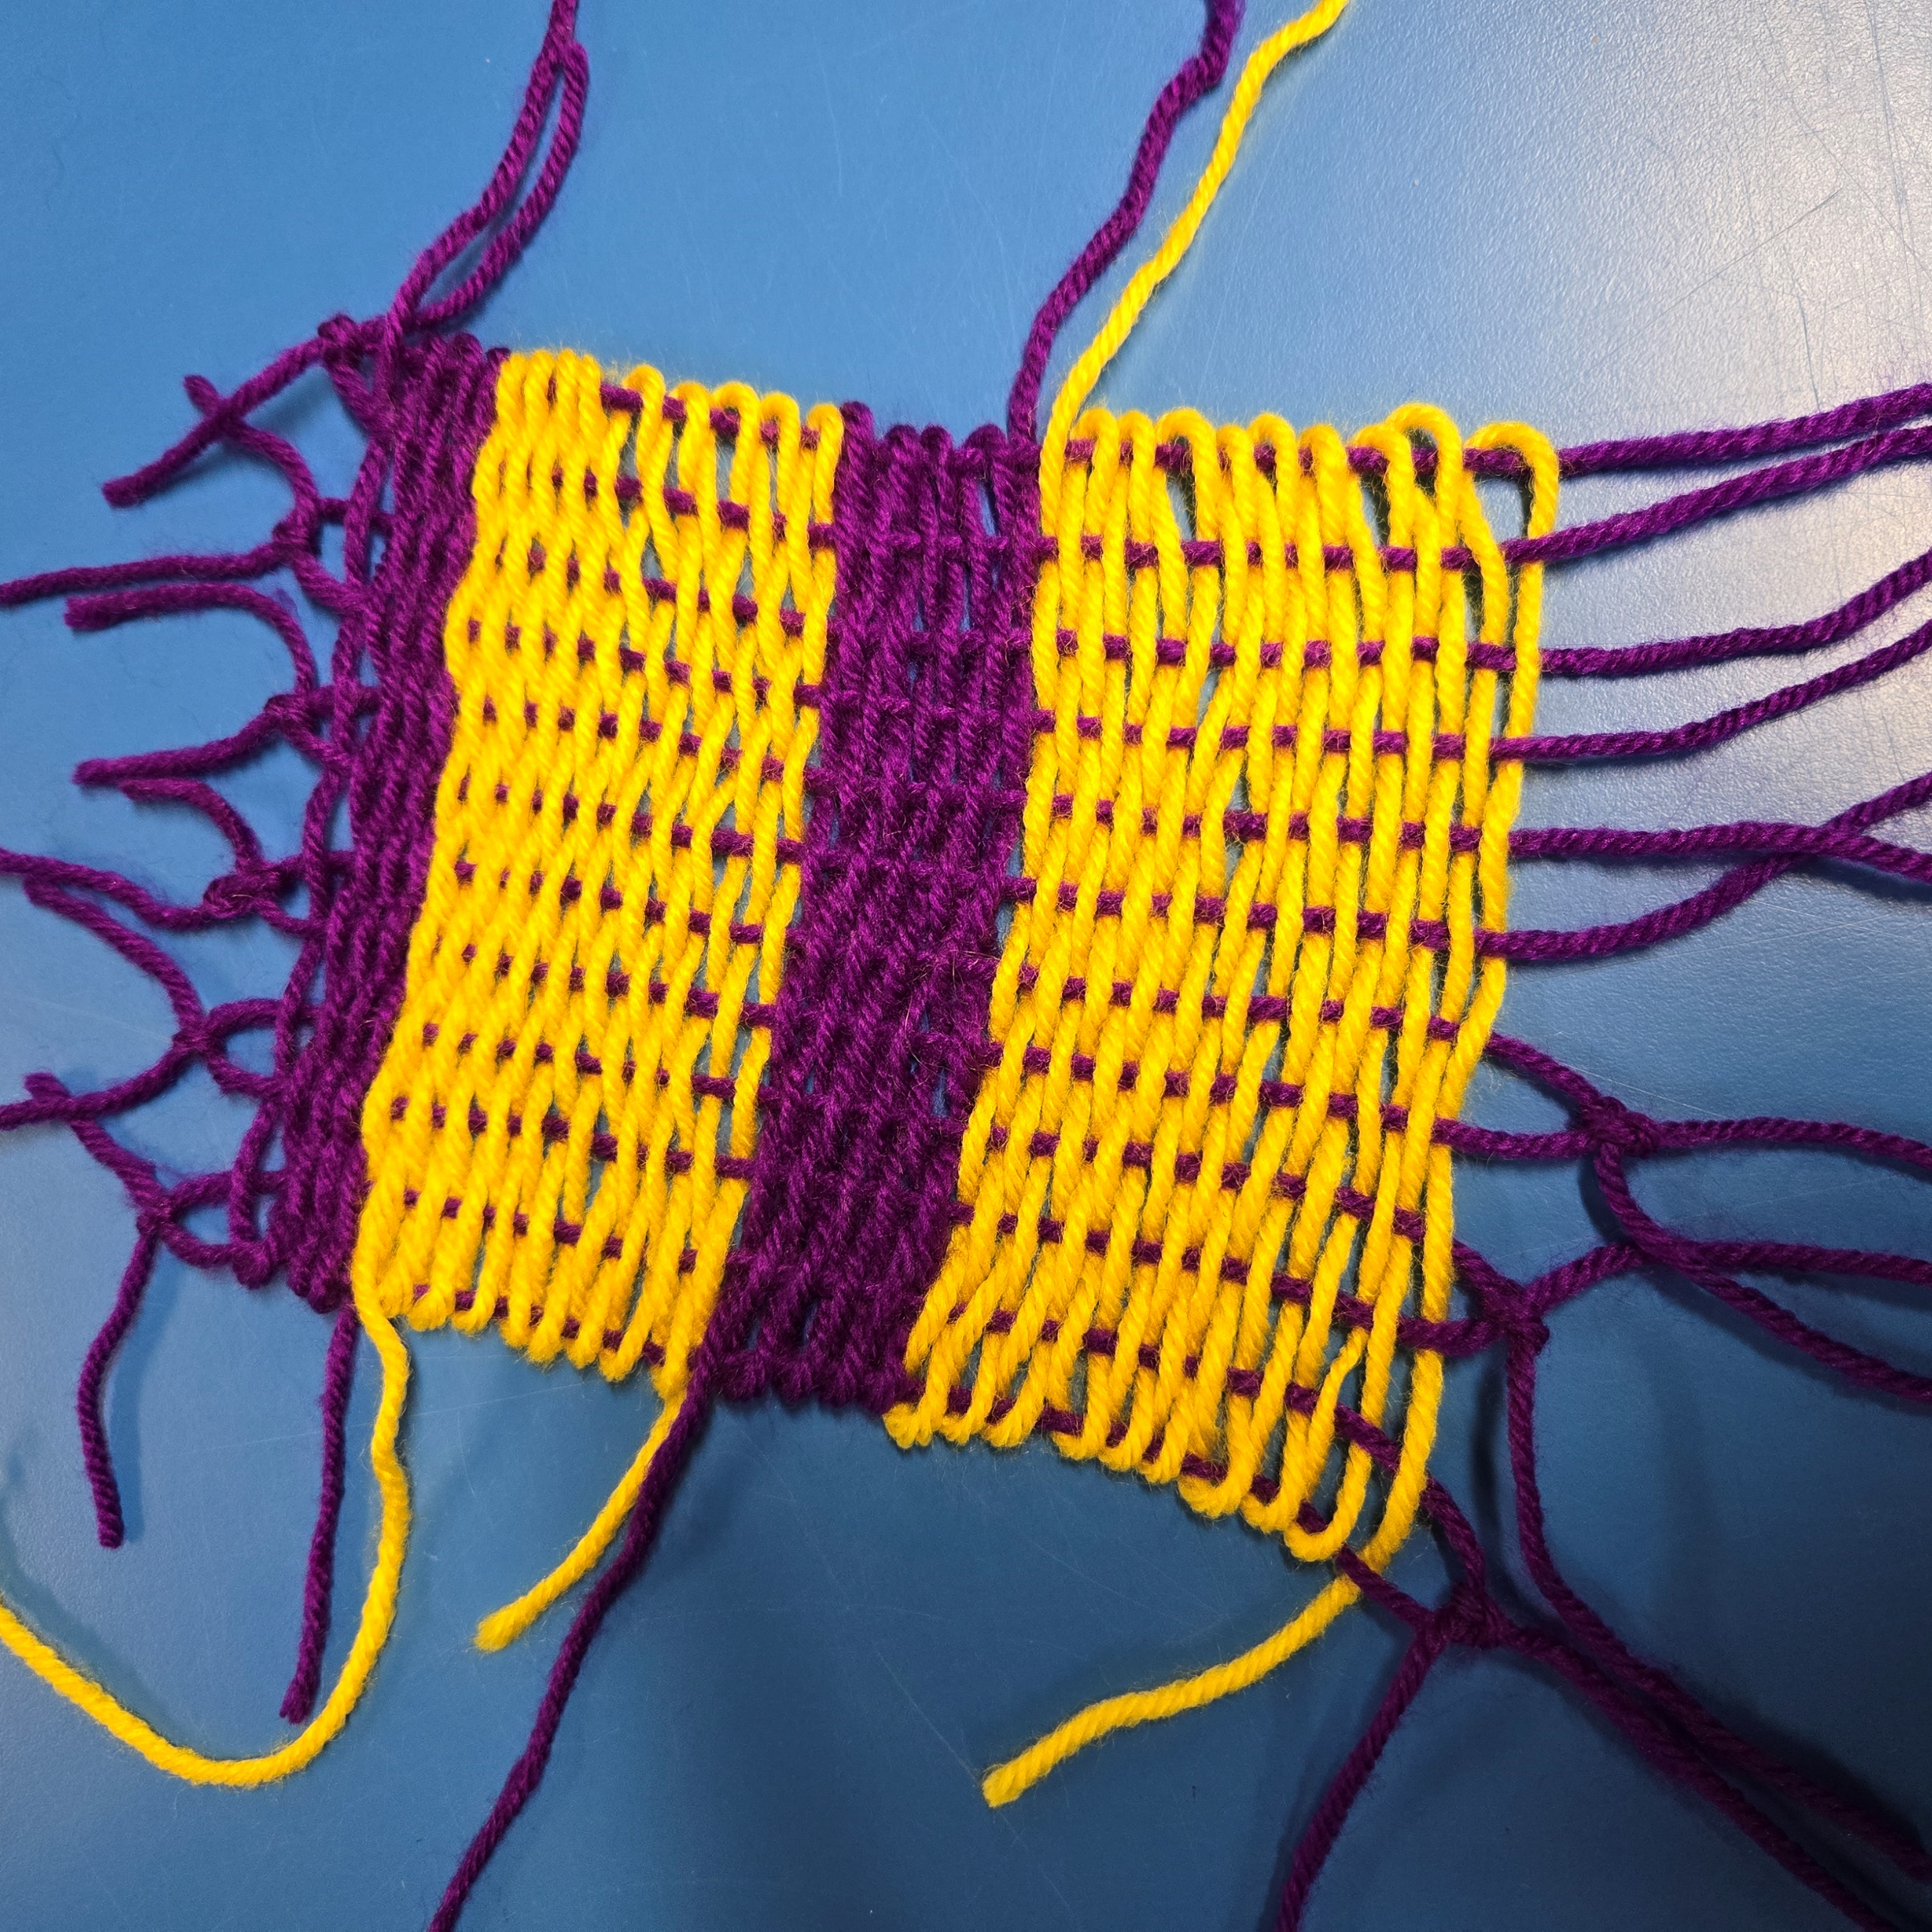
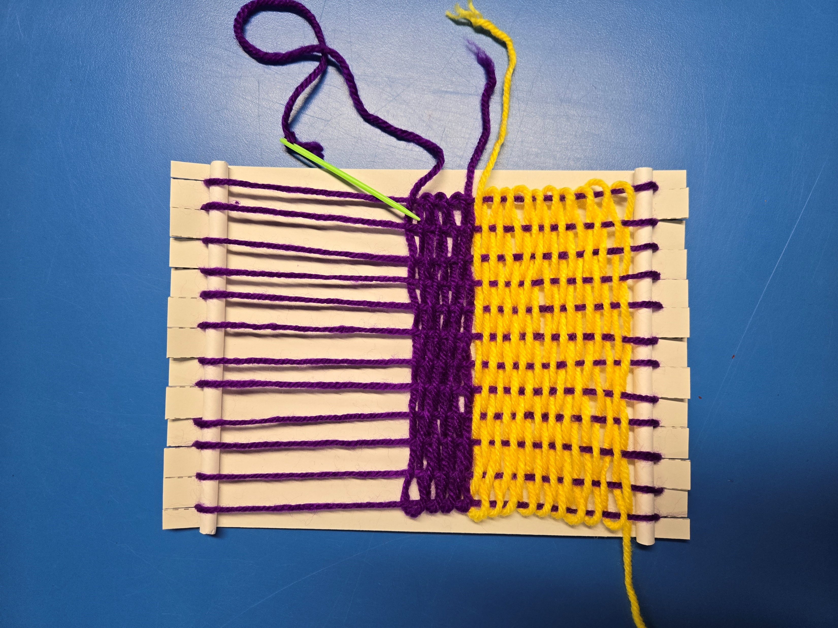
How to weave:
1
2
4
3

Slide 9
Music from the past
Activity 7

Slide 10
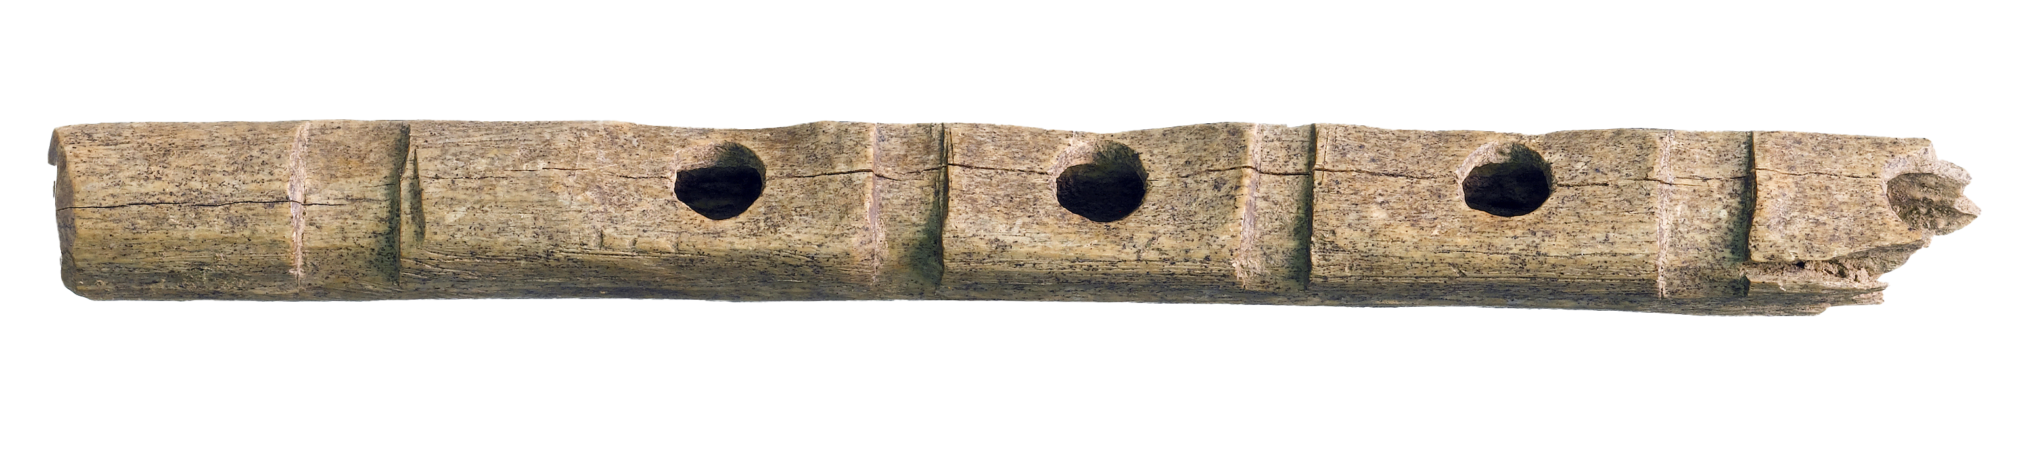


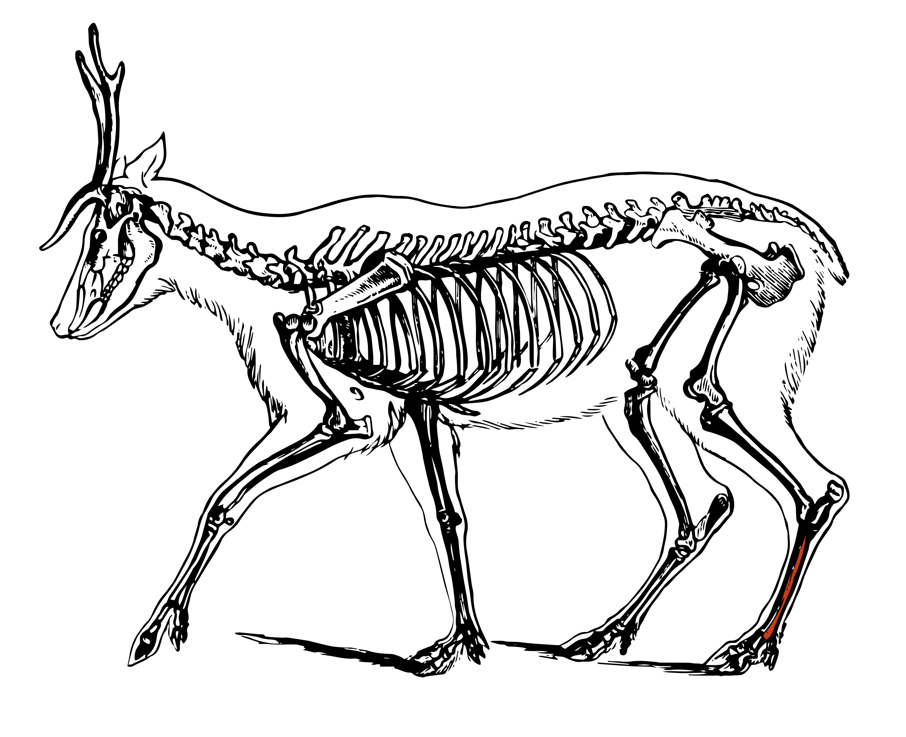
Early Medieval music
What did the pipe
sound like?
Play the audio clip
to hear it!
This reed pipe was made in the 700s…
… from the leg bone of a deer!

Slide 11



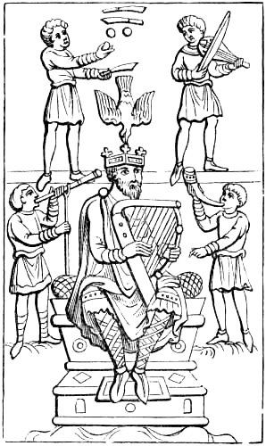
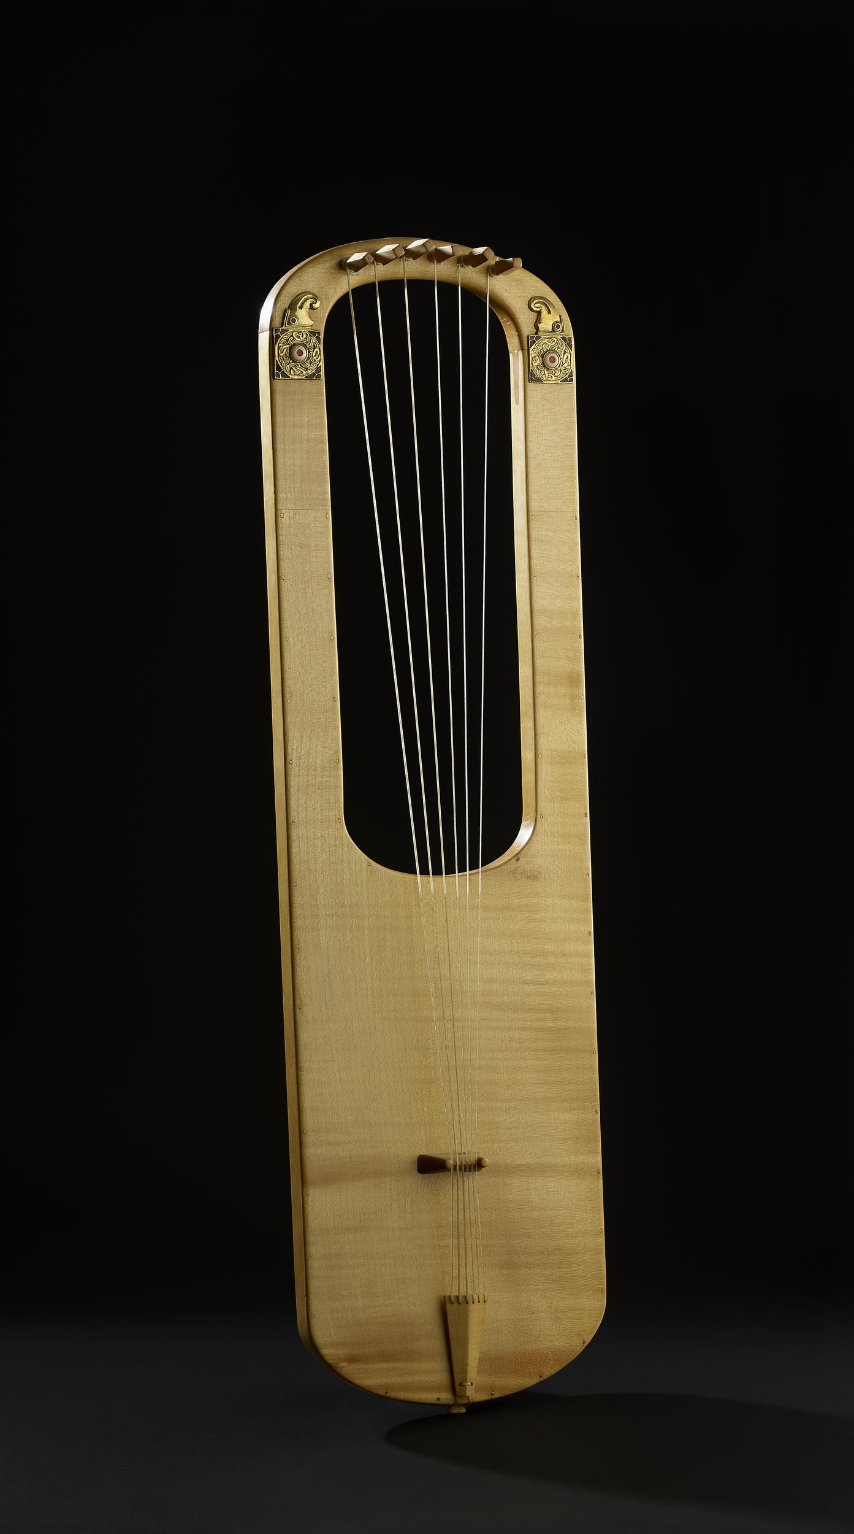
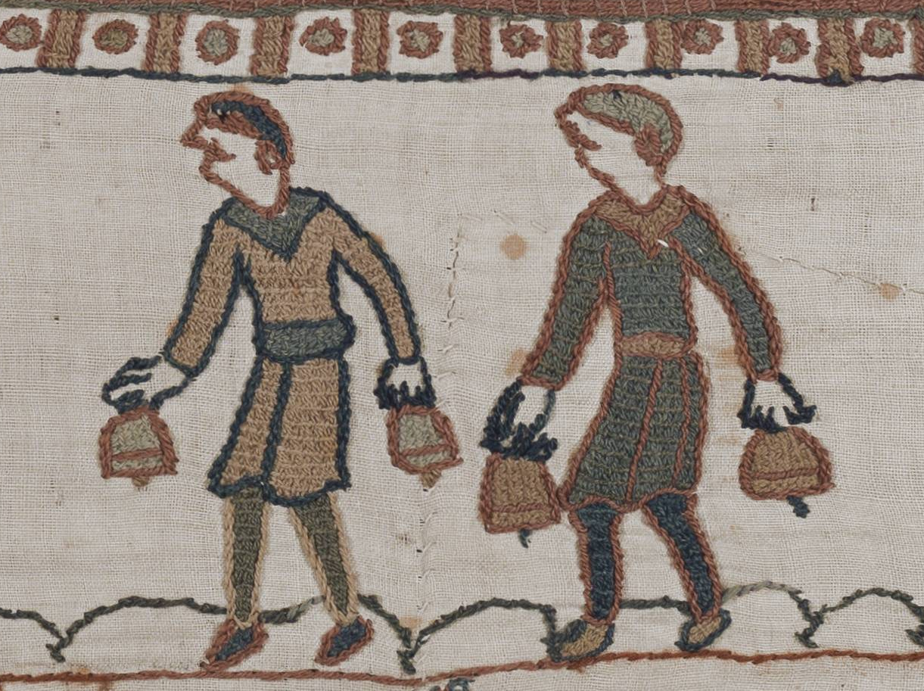


More Early Medieval musical instruments​
Musicians and a king
playing the fiddle, harp and
two types of horns
Lyre
(like a guitar or harp)
Bell ringers from the Bayeux Tapestry (made in 1066). They are playing at a king’s funeral
Notes:
Replica lyre based on the Sutton Hoo lyre © The Trustees of the British Museum. Shared under a Creative Commons Attribution-NonCommercial-ShareAlike 4.0 International (CC BY-NC-SA 4.0) licence.
Saxon Band of Minstrels. From Edward Lewes Cutts, “Scenes and Characters of the Middle Ages”, London – 1911 (https://www.gutenberg.org/files/42824/42824-h/42824-h.htm
Bellringers from the Bayeux Tapestry Scene 26, King Edward the Confessor's funeral procession. Photography by University of Caen Normandy · CNRS · ENSICAEN based on the 2017 photographic campaign of the Heritage Factory in Normandy. - cropped from Wikimedia Commons image: File:Bayeux Tapestry Scene 26.png, Public Domain, https://commons.wikimedia.org/w/index.php?curid=158215144

